Slide 1
What’s in the Muck!?
https://www.youtube.com/watch?v=smkT9sR3fyY&feature=youtu.be
Notes:
Attention Grabber!
Have this video playing when the students come into class.
Video Contents: Polychaete worms crawling through the sediment in a time lapse video. This video was taken in the York River.

Slide 2
What is Sediment?
Photo by Adam Seckel on Unsplash
Notes:
What is sediment?
Have you ever gone to the beach and felt the sand between your toes as you walk into the water? Or have you ever swam in a river or a lake where the bottom was really sticky and mucky? Well this sand and mud that you are stepping in are known as sediments. Sediments are very important in any marine or aquatic system because, believe it or not, many organisms live in the sediment at the bottom of the lake, river, and ocean!

Slide 3
Grain-Size Distribution
SILT GRAIN
SAND GRAIN
Diameter = 0.065 - 0.004 mm
Diameter = 2 – 0.065 mm
CLAY GRAIN
.
Diameter < 0.004 mm
Sand:Silt:Clay
480:16:1
Notes:
There are many different size sediment and they all have different properties. The sizes that we will work with today include sand, silt, and clay. Sand grains are what you find at the beach on the shore and in the water. These grains range from 2 mm to 0.65 mm in diameter.
But have you ever walked out too far at the beach and stepped in a sticky-mucky section of the mud? This area is likely more silt and clay size grains. These grains are much smaller and create a stickier sediment texture. The silt and clay size grains are collectively referred to as ‘mud’
The relative sizes of the sand, silt, and clay size grains are shown here. The ratio between them is approximately 480:16:1 meaning that one clay particle is 480 times smaller than a piece of sand that you would see at the beach. Now that’s small!!

Slide 4
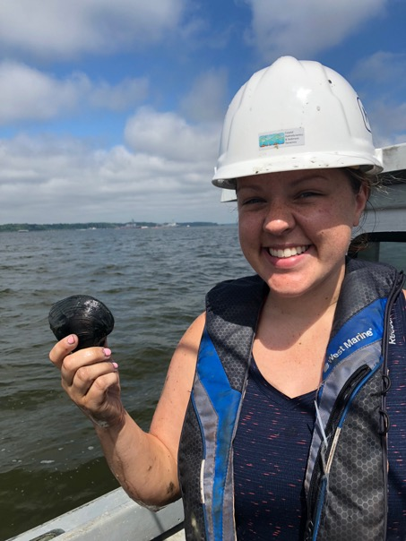
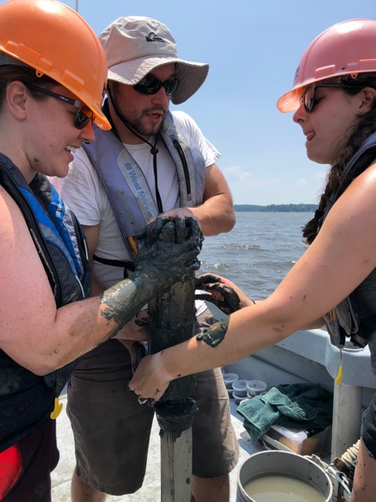
Why do we study sediment?
A dirty job!
Hard Clam!
To learn more about the organisms that live there and how they impact the ecosystem.
  Sediments are important in controlling water quality in the Chesapeake bay
Photo by Grace Massey
Photo by Grace Massey
Cristin Wright
Master’s Student at the
Virginia Institute of Marine Science
Notes:
-Many different organisms call the sediment at the bottom of the York River home. Although humans may not eat all of the organisms that live in the sediments (like worms, yuck!), they play a large role in the food web by feeding organisms that humans do eat (fish, blue crab, yum!).
- Sediments are important in water quality of the Chesapeake Bay. If there is too much sediment suspended in the water, it can result in murky water. The murkier the water, the harder it is for primary producers to photosynthesize, because they need light. These primary producers are the base of the food web, so it is crucial that they are able to thrive.

Slide 5
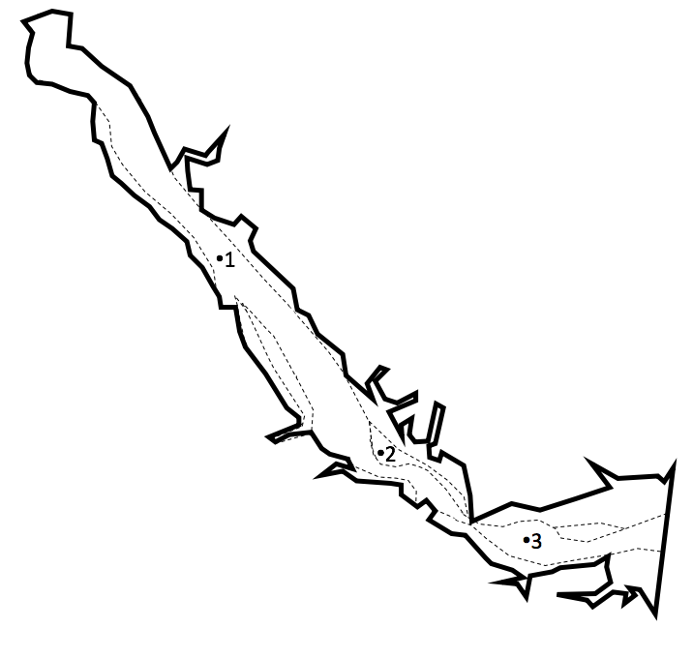
York River
One of the major tributaries of the Chesapeake Bay.
Two rivers flow into the York River, the Mattaponi and the Pamunkey Rivers.
Approximately 55 km long.
To Chesapeake Bay
By NASA Goddard Space Flight Center from Greenbelt, MD, USA - Beautiful New Landsat Mosaic of Chesapeake Bay, CC BY 2.0, https://commons.wikimedia.org/w/index.php?curid=63592867
Notes:
For this lesson, each group will have a sediment sample, either 1, 2, or 3, shown in the figure on the right. Each group will analyze their sample to determine if there are differences in sediment grain-size distribution along the length of the York River and how these sediments may impacts which types of organisms are present.

Slide 6
Procedure: Part 1
In Groups!
Collect your group’s sediment sample and record the sample number.
Have one group member take the sediment to the scale and weigh the entire sample. Record the value on your worksheet. (Don’t forget to tare the scale before weighing the sample in the weigh beaker!)
Notes:
Procedure:
Step 1: Split students up into groups of 2-3 students. Have each group choose a sediment sample and have them record the sample number on their group worksheet (Appendix A).
Step 2: Weight the entire sediment sample to get the total weight. Make sure there are beakers at the scale that they are able to use for weighing and practicing taring the scale and weighing samples.

Slide 7
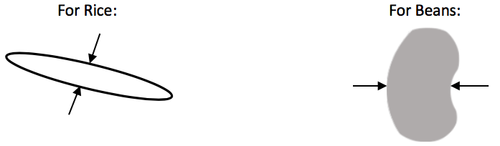
Procedure: Part 1
In Groups!
Measure the diameter of one grain for each grain type.
Sort the different size classes of sediment in your sample and weigh each different size class. Record the weights on your worksheet.
Notes:
Step 3: Each group will measure one grain of each of the different types of sediments. Have them measure the grains as shown on the slide. Measure the width indicated by the arrows.
Step 4: Students will separate the sample into the three types of sediment and weigh each individual group. They will record this on their group worksheet.

Slide 8
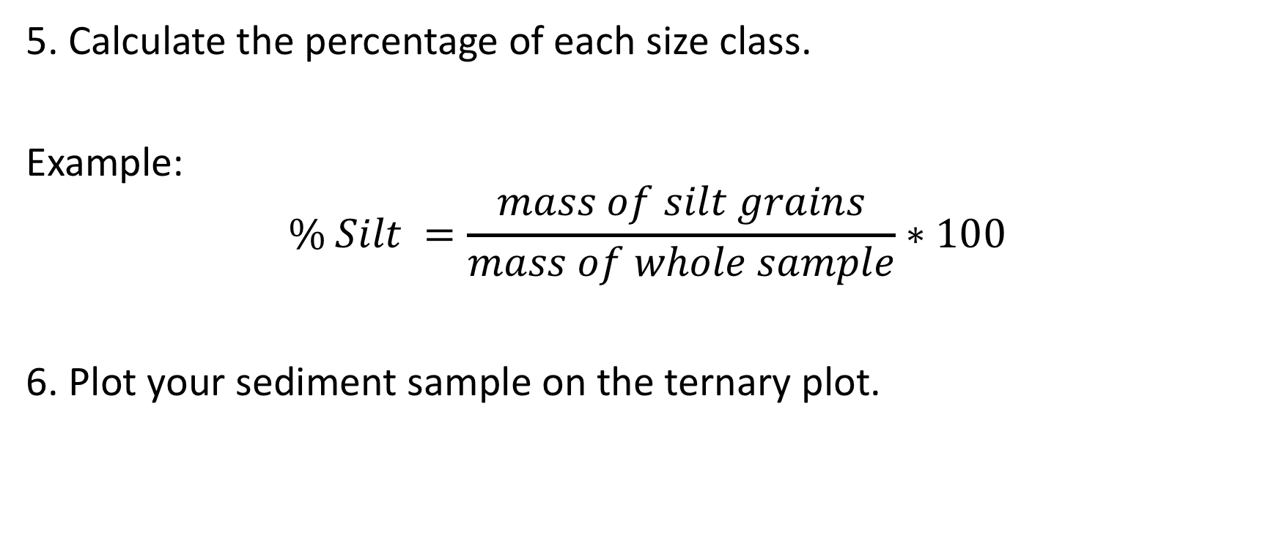
Procedure: Part 1
In Groups!
5. Calculate the percentage of each size class.
Example:
$$\% Silt =\frac{mass of silt grains}{mass of whole sample}∗100$$
6. Plot your sediment sample on the ternary plot.
Notes:
Step 5: Calculate the percentage of each size class using the example provided.
Step 6: Plot you sediment sample on the ternary plot (step-by-step directions on next slide)

Slide 9
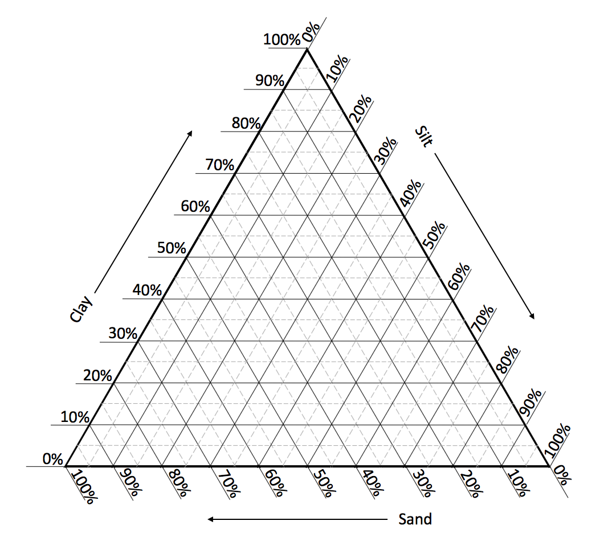
Ternary Plot Example
Sample 5:
50% Sand
20% Silt
30% Clay
5
Be sure to label your points!
Notes:
Example of how to plot on a ternary plot
Click one and two: Start with the sandy sediment and find the percentage on the sand axis
Click three and four: Then silt and find 20% on the silt axis
Click five sand six: Then clay and find 30% on the silt axis
Click seven: follow grid lines to where all three percentages intersect
Click eight: this is where the sediment sample falls on the plot
Click nine: don’t forget to label the point!

Slide 10
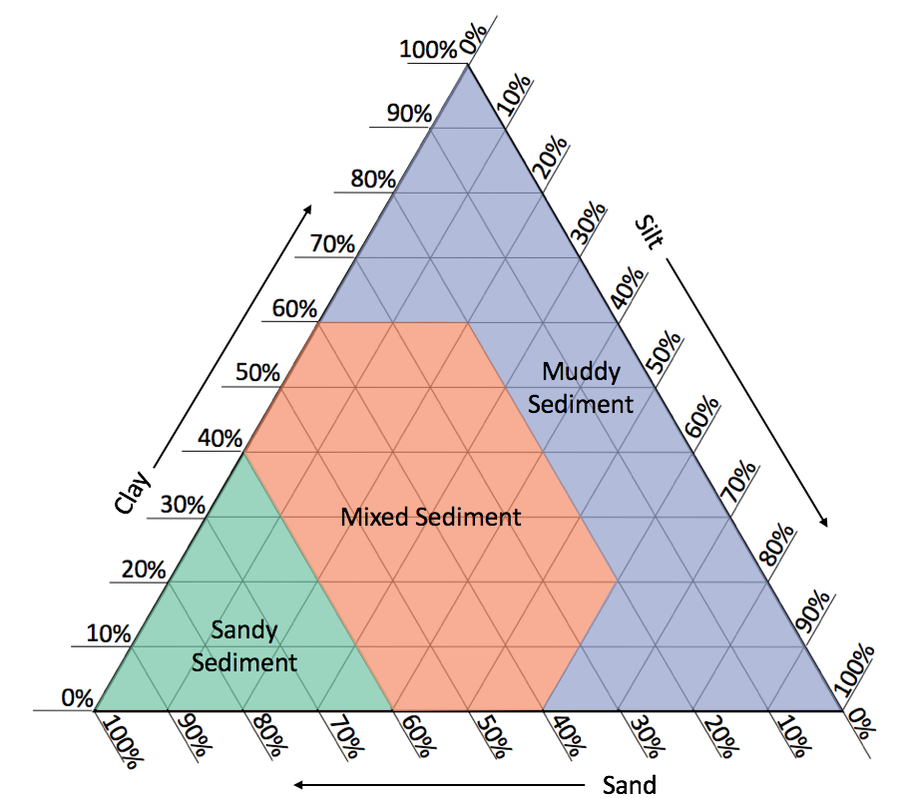
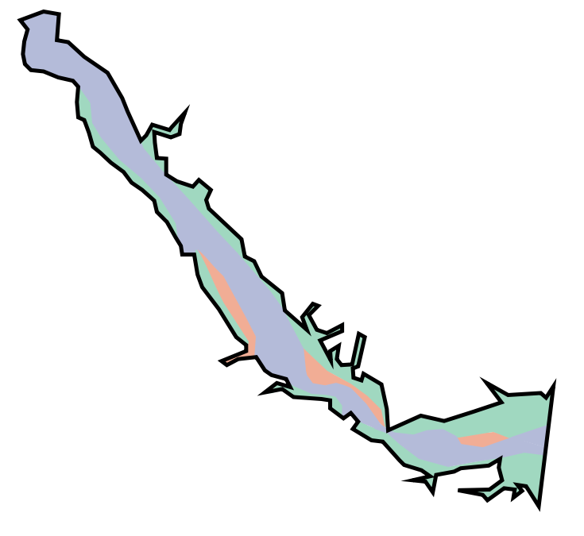
Ternary Plot: Sediment Types
In Groups!
7. Determine what type of sediment is in your sample and see where that sediment is found in the York River. Record your sediment type.
Notes:
Next, students will determine in what region their sediment samples falls into : sandy sediment, mixed sediment, or muddy sediment. Then they will determine where in the York River is their sediment found.
From here, students will then choose the corresponding envelope for their sediment type and learn about what type of organisms are found in their sediment sample. Students will fill in the table on the white board for the remainder of the group portion.

Slide 11
Procedure: Part 2
In Groups!
Have one group member get the envelope at the front of the room labeled with your type of sediment.
Read directions on the group worksheet and fill out Table 3 for your sediment type.
2. Once you have filled in Table 2, plot the other two sediment types on your ternary plot.

Slide 12
Procedure:
Individually!
1. Once the table of organisms has been completed for each sediment type, students will individually create color-coded maps for different organisms.
Boundary lines between sediment types have been added for you.
Notes:
Students will individually color in range maps for different organisms (Appendix C). All students will have to complete range maps for the Baltic clam and the Red-Gilled Mud Worm, but they are able to choose the other three organisms.

Slide 13
Should the profiles of benthic species be included in the PPT so the instructor can review
with the students, reinforce salient points, etc.

Slide 14
Should the PPT include the color maps of benthic organism distributions, as shown in the key to the worksheet.
That would make class discussions easier, since they won’t really be able to share their individual distribution
maps unless the is a document camera available. This is often the kind of thing we add when we demo a lesson
for teachers

Slide 15
Procedure:
Individually!
2. Students will complete the Data Analysis and Summary pages during the remainder of the class.
Exit Slip!
Notes:
Then, individual students will answer the data analysis and summary questions provided to them.
If the teach chooses, students can also complete the supplementary exit slip.

Slide 16
So what did we learn?
Marine scientists classify sediment particles based on their size: Sand is largest, then silt and clay is smallest.
Sediments are often mixtures of these particle sizes and scientists use a ternary plot to classify them into 3 types: sandy; mixed; or muddy sediment
Notes:
Show this slide after students are finished with their questions.
You can either show this slide if you are running out of time or have a discussion about conclusions as a group and record findings the students report.

Slide 17
So what did we learn?
Sediment type can affect which organisms are found in certain areas.
Some organisms are more resilient to sediment changes and are able to survive in different types of sediment.
Some organisms only live in very specific sediment types.
Biodiversity was highest in mixed sediment types.
Notes:
Show this slide after students are finished with their questions.
You can either show this slide if you are running out of time or have a discussion about conclusions as a group and record findings the students report.

