Slide 1
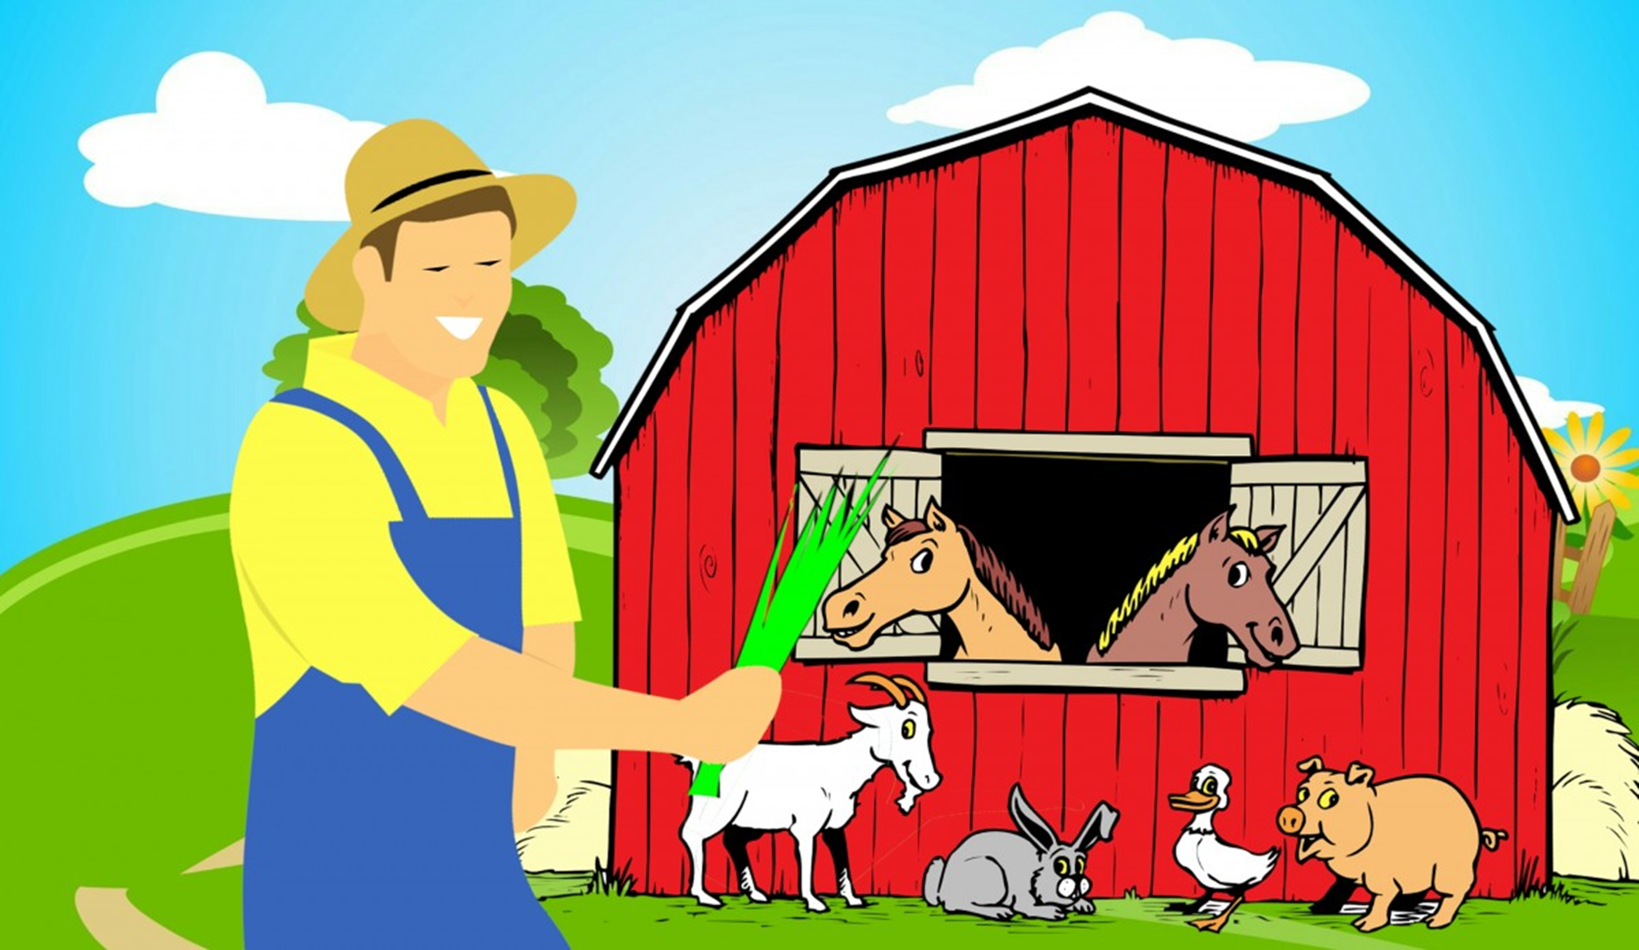
Old MacDonald had an Aquaculture Farm
Notes:
Before moving onto the next slide, ask students if they eat seafood and where they think their seafood comes from. You might get answers that include the grocery store, farmers market, or fishing them directly. If aquaculture is not brought up, mention that majority of the seafood that the students eat comes from aquaculture.
Image source: pxhere.com

Slide 2
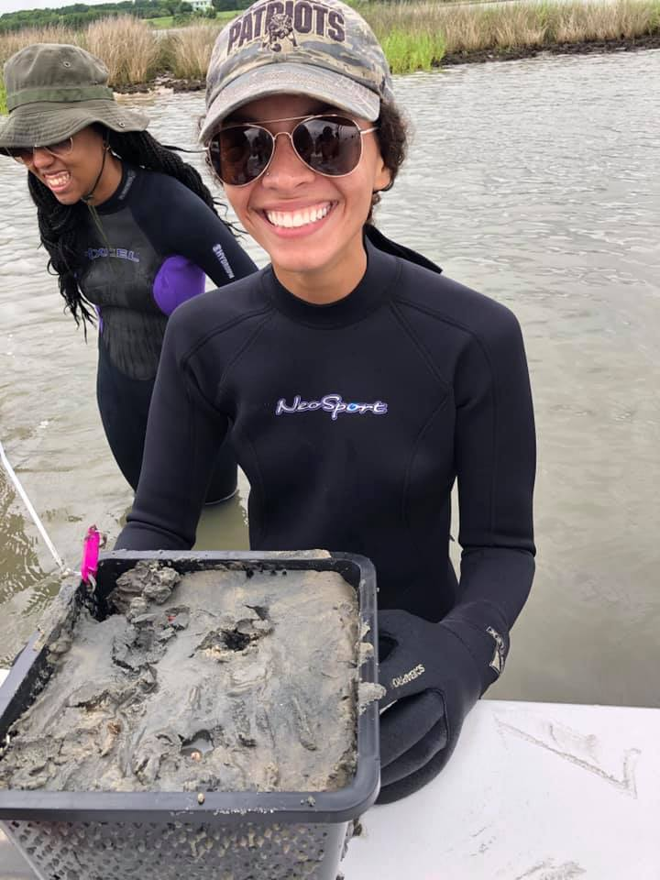
Real Life Science!
Who am I? Shantelle Landry
Where am I from? New Hampshire, USA
Graduate student at Virginia Institute of Marine Science (VIMS)
Researching soft-shell clam aquaculture by experimenting with cage and mesh type for predator exclusion
Notes:
Image credit: Rochelle Seitz, PhD – Virginia Institute of Marine Science

Slide 3
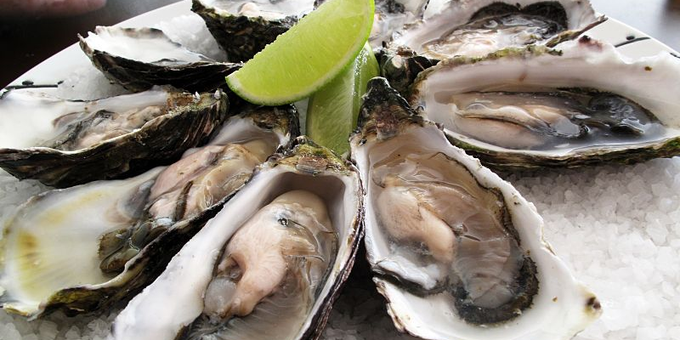
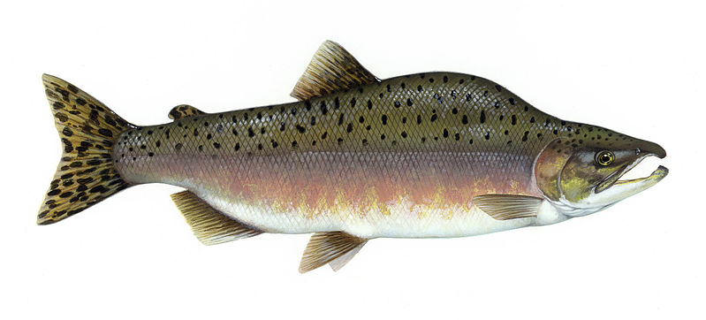
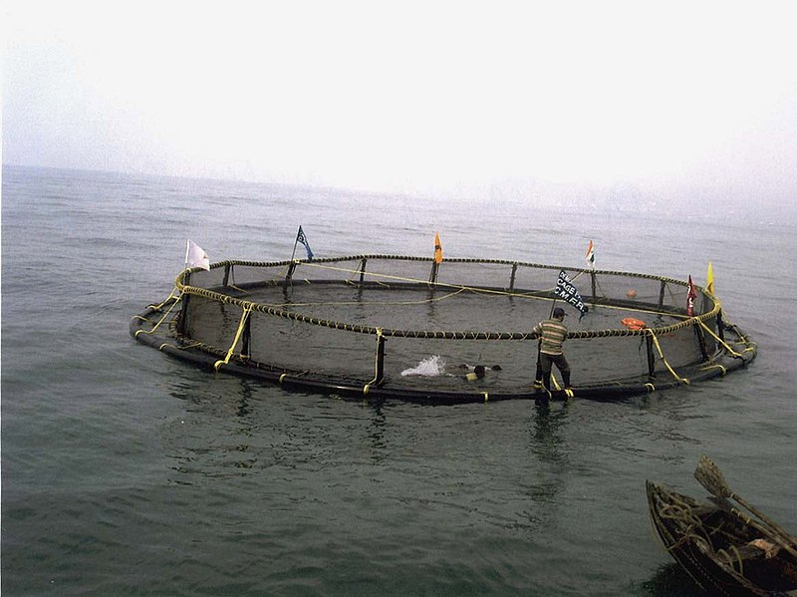
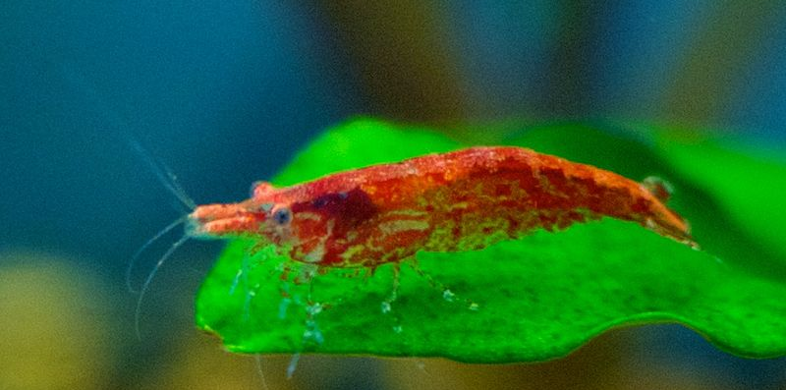
What is aquaculture?
The farming of aquatic organisms, including fresh and saltwater animals
Notes:
What is aquaculture? Ask the students.
Aquaculture is the farming of aquatic organisms, including both salt and freshwater. The image provided is of an open water aquaculture cage. Here, aquaculturists capture wild animals (like tuna or other larger fish) and keep them in these cages so they can monitor their growth, health, and food.
Ask students if they can provide some examples of some saltwater animals that might be reared in aquaculture. The ones that are provided include (from top to bottom): oysters, salmon, and some species of shrimp.
Image sources: oysters: https://commons.wikimedia.org/wiki/File:Pacific_oysters.jpg– author: Guido, no alterations were made; salmon:https://commons.wikimedia.org/wiki/File:Pink_salmon_FWS.jpg – author: Timothy Knepp, no alterations were made; shrimp: https://commons.wikimedia.org/wiki/File:Red_Cherry_Shrimp_1.jpg – author:
TheJammingYam (talk), no alterations were made.
Aquaculture cage:https://commons.wikimedia.org/wiki/File:A_view_of_the_recently_launched_Open_Sea_Cage_seashore_at_Visakhapatnam_in_Andhra_Pradesh.jpg – author: Ministry of Civil Avaition, no alterations were made

Slide 4
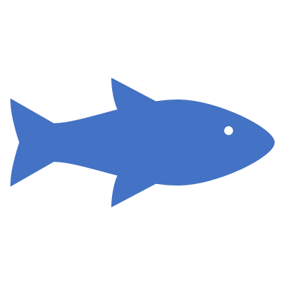
Importance of Aquaculture
In 2016, aquaculture provided over 50% of the seafood humans use for consumption
Occurs all over the world; top aquaculture producers include
  China
  Indonesia
  India
Notes:
Aquaculture continues to grow, and the amount of seafood provided for human consumption will only continue to grow along with it.

Slide 5
What are the main marine animals farmed in aquaculture?
Finfish (salmon)
Mollusks (snails)
Crustaceans (shrimp)
Notes:
Have students guess the types of marine animals that are farmed in aquaculture. You might want to prompt them with different groups of animals like fish, bivalves, etc. You can mention that there are other animals and plants that are farmed in aquaculture, but these are the top three.

Slide 6
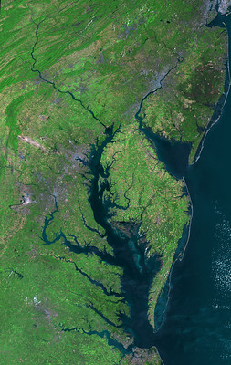
What marine animals are farmed in Chesapeake Bay?
Oysters
Striped bass
Clams
  Hard clams
  Soft-shell clams
Notes:
Ask students if they know what types of animals are farmed here in Chesapeake Bay. Oysters are the main animal that is farmed in Chesapeake Bay. Clams are last on this list to lead into the background information on soft-shell clams
**If Chesapeake Bay is not relevant to your location, you can replace this slide with examples that are relevant to your area.
Image credit: NASA/USGS/Landsat 5

Slide 7
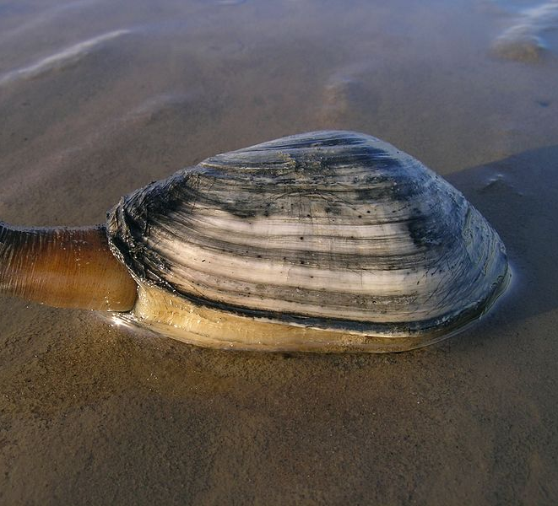
Soft-Shell Clams: Background
Renewable resource
Deep-burrowing
Important filter feeders
Soft shell
Important prey item
Notes:
This slide provides the teacher with basic background information on soft-shell clams.
For the renewable resource bullet, it is important to discuss the meaning on this: a natural resource that will replenish to replace the portion depleted due to usage and consumption, either through natural reproduction or other recurring processes
Like oysters, soft-shell clams filter the Bay and make the water cleaner.
To explain the soft-shell aspect, ask students if they have ever held a clam, scallop, or snail shell in their hands and discuss how difficult it is to break their shells. Soft-shell clams get their name because you can crush them in your hands.
These clams are also an important prey item to many Bay inhabitants including blue crabs, horseshoe crabs, cownose rays, and many fishes like spot.
Image source: https://commons.wikimedia.org/wiki/File:Ecomare_-_strandgaper_(4792-mya-strandgaper-mok-ogb).jpg, author: Ecomare/Oscar Bos

Slide 8
Soft-shell Clams in Chesapeake Bay: History
MD/VA fishery est. 1950s
Declined since early 1970s due to overharvest
Tropical Storm Agnes in 1972
Fishery no longer in VA, low harvests in MD
High predation pressure: blue crab
Notes:
Soft-shell clams are the animal that the activity focuses on, so it is important to go over their history in Chesapeake Bay.
The fishery was established in the Bay in to 1950 and the clams were wild caught. The numbers of clams harvested began to decline in the early 1970s because of overharvesting. Here, it is important to make sure that students understand that overharvesting means that clams were being taken in such high amounts and weren’t given the time to reproduce to keep the population up.
The fishery was all but destroyed after Tropical Storm Agnes came in 1972 and deposited tons sediment into the Bay, thus smothering the clams (here, you can ask students why the addition of sediment might be bad for a creature that lives in the sediment; answers include that they won’t be able to breathe or eat since they get all of their food from the water). In the Maryland portion of the Bay, there are still small harvests but there is no remaining fishery in Virginia.
One of the main reasons soft-shell clams are struggling to replenish their population is due to the fact that their predators are so voracious, mainly the blue crab. The blue crabs eat majority of the juvenile clams before they have a chance to grow to and reproduce.

Slide 9

How can we help soft-shell clams?
Notes:
Ask students the following question:
If soft-shell clams cannot replenish their population due to the presence of their predators, what can we do to help restore the population?
One answer is aquaculture!

Slide 10
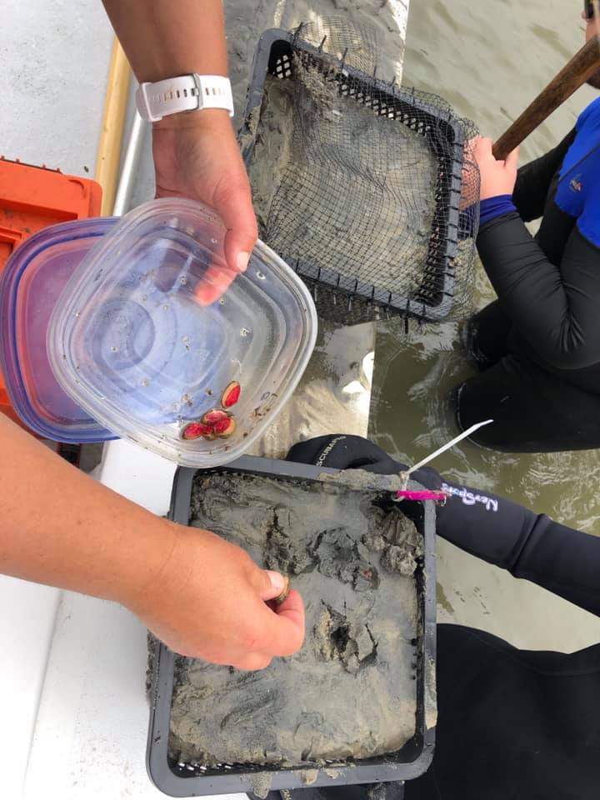
Restoration through Aquaculture!
Notes:
One way to potentially restore the population is through aquaculture!
The picture is of the cages that are being used to grow soft-shell clams. The reason for the cages is to exclude predators like blue crabs and cownose rays and give the clams a chance to survive.
Image credit: Rochelle Seitz, PhD – Virginia Institute of Marine Science

Slide 11



Aquaculture isn’t perfect
Factors that affect aquaculture include:
  Hurricanes
  Disease
Notes:
It is important to point out that there are things that can affect the harvest of aquaculture. We already know that hurricanes can affect wild populations and, in this example, these clams are grown out in the Bay, so hurricanes can still affect the aquaculture of soft-shell clams.
Disease is a big concern for aquaculture because the animals are in high numbers and in a small space. If one gets sick, it is very easy for others to contract the disease and kill the entire population.

Slide 12
Today’s Activity
Two groups
Aquaculturists
Watermen
Track soft-shell clam yield on your data log sheet
At the end, work with partner to create a bar graph comparing your initial and final yields
Notes:
**THIS IS THE LAST SLIDE TO SHOW BEFORE THE ACTIVITY**
For the activity, explain that you will be splitting the class into two groups: aquaculturists and watermen. Students will work with a partner in the same group for this activity. Explain that there are different scenarios around the room which represent different events that will affect their soft-shell clam yield. The students are to read each scenario and record the addition or loss of soft-shell clams on their data log sheet. After everyone is done, have the students total their soft-shell clam yield and create a bar graph (using the graph template handout) to compare their initial and final soft-shell clam yield.

Slide 13
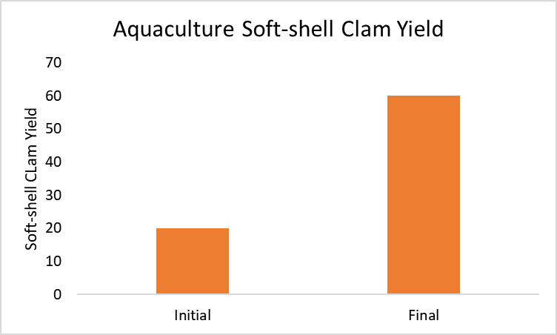
Aquaculturist
Notes:
For the aquaculturists, ask students what scenarios caused them to lose the most clams:
Disease → ask why this caused such a major loss in yield? (answer is because the clams are in such a tight space that it is easy for many of them to get sick)
Hurricane → ask why this caused a loss in yield? (answer Is because the cages keep the clams confined in one space so they cannot move around as much as they would be able to if they weren’t in cages)

Slide 14
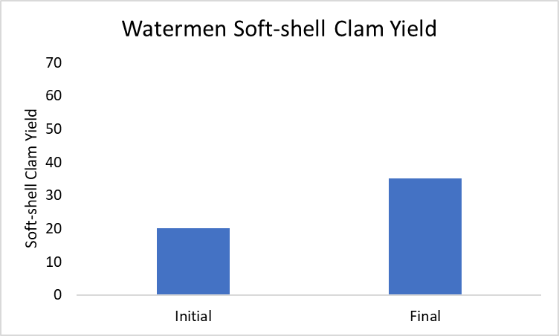
Watermen
Notes:
For the watermen, ask students what scenarios caused them to lose the most clams

Slide 15
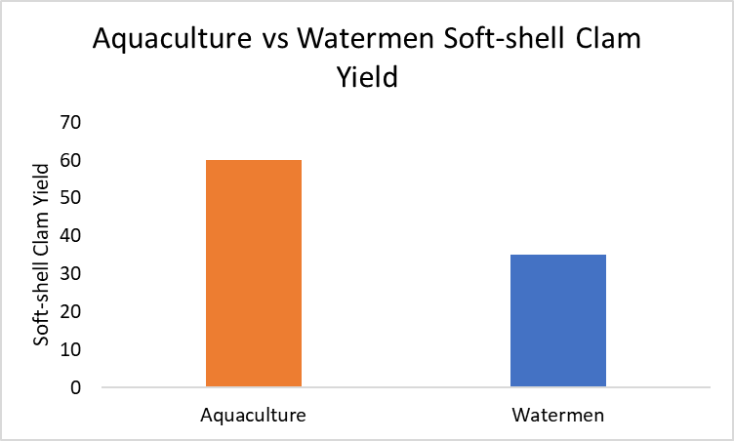
Notes:
This slide is used to show the comparison of aquaculturists and watermen soft-shell clam yields. The point is to show that aquaculture can be used to restore the soft-shell clams in Virginia

Slide 16

Why did Aquaculturists have a higher yield?
Aquaculturists can control/monitor almost everything in their farms including:
  Food availability
  Number of animals
  Disease/illness (by medicating their animals)
Watermen do not have as much control on the environment and nature – they can only catch what is there!

Slide 17
This is just one scenario…
Watermen are just as important!
Wild caught marine animals include
  Sharks
  Tuna
  Lobsters
  Blue crabs!
Notes:
It is important to let students know that soft-shell clam aquaculture is just one example of how their seafood is produced but that watermen are just as equally important. There are many fisheries that are solely caught by watermen and they are included in this slide. In the Chesapeake Bay, watermen are responsible for the blue crabs that we eat!

