Slide 1
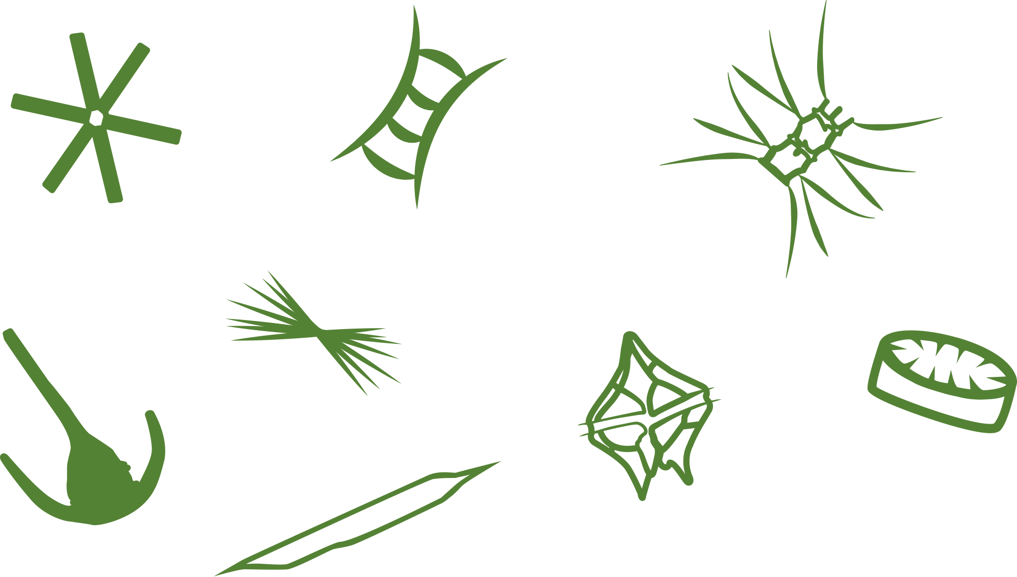
Feeding Time
―
How Nutrients Drive Phytoplankton Growth
Symbols courtesy of the Integration and Application Network, University of Maryland Center for Environmental Science

Slide 2
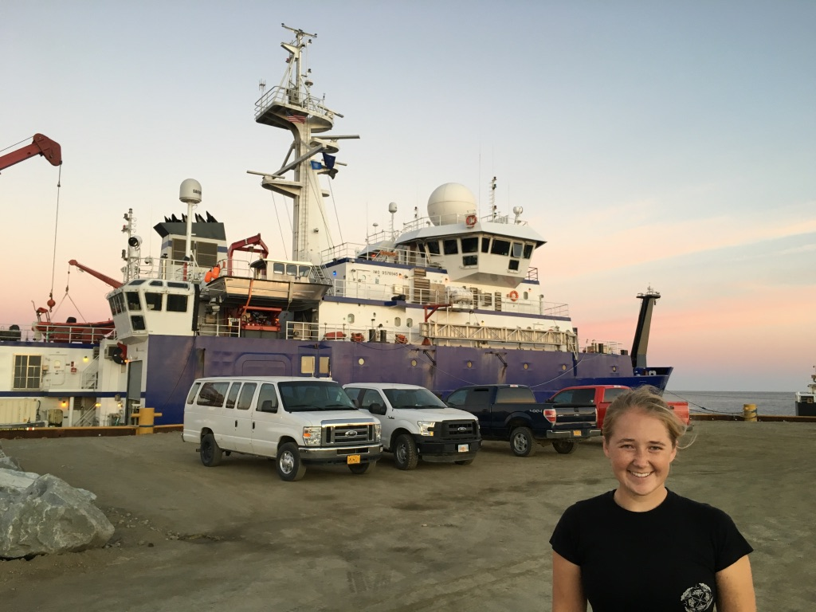
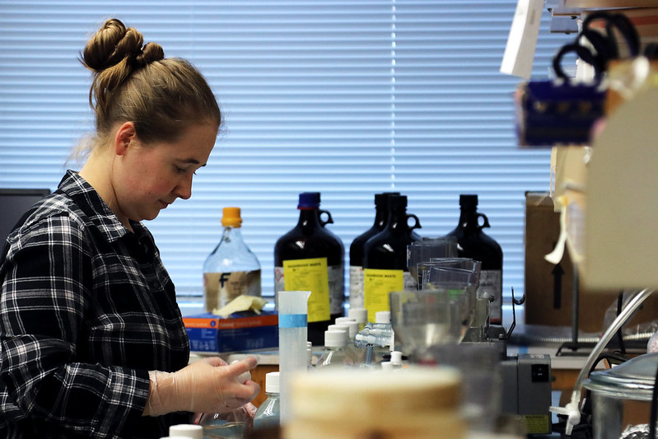
Brianna Stanley
I am a graduate student studying nitrogen cycling all around the world! I have done science in the Alaskan Arctic and in coastal Virginia.
Madeleine Jepsen for VA Sea Grant
Lab work in Virginia
Brianna Stanley
Fun Fact! I spent 23 days on a boat in the Arctic doing research
Notes:
I am a graduate student studying nitrogen and how it moves throughout the environment. I’m particularly interested in how processes vary across the world. The first picture on this slide shows me doing lab work in Virginia. I do most of my work in Virginia, but I also get to travel to do research. The second photo shows me in front of the research vessel Sikuliaq. I got to spend almost a month on the Arctic Ocean, off of Alaska, to study how nitrogen cycling is changing there.

Slide 3
Liebig’s Law of the Minimum
Biological growth is not controlled by total resource availability, but rather by the availability of the scarcest resource. This scarce resource is known as the limiting factor.
For example
Limiting factor
VS
Shorter slat
No matter how much water you have, you will never fully fill this barrel
Notes:
This slide introduces the idea of limiting factors for biological growth. Often referred to as Liebig’s law of the minimum, biological growth and activity is limited by the scarcest factor that is needed. One way to think of this is with how much water a barrel can hold. If the sides or slates are of varying height, it is the lowest that limits how much water the barrel can actually hold.

Slide 4

Liebig’s Law of the Minimum
Limiting factors can be environmental conditions.
-i.e. temperature, sunlight during different seasons, and nutrients
Phosphorus
Nitrogen
Carbon
Metals
NOAA Photo Library
Sunlight
Nutrients
Notes:
Environmental conditions can be an example of limiting factors. For example, if an organism requires sunlight for photosynthesis, access to sunlight can be a limiting factor if it is cloudy or winter time. Nutrients are another example of limiting factors and are the focus of today’s activity. Nutrients are like food for phytoplankton and can include nitrogen, phosphorus, carbon, and even metals!

Slide 5
Redfield Ratios – Limiting Nutrient Factors for Marine Systems
The ratio of inorganic nutrients in the both the ocean and inside phytoplankton biomass!
106 carbon : 16 nitrogen : 1 phosphorus
  (106 C: 16 N: 1 P)
While ratios measured by scientists may vary by conditions and locations, this is the general nutrient proportion found throughout the world’s marine systems.
Symbols courtesy of the Integration and Application Network, University of Maryland Center for Environmental Science
Notes:
The concept of the Redfield ratio is one way that biologists monitor limiting factors. The Redfield ratio is the ratio of important inorganic nutrients in both the ocean and inside phytoplankton biomass. The “golden” ratio is 106 carbon: 16 nitrogen: 1 phosphorus. This ratio can vary across ecosystems depending on local conditions, but the general ratio is upheld across the world!

Slide 6
Eutrophication
The increased supply of organic matter, which includes the increased phytoplankton that grow when extra nutrients are available.
Carbon
Nitrogen
Phosphorus
Symbols courtesy of the Integration and Application Network, University of Maryland Center for Environmental Science
Notes:
These slides introduce the idea of eutrophication. It is classically defined as “the increased supply of organic matter.” One way of thinking about this is that as nutrients are delivered to an ecosystem, more phytoplankton are able to grow, which leads to more biomass in the system. As more phytoplankton grow, certain phytoplankton that can cause harmful algal blooms can also grow. These can negatively impact the ecosystem by releasing toxins, but by also taking up the oxygen needed by fish to live.

Slide 7
Eutrophication
The increased supply of organic matter, which includes the increased phytoplankton that grow when extra nutrients are available.
Carbon
Nitrogen
Phosphorus
Symbols courtesy of the Integration and Application Network, University of Maryland Center for Environmental Science
Notes:
These slides introduce the idea of eutrophication. It is classically defined as “the increased supply of organic matter.” One way of thinking about this is that as nutrients are delivered to an ecosystem, more phytoplankton are able to grow, which leads to more biomass in the system. As more phytoplankton grow, certain phytoplankton that can cause harmful algal blooms can also grow. These can negatively impact the ecosystem by releasing toxins, but by also taking up the oxygen needed by fish to live.
If you have more nutrients…

Slide 8

Eutrophication
The increased supply of organic matter, which includes the increased phytoplankton that grow when extra nutrients are available.
Carbon
Nitrogen
Phosphorus
Symbols courtesy of the Integration and Application Network, University of Maryland Center for Environmental Science
Notes:
These slides introduce the idea of eutrophication. It is classically defined as “the increased supply of organic matter.” One way of thinking about this is that as nutrients are delivered to an ecosystem, more phytoplankton are able to grow, which leads to more biomass in the system. As more phytoplankton grow, certain phytoplankton that can cause harmful algal blooms can also grow. These can negatively impact the ecosystem by releasing toxins, but by also taking up the oxygen needed by fish to live.
If you have more nutrients… you get more phytoplankton.

Slide 9
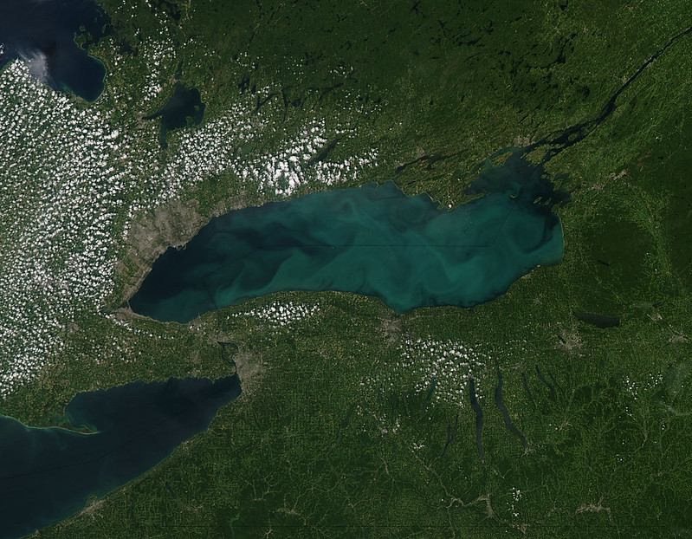
Eutrophication
The increased supply of organic matter, which includes the increased phytoplankton that grow when extra nutrients are available.
Carbon
Nitrogen
Phosphorus
NASA/GSFC/Jeff Schmaltz/MODIS Land Rapid Response Team
Symbols courtesy of the Integration and Application Network, University of Maryland Center for Environmental Science
Notes:
These slides introduce the idea of eutrophication. It is classically defined as “the increased supply of organic matter.” One way of thinking about this is that as nutrients are delivered to an ecosystem, more phytoplankton are able to grow, which leads to more biomass in the system. As more phytoplankton grow, certain phytoplankton that can cause harmful algal blooms can also grow. These can negatively impact the ecosystem by releasing toxins, but by also taking up the oxygen needed by fish to live.
If you have more nutrients… you get more phytoplankton. And these phytoplankton can cause large blooms.

Slide 10
Eutrophication
The increased supply of organic matter, which includes the increased phytoplankton that grow when extra nutrients are available.
Carbon
Nitrogen
Phosphorus
Redfield ratios still apply
NASA/GSFC/Jeff Schmaltz/MODIS Land Rapid Response Team
Symbols courtesy of the Integration and Application Network, University of Maryland Center for Environmental Science
Notes:
These slides introduce the idea of eutrophication. It is classically defined as “the increased supply of organic matter.” One way of thinking about this is that as nutrients are delivered to an ecosystem, more phytoplankton are able to grow, which leads to more biomass in the system. As more phytoplankton grow, certain phytoplankton that can cause harmful algal blooms can also grow. These can negatively impact the ecosystem by releasing toxins, but by also taking up the oxygen needed by fish to live.
If you have more nutrients… you get more phytoplankton. And these phytoplankton can cause large blooms. One way scientists are studying these blooms is by focusing on the nutrients. Even with the increase in nutrients, the dependence on Redfield ratios still apply. As is shown in the next slide, this can help inform management decisions.

Slide 11
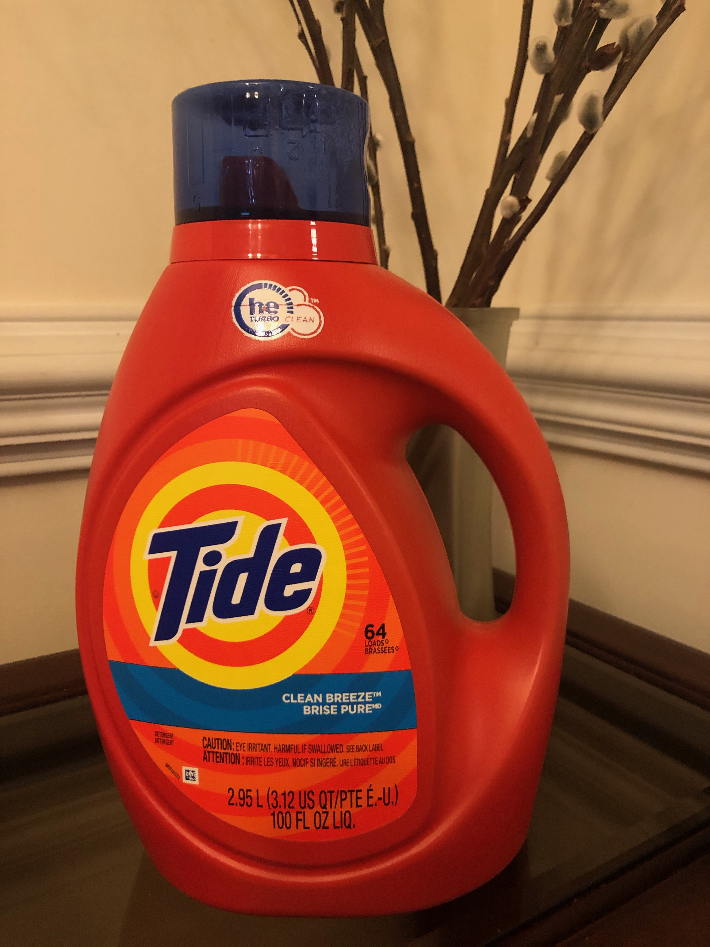
Use in Modern Ecology
Is this system nitrogen or phosphorus limited?
Measured N:P ratio > 16:1 - phosphorus limited
Measured N:P ratio < 16:1 - nitrogen limited
Broadly, freshwater systems are phosphorus limited and saltwater systems are nitrogen limited.
This can be important for management decisions
Notes:
In modern ecology, we use the Redfield ratio to determine if an ecosystem is limiting for one of these critical nutrients. To do this, scientists focus on the nitrogen: phosphorus part of the ratio. By measuring the nutrients in the environment, scientists can then calculate ratios.
When the measured N:P is greater than the ideal 16:1 (say 18:1), the system is labeled as phosphorus-limited, because there is less phosphorus than is needed. Another way of saying this is there will still be nitrogen left when all the phosphorus has been used by the phytoplankton. Even if there is nitrogen left, the can’t continue to grow because there is no longer any phosphorus.
When the measured N:P is less than the ideal 16:1 (say 15:1), the system is labeled as nitrogen limited, because there is less nitrogen than is needed.
In the environment, freshwater systems are usually phosphorus limited and saltwater systems are nitrogen limited. This can be important for management, especially when trying to combat eutrophication. For example, today most laundry detergent does not contain phosphorus because of the impact that nutrient has on our inland waterways (https://www.npr.org/2010/12/15/132072122/it-s-not-your-fault-your-dishes-are-still-dirty). With less phosphorus being imputed into the freshwater environment, fewer blooms are thought to occur there.

Slide 12
Use in Modern Ecology
Is this system nitrogen or phosphorus limited?
Measured N:P ratio > 16:1 - phosphorus limited
Measured N:P ratio < 16:1 - nitrogen limited
Broadly, freshwater systems are phosphorus limited and saltwater systems are nitrogen limited.
This can be important for management decisions
Take home: Check your home detergents (dishwasher, laundry etc.) for phosphate.
Notes:
In modern ecology, we use the Redfield ratio to determine if an ecosystem is limiting for one of these critical nutrients. To do this, scientists focus on the nitrogen: phosphorus part of the ratio. By measuring the nutrients in the environment, scientists can then calculate ratios.
When the measured N:P is greater than the ideal 16:1 (say 18:1), the system is labeled as phosphorus-limited, because there is less phosphorus than is needed. Another way of saying this is there will still be nitrogen left when all the phosphorus has been used by the phytoplankton. Even if there is nitrogen left, the can’t continue to grow because there is no longer any phosphorus.
When the measured N:P is less than the ideal 16:1 (say 15:1), the system is labeled as nitrogen limited, because there is less nitrogen than is needed.
In the environment, freshwater systems are usually phosphorus limited and saltwater systems are nitrogen limited. This can be important for management, especially when trying to combat eutrophication. For example, today most laundry detergent does not contain phosphorus because of the impact that nutrient has on our inland waterways (https://www.npr.org/2010/12/15/132072122/it-s-not-your-fault-your-dishes-are-still-dirty). With less phosphorus being imputed into the freshwater environment, fewer blooms are thought to occur there.

Slide 13
Today’s Activity
We will explore limiting factors by determining limiting nutrients for 4 water samples using the concept of Redfield ratios.
Water Sample | Measurement
 | Phytoplankton (x 10⁵ cells) | Nitrogen (μmol N L⁻¹) | Phosphorus (μmol P L⁻¹)
Sample 1 | 2 | 22 | 2
Sample 2 | 2 | 27 | 1.5
Sample 3 | 18 | 40 | 2.5
Sample 4 | 6 | 24 | 1.5

Slide 14
Today’s Activity
This activity will include the challenge of graphing with 2 y-axes.
This helps scientists visualize multiple measurements at the same time
Sample
Notes:
One aspect that may be confusing to students is that the graphing activity includes a graph with 2 y-axes. This is an opportunity to introduce that concept to students. Scientists often use graphs with 2 y-axes because it allows us to visualize more data together and try to piece together relationships. In order to read the axes, you need to determine which measurement goes with which axes (will be guided in worksheet). Give the example of the red nutrient measurement goes with the y-axis labeled nutrient concentration. Green, then goes with phytoplankton cells.

Slide 15
Today’s Activity
This activity will include the challenge of graphing with 2 y-axes.
i.e. red nutrients goes with the first y-axis
i.e. green phytoplankton goes with the second y-axis
This helps scientists visualize multiple measurements at the same time
Sample
Notes:
One aspect that may be confusing to students is that the graphing activity includes a graph with 2 y-axes. This is an opportunity to introduce that concept to students. Scientists often use graphs with 2 y-axes because it allows us to visualize more data together and try to piece together relationships. In order to read the axes, you need to determine which measurement goes with which axes (will be guided in worksheet). Give the example of the red nutrient measurement goes with the y-axis labeled nutrient concentration. Green, then goes with phytoplankton cells.

Slide 16
Today’s Activity
In your groups, use the provided data to create a graph and answer questions.
Now that you have viewed your data, answer the worksheet questions about the data.
If time, answer questions about eutrophication with your group.
Discuss findings as a class.
Notes:
Optional

Slide 17
Sample 1 11:1 < 16:1
- nitrogen limitation
Sample 2 18:1 >16:1
- phosphorus limitation
Sample 3 16:1
-equal, no nitrogen or phosphorus limitation
Sample 4 16:1
-equal, no nitrogen or phosphorus limitation
Notes:
Answer Key

