Slide 1

One Fish, Two Fish, Red Fish…Whose Fish?
Exploring the Interdisciplinary Approach to Fisheries Management
Notes:
This lesson plan explores the interdisciplinary approach to fisheries management through simulation of a fisheries management meeting. Various stakeholders will have different approaches to how they believe a resource should be managed based on their use of the resource. Often times, fisheries management encompasses a wide range of disciplines (policy, social sciences, economics, ecology, biology, etc.).

Slide 2

Background - Shelby White
PhD student at VIMS
Originally from North Carolina
Interested in fisheries economics/policy
Research focuses on changes in coastal commercial fishing communities of Virginia – why do individuals choose to enter or exit the commercial fishing industry?
Notes:
This activity is based on the research of a PhD student at the Virginia Institute for Marine Science. She is from North Carolina and has personal experience working in the commercial fishing industry with her family. Broadly, Shelby focuses on the topics of economics and policy in fisheries. Her research aims to identify changes in coastal commercial fishing communities of Virginia. Shelby hopes to understand what drives an individual to enter or leave the industry, as well as how individuals make decisions on when to fish, what to fish for, and how to fish. These decisions are often influenced by a variety of topics, including increased regulation, availability, personal knowledge, location, etc.

Slide 3
Sustainability
Why is it important to manage fisheries?
Fishery resources are scarce.
What does sustainability mean to you?
Notes:
At the beginning of the activity, teachers should engage students by asking if they have ever been fishing (i.e. recreational, commercial, charter, etc.). This will give the teacher an idea about the background knowledge of the students and may even encourage the teacher to ask questions throughout the activity.
The teacher should then discuss why it is important to manage fisheries (without management, people would likely deplete the resource until there is nothing left). Fisheries management is often about managing people, not the resource itself. Fishery resources are scarce and cannot always support unregulated fisheries. Therefore, we manage these resources to ensure that they are sustainable. Teachers should ask students what sustainability means to them by encouraging students to identify 1) the importance of sustainability ; 2) the impacts of removing a species from the environment ; and 3) the impact of unregulated fishery resources. Teachers may also consider using the recommended videos to further discussion.

Slide 4
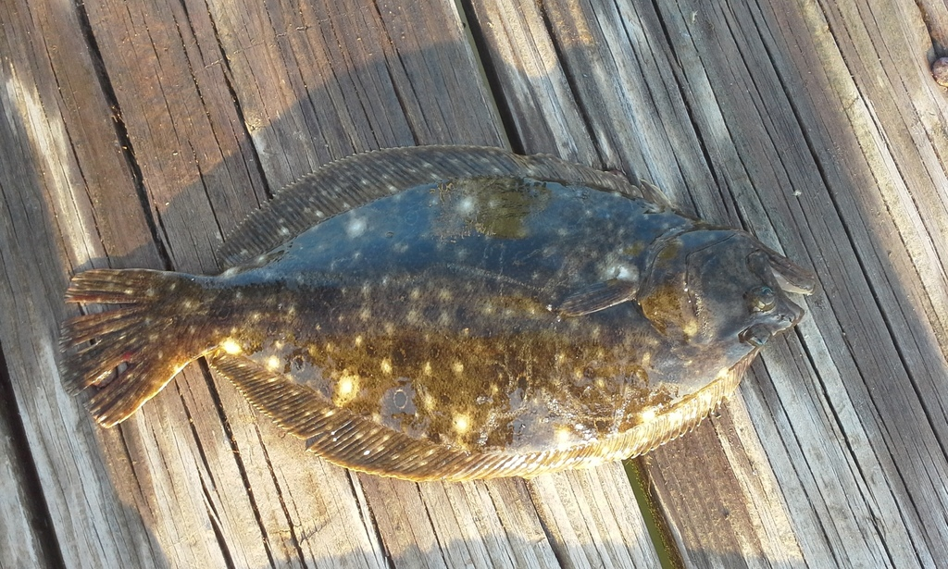
Stakeholders
What if there is a newly proposed regulation to manage summer flounder?
Who are the stakeholders? Would they be happy or unhappy about this proposed regulation? Why or why not?
Jonathan Irons
Notes:
Students should be able to identify various stakeholders in a given situation and evaluate how the viewpoints of different stakeholders vary. This can be demonstrated with a scientific or non-scientific example. For example, if a new shopping mall will be built in your area, who would be affected or care about this? These are potential stakeholders. Would all of the stakeholders be happy about this new development?
Teachers should then introduce the summer flounder as the species of interest. Teachers can always use other species that are relevant to the area for clarity.

Slide 5
Fishery Management Meeting
Students will re-enact a fisheries management meeting by assuming the roles of various stakeholders.
Recreational fishers
Commercial fishers
Local citizen
Scientist/researcher
Management agency
Notes:
Students will re-enact a fishery management meeting to discuss a newly proposed regulation. Students will assume the roles of various stakeholders that may be involved. After previous review of stakeholders, teachers should ask students to identify possible stakeholders that would be affected by a change in regulation?

Slide 6
Activity
Groups of 4-6 students – read and discuss your Stakeholder Information handout as a group. Write down your initial thoughts and ideas about how this newly proposed regulation might affect you.
Consider social, economic, and ecological aspects in your role.
Each group will have 3 minutes to present their argument to the management agency.
If another stakeholder group wants to respond to the group presenting, they will have 1.5 minutes to do so.
Based on the stakeholder presentations, the management agency will decide how to proceed with the proposed regulation.

