Slide 1
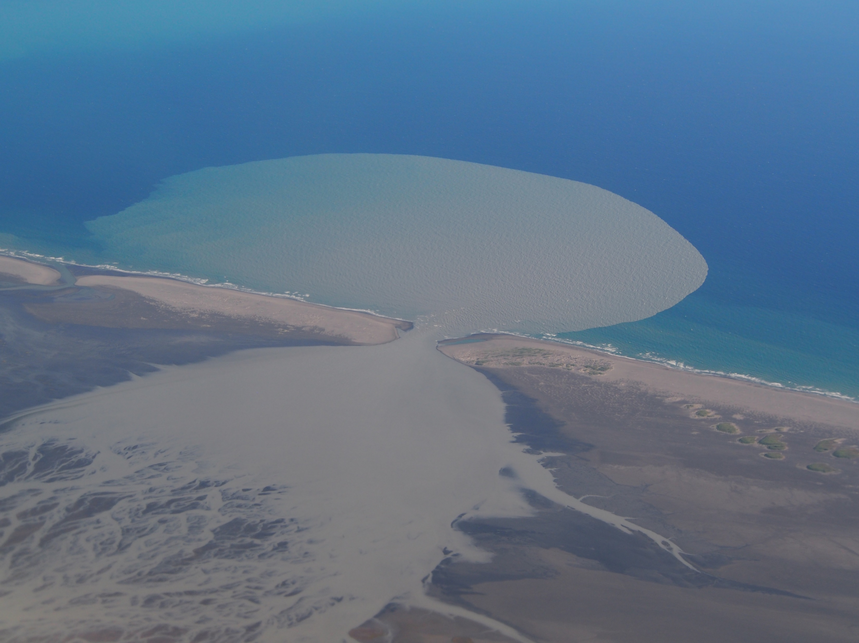
Describe what you see in this picture. What do you think is going on here?
Dangerous River Plume. Photographed August 3, 2015. Andrew McDonnell, University of Alaska Fairbanks, Personal permission. amcdonnell@alaska.edu

Slide 2
Sediments are a natural part of our world
Sediments can be “bad” for ecosystems and people when too much erosion causes lower water quality.
Sediments can be “good” for ecosystems and people because they are used to replenish marshes and nourish beaches.
Video Links:
Bay 101: Sediment https://vimeo.com/110608386
Marsh Replenishment https://www.youtube.com/watch?v=_AIgYACJfSQ&feature=youtu.be
Beach Nourishment https://www.youtube.com/watch?v=-7w6jY6LnpM
Notes:
When introducing sediments:
Explain to students how sediments can be seen as “good” vs. “bad” for ecosystems and for people.
For example, sediments are a renewable resource for marshes and beaches (good),
but they can be detrimental to water quality when there is too much erosion (bad).

Slide 3
Game Instructions
You will be travelling around the watershed as an individual grain of sand.
Each student is one grain of sand. Keep track of where you go on the worksheet with the table.
Each turn, when you arrive at a new station:
  Write down where you have arrived in the 2nd column of the current row and in the first column of the next row down.
  Write down how you got there – what was your sediment transport process?
  Roll the dice to see where you will go next.
Notes:
When introducing the game:
Ask students “Where do we find sediments?” or “Where do we find mud? Sand?”
As students give correct answers, put the respective station labels up around the room where each station will be.

Slide 4
Example
Time | Location started | Location ended | Transport process (What happened?)
1 | Ocean | Beach | Wind/waves washed me up
2 | Beach

Slide 5
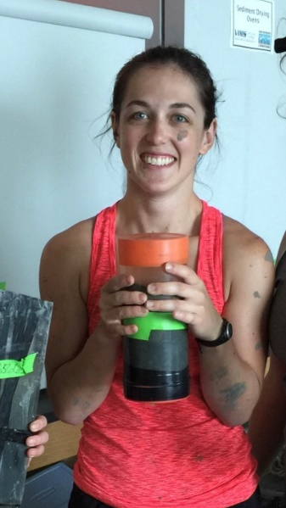
Motivation for this lesson
My name is Jessie Turner and I am a marine science graduate student at the Virginia Institute of Marine Science (VIMS). I study water clarity in the Chesapeake Bay. One of my projects is trying to find out how the amount of sediments coming from rivers and bank erosion changes how clear the water is in the Bay. I need to know where the sediments came from, how fast they settle to the bottom, and how long they stay in each part of the Chesapeake Bay before they get resuspended and moved somewhere else. I also help collect sediment samples for lots of other projects.

