Slide 1
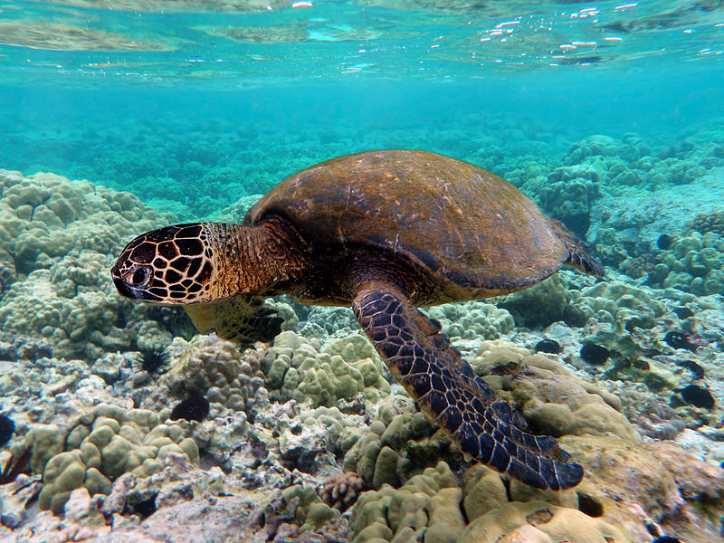
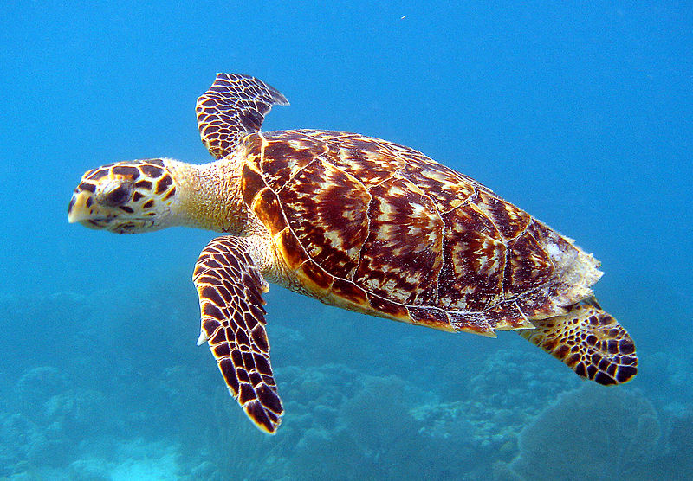
Sea Turtles
Notes:
Images from Wikimedia Commons

Slide 2
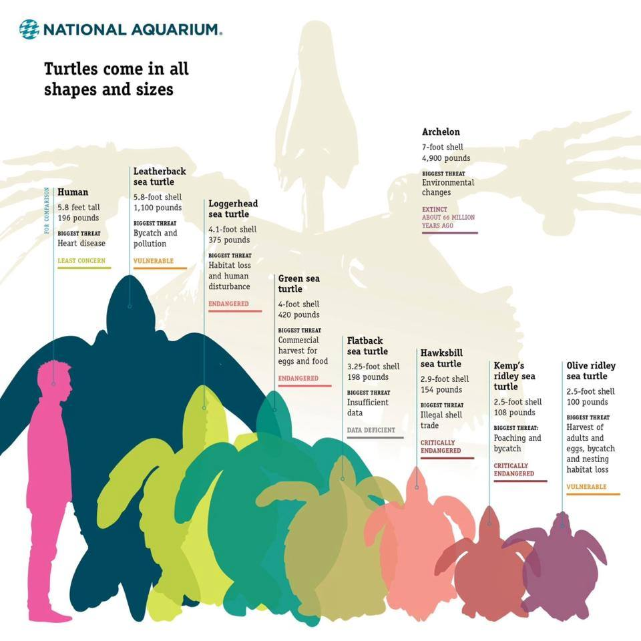
Sea Turtle Facts
Size: Big! Some adults are over 4 feet long
Diet: Jellyfish, seagrass, crabs, shrimp, sponges
Lifespan: 50-80 years
Reproduction: Turtles are reptiles so they hatch from eggs
  Turtles lay over 100 eggs per nest!
Fun fact: Can hold their breath for up to 7 hours
Notes:
- Sea turtles are reptiles that live in the ocean.
-Size: Size depends on species, but some adults are over four feet long. Leatherbacks are the biggest of the extant sea turtle species, and they can grow to be up to 8ft long and 1,500 lbs
-Diet: Sea turtles feed on lots of different things and depends on the species, but common prey items include jellyfish, seagrass, crabs, shrimp, and sponges
-Lifespan: Lifespan depends on species and can be really hard to determine. Although some species are believed to be able to live to be over 150 years old, due to multiple threats, turtles aren’t living as long anymore. It is believed that today, most species live up to be 50-80 years old.
-Reproduction: Turtles spend their entire lives in the ocean and then return to the same nesting beaches where they were born to lay their eggs. The nest from one female can have more than 100 eggs in it, depending on species.
-Fun fact: Can hold their breath for up to 7 hours. Sea turtles are air breathing reptiles so they have lungs and need to surface to breathe. But, they can hold their breath for several hours depending on activity intensity. A resting or sleeping turtle can hold its breath for 4-7
Additional Information:
https://conserveturtles.org/information-sea-turtles-frequently-asked-questions
http://www.seeturtles.org/sea-turtle-facts/
http://www.livescience.com/55507-sea-turtles.html

Slide 3
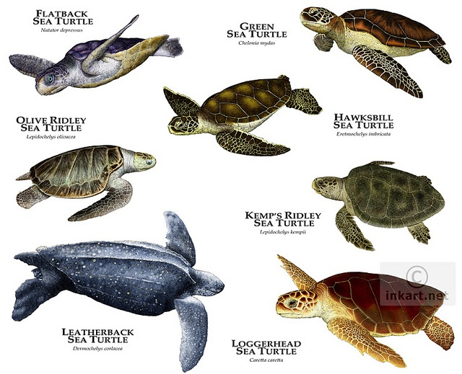
Sea Turtle Species
1
2
3
4
5
6
7
Notes:
7 sea turtle species around the world
What are differences you see among the different sea turtle species
Note that leatherbacks do not have hard shell like the others, but a soft, rubbery shell
Leatherbacks are the biggest turtles, they grow up to 9 feet, and have been around since the time of the dinosaurs
The other 6 species are “hard-shelled” sea turtles, with the typical characteristic hard turtle shell that we think of when we think of turtles
- 6 of the species are found in US waters with exception of Flatback which is found only in Australian waters

Slide 4
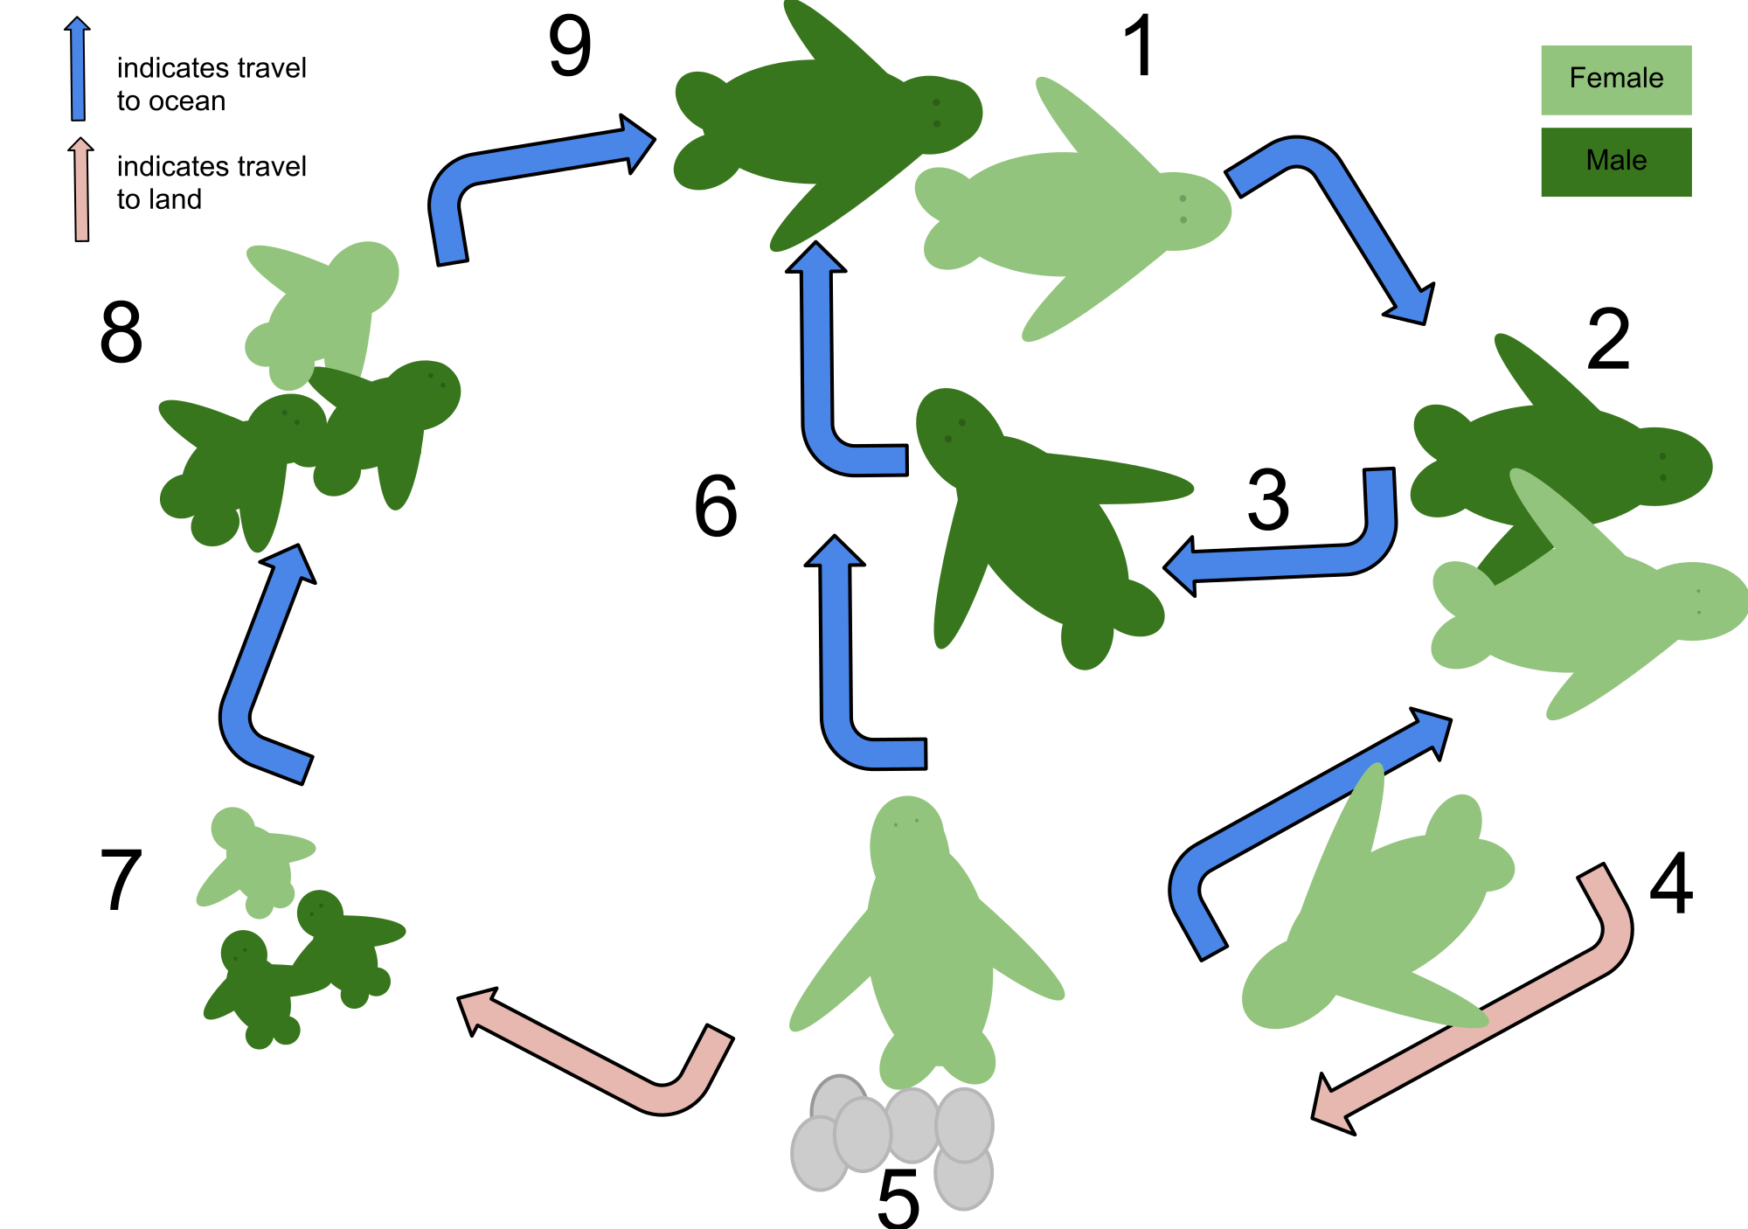
Sea Turtle Life Cycle
Notes:
1) Mature turtles migrate to reach coastal breeding sites. Females hatch their eggs in the same nesting beaches that they were born.
2) Male and female turtles mate in the water
3) Males return to deep sea to feed, while 4) Female sea turtles alternate between mating in the water and 5) laying their eggs for several on land for several weeks. Depending on turtle species, a female will lay 2-8 nests throughout the nesting season.
7) After about two months, the eggs in the nest hatch. Hatching typically occurs at night to avoid predation, and the baby turtles (known as hatchlings), crawl to the water
8) The hatchlings swim out to sea, growing and eating until reaching reproductive age and continuing the cycle
Images from Wikimedia Commons

Slide 5
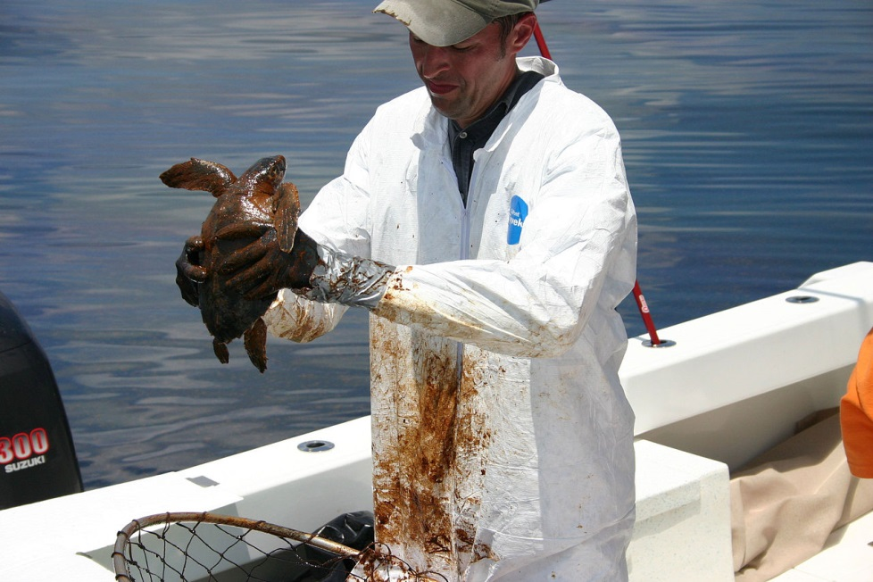
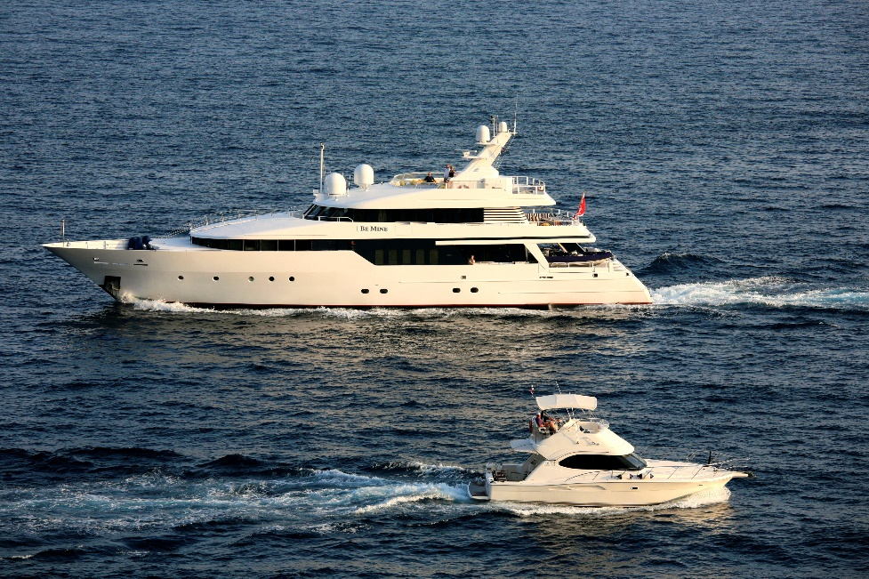
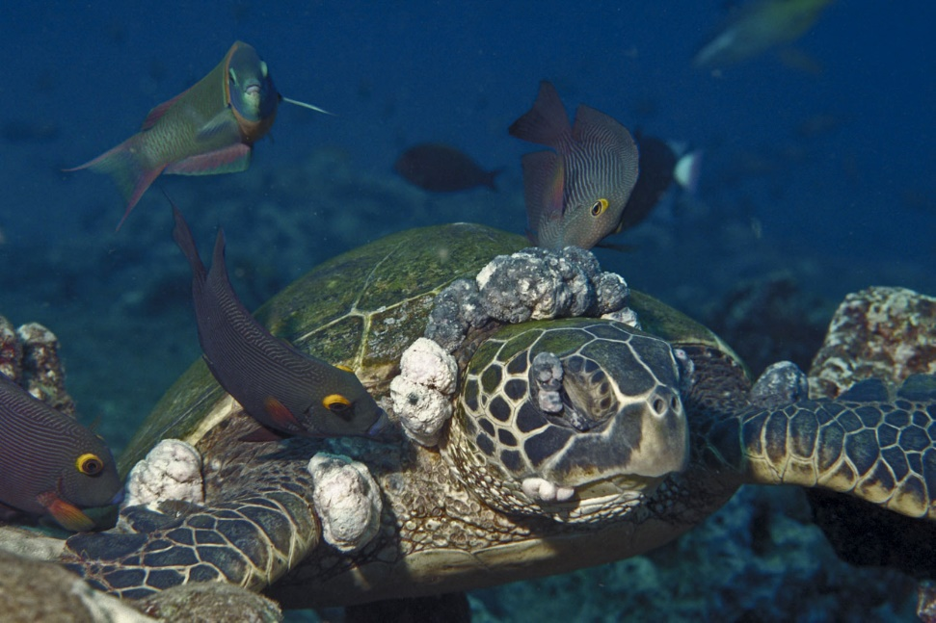
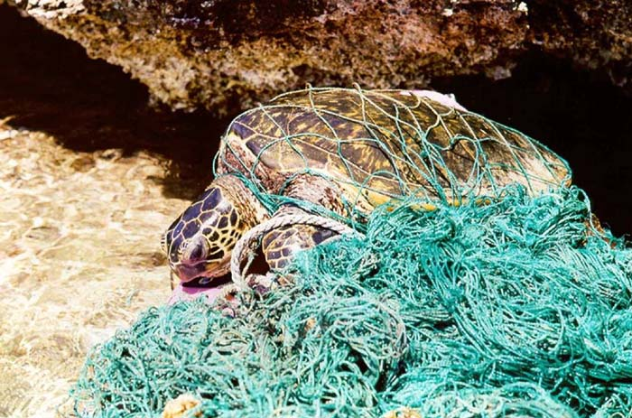
Threats to Sea Turtles
Endangered vs Threatened Species
Notes:
What does it mean to be endangered? Species that is in danger of becoming extinct
What does it mean to be threatened? Species that is likely to become endangered soon
Which is worse? Endangered
Do you think any sea turtle species are endangered or threatened? Of the 7 species, how many?
All of them
Why? What type of threats do you think there are to sea turtles?
Examples:
Harvesting for meat, eggs, shells, oil
Pollution; plastic bags mistaken for jellyfish
Boat strikes/boat collision (top right image)
Fisheries interactions: Bycatch or entanglement in gear (bottom right image)
Predators
Beach development
Beach lighting
Disease (bottom right image, turtle with external tumors)
Oil spills (top right image): oil can get ingested when turtle surfaces to breathe
Images from Wikimedia Commons

Slide 6
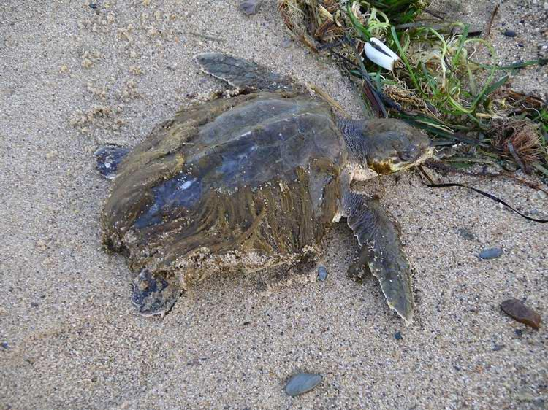
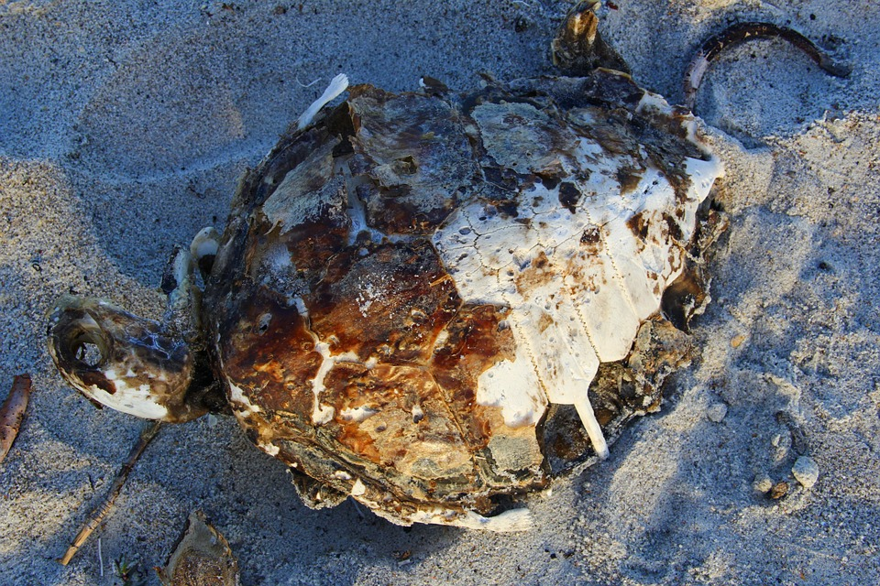
Sea Turtle Strandings
© Bill Allen, MassAudubon Wellfleet Bay Wildlife Sanctuary
Any ocean turtle found floating on the ocean surface or washed up along the coastline, often deceased or severely injured
Notes:
What is a stranded sea turtle?
Any ocean turtle that washes up on beaches either really sick but usually deceased
What other animals can become stranded?
Dolphins, whales, seals, etc
Each (coastal) state has a stranding response team, that responses to reports of strandings and comes in to take data and investigate
Optional: look up the stranding team in your state
Right-hand image from MaxPixel (open source images)

Slide 7




Sea Turtle CSI
Notes:
Hop to it: Talk to your group about some threats that sea turtles face

Slide 8
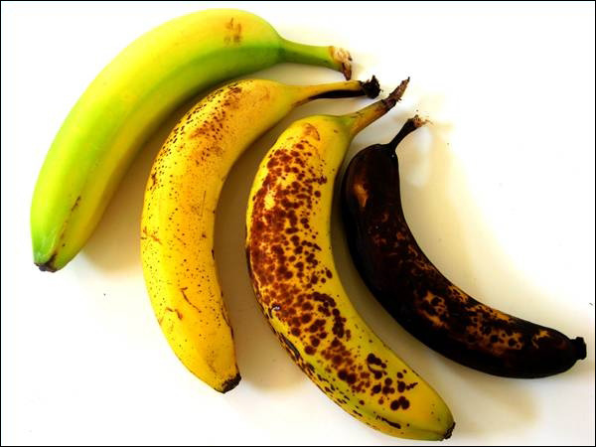
#1
#4
#2
#3
Notes:
Say you have these 4 bananas sitting on your countertop
Which one(s) would you eat?
Which one(s) would you not eat?
Why? What are different about these bananas? (because the bananas are getting rotten, etc)
How do you know they are getting rotten? (color, smell, texture)
How long do you think it takes, sitting on the counter, to get from the fresh banana to banana two? Three? Four? (if you have to guess in days)
How would you test that? (leave the fresh banana sitting out, check on it every day, see how long it takes to get rotten)
Image from: http://www.tophealthylifeadvices.com/how-to-resurrect-a-rotten-banana/

Slide 9

Notes:
- Now lets think about a crime scene. Say there is a murder and detectives come across a body. One of the most important questions you need to know is how long since the crime happened? Hours? Days? Weeks?
One of the ways to begin to determine time since death is to look at the body. What does it look like? Is it cold? Does it smell yet?
Similar to the bananas, it will look different depending on how many days has passed since death. A human body will look different 1 day after death, versus 1 week after death

Slide 10
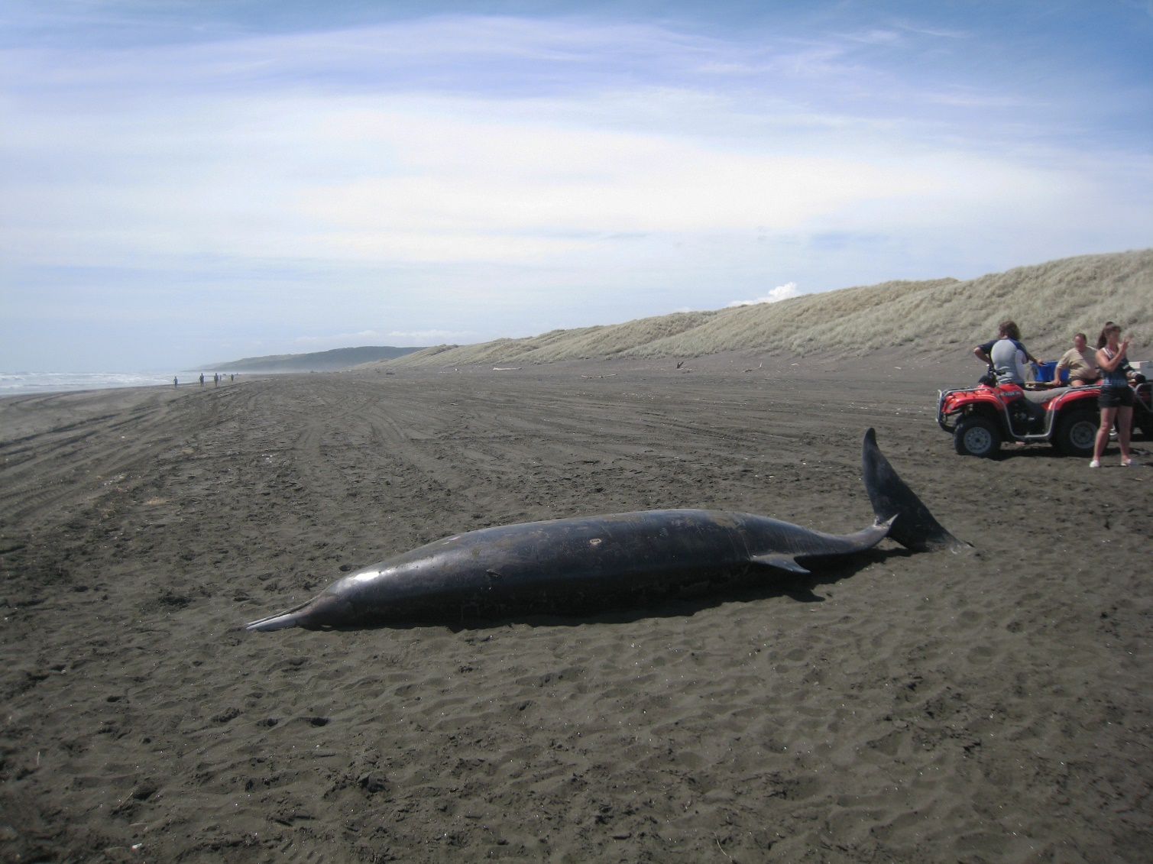
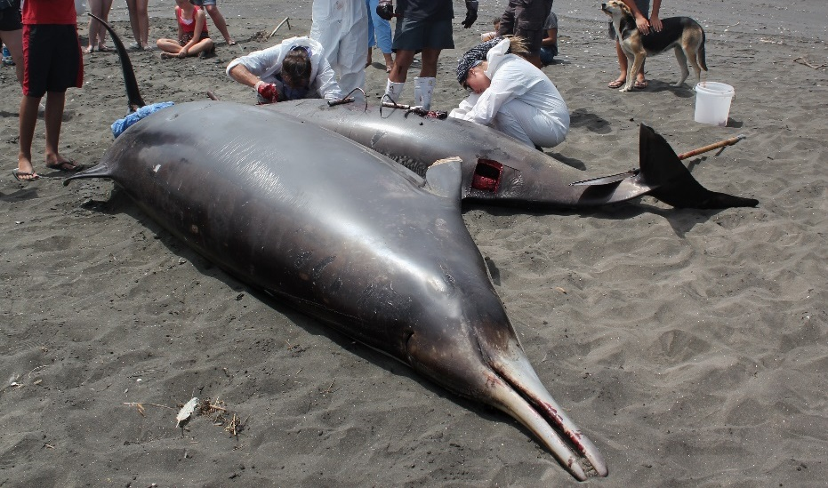
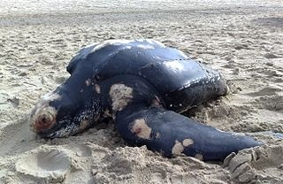
Strandings
Notes:
Now let’s take this one step further. Who remembers what a stranded animal is?
Marine mammals (dolphins, whales, etc) can also strand
A stranding response team is called in to document and record the event
They are interested in figuring out why these animals are dying and what is causing their death

Slide 11
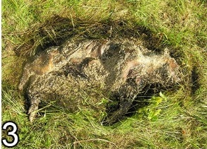
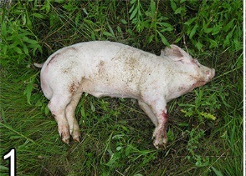
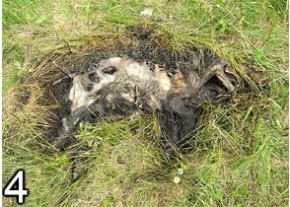
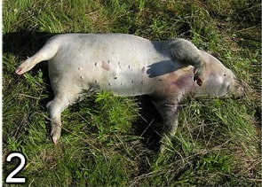
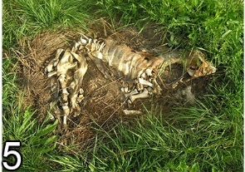
Condition Code | Carcass State
0 | Alive
1 | Fresh dead
2 | Moderately decomposed
3 | Severely decomposed
4 | Dried carcass
5 | Skeleton, bones only
Notes:
- In order to try and figure out why the animal died, similar to a detective investigating a murder, you are first trying to figure out how long it has been since it died
- Pictures are of the decomposition stages of a pig, NOT a marine animal (but essentially the same, shown so they can see the different stages)
That will give you an idea of how long it has been floating in the water before washing up on shore (ie. in this example of pigs, the pig with a code 5 obviously died a lot longer ago than the pig with a code 2)
Then you can try and backtrack to determine where it died, and why
When a stranding team responses to the stranded animal, they look at it and based on observations they assign it a condition code from 0-5
But, this code is only useful if we can associate a time component with it.
Images from Wikimedia Commons

Slide 12
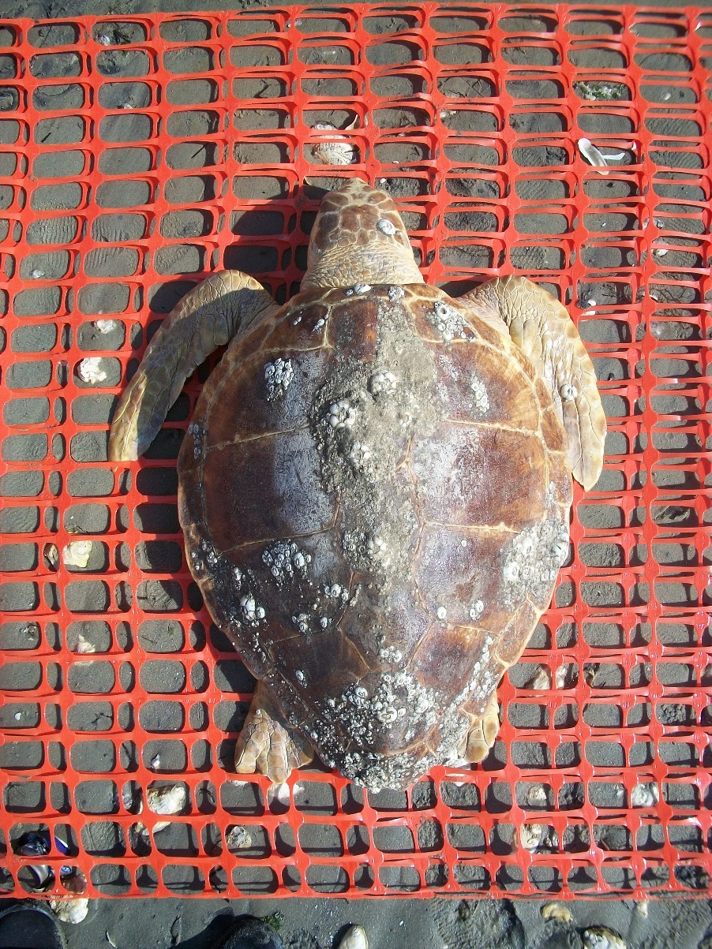
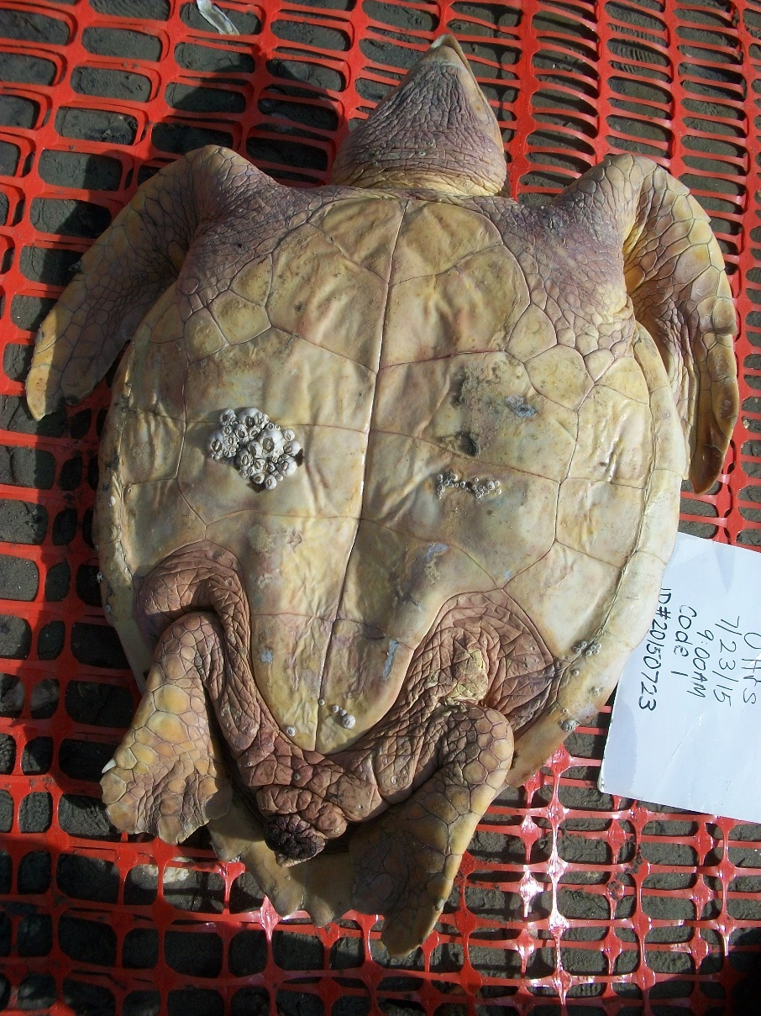
Sea Turtle Decomposition Case Study
© B Santos
© B Santos
Notes:
Explain the activity to the class:
- We are going to play the role of detectives and try to associate a time component with a stranded sea turtle that was found in code 1 (fresh dead)
An experiment was set up where a turtle carcass was laid out and every day it was checked on, and its condition code was noted
Scientists wanted to see how long it took for the sea turtle to go through all the stages
We are going to break up into 6 groups and every group will get a “case file”
In this file, there is information and pictures of a turtle carcass sampled on a certain day
- Your job is to compare it to these photos, which are day 0, code 1, and assign your case file turtle a certain condition code

Slide 13
Group Activity
1. Compare Day 0 pictures with your case file
  2. Fill out police report with detailed description
    Use “Carcass Evaluation” as guide
    Use sea turtle anatomy terms
3. Compare with “Condition Code Guide”
4. Assign condition code
Head
Foreflippers
Carapace
Plastron
Scutes
Rearflippers
Case File | Condition Code
A
B
C
D
E
F
Notes:
To do that, there are a few documents in each case file to help you
Fill out police report with a detailed description
Compare that description to the criteria listed in the condition code
Go over parts of turtle
Try to use some anatomy language
Assign the turtle a condition code
Once each group assigns their case file a condition code, we will all share and fill out chart
Scutes = bony plates on the shell
Carapace and plastron are the two parts that make up the shell
Carapace covers the top of the turtle, over its back
Plastron cover the bottom, over its belly
Image: Modified from NOAA sea turtle stranding reporting form (https://www.sefsc.noaa.gov/turtles/STSSN_formfront.pdf), available at https://www.sefsc.noaa.gov/species/turtles/strandings.htm

Slide 14

Agree or Disagree?

Slide 15
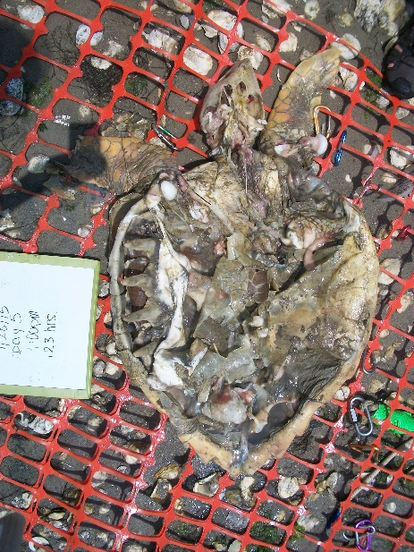
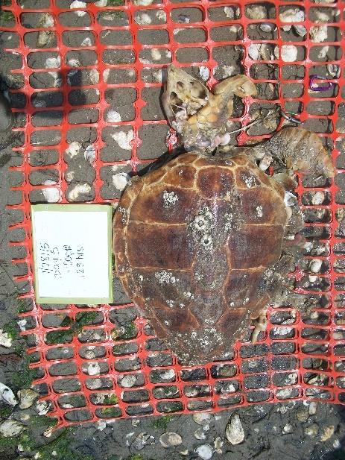
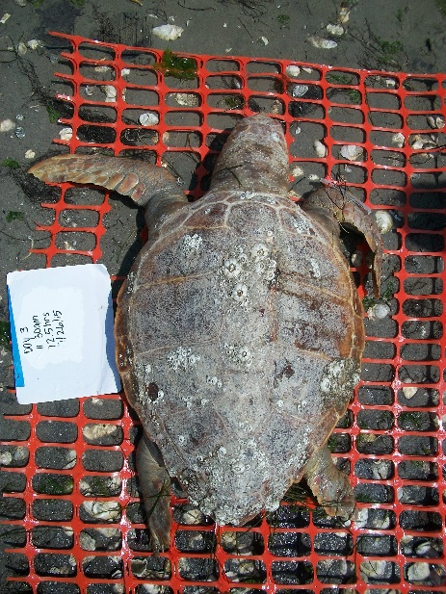
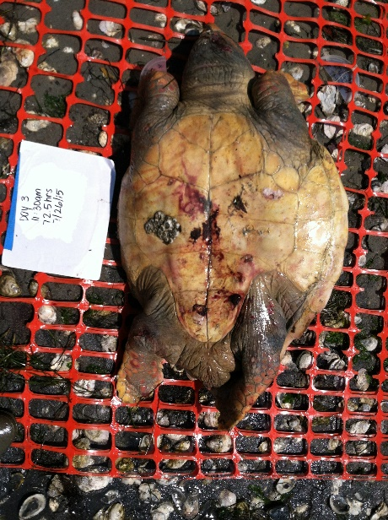
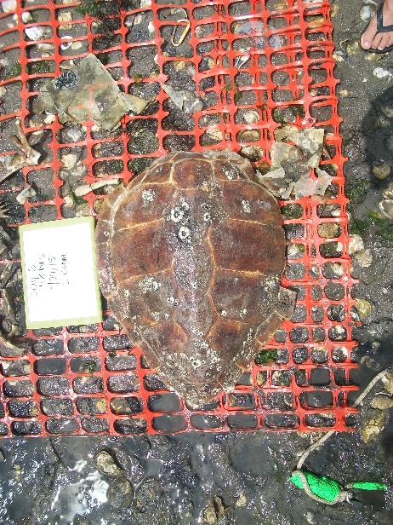
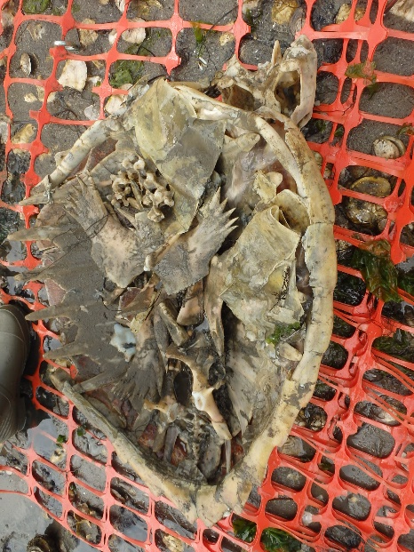

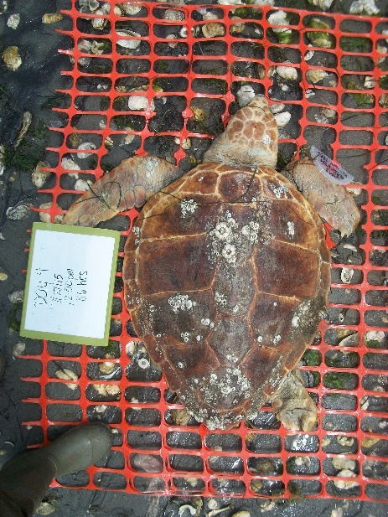
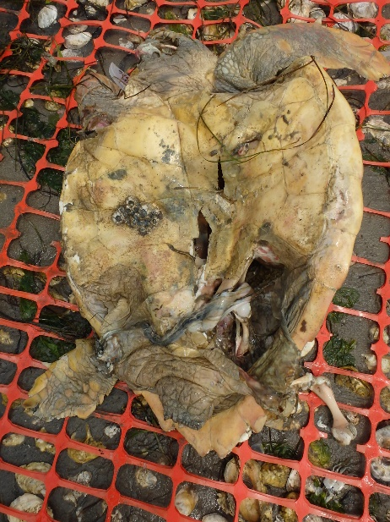
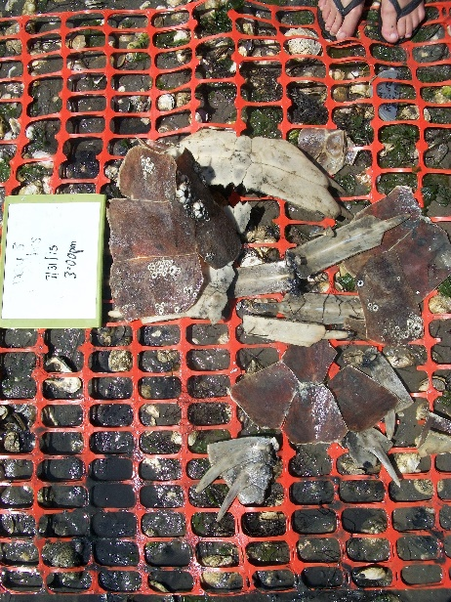
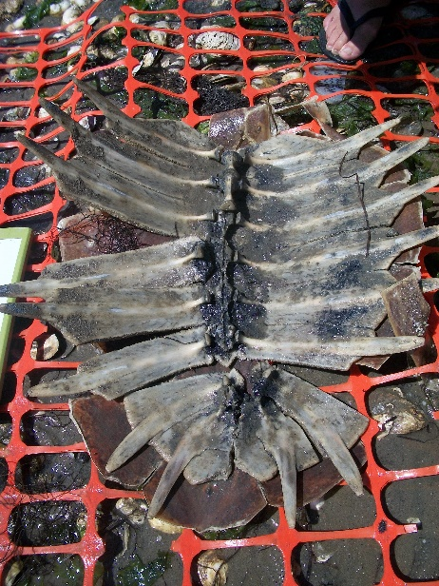
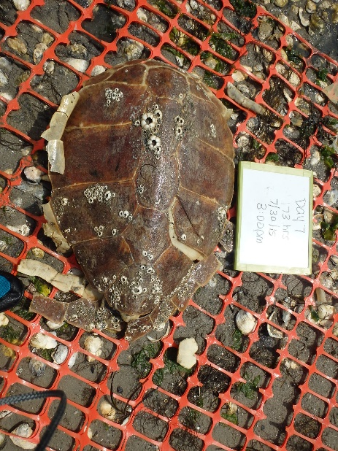
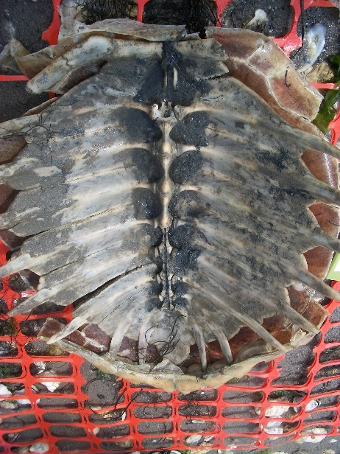
Case File A
Case File B
Case File C
Case File D
Case File E
Case File F
Notes:
One by one, as the photos appear, ask that group what their condition code is and justification
Images: © B. Santos

Slide 16
Graphing Activity
Fill out data table
Graph results
  A. Title
  B. Axis labels
Answer questions
Case File | Condition Code | Day
A
B
C
D
E
F
G
Notes:
Individual activity

