Slide 1
Keeping Up with Sea-Level Rise
VA SEA 2015-2016
Bethany L. Williams

Slide 2
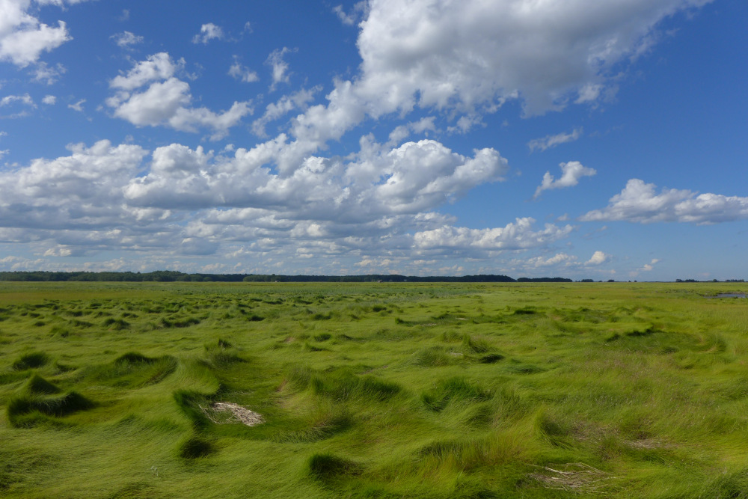
Salt marshes
Notes:
Figure 1: photo of a salt marsh for students who haven’t seen one

Slide 3
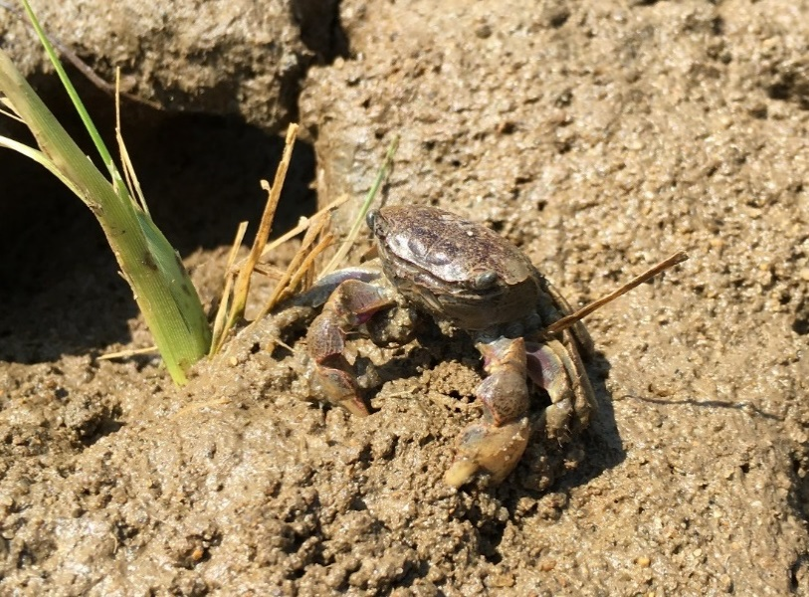
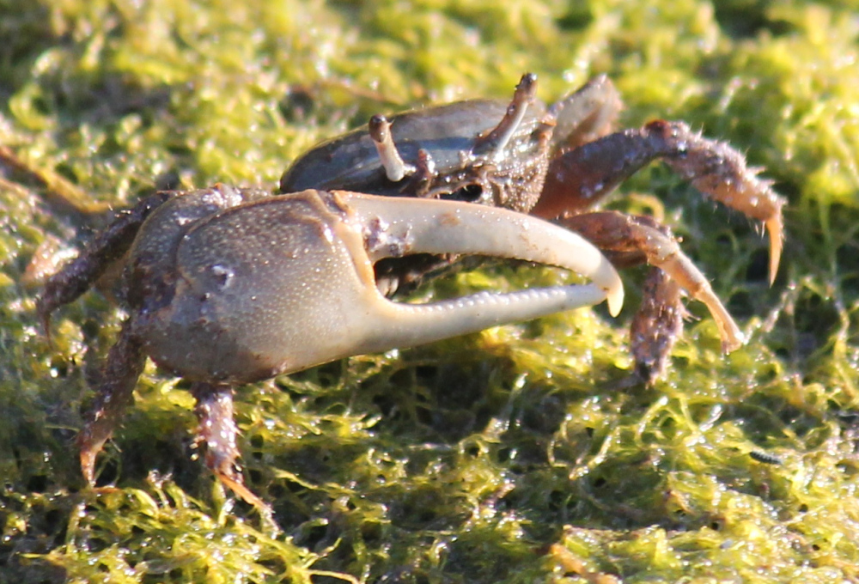
Salt marsh crabs
Purple marsh crab, Sesarma reticulatum
Marsh fiddler crab, Uca pugnax

