Slide 1
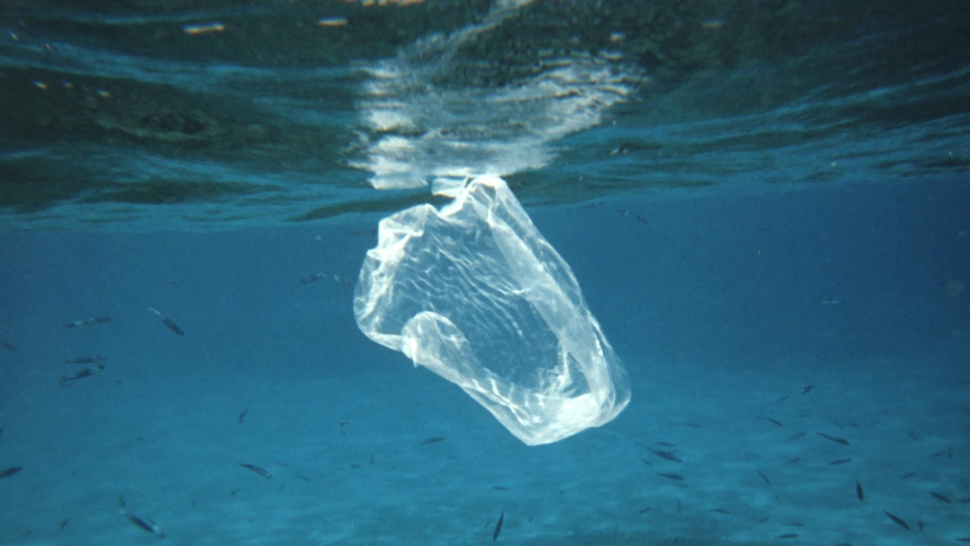
Trawling Through the 5 Ocean Gyres:
A Microplastic Research Study
Prepared by: Meredith Evans Seeley
Photo Credit: NOAA Photo Library
Notes:
***Image labeled for reuse by NOAA Photo Library (https://www.google.com/url?sa=i&source=images&cd=&cad=rja&uact=8&ved=2ahUKEwjTyK3t58XfAhUoU98KHbVKCxMQjRx6BAgBEAU&url=https%3A%2F%2Fwww.photolib.noaa.gov%2Fhtmls%2Freef2129.htm&psig=AOvVaw0QSWoLYjVcMZzWeNpCfPUO&ust=1546199334435149)

Slide 2
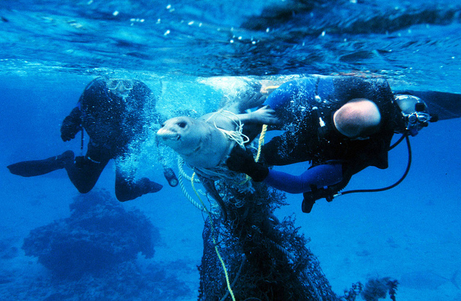
SCIENTIST HELP NEEDED!
THE PROBLEM Researchers have found plastic pollution across the world’s oceans.
This causes problems for marine life, and pollutes our natural habitats.
YOUR JOB:
learn more about what scientists already know
Complete your research assignment
Report your results
Develop an action plan to help stop the marine debris problem
Photo Credit: NOAA Photo Library
Notes:
Talking points/script: Introduce the project to the students. Tell them that researchers have discovered that there is a lot of plastic in the oceans, particularly in places like the pacific ocean gyre. The researchers are trying to learn more about this pollution, what types of plastic is there, how much and what the effects are. The students will work on research teams to contribute to the field.
***Image labeled for reuse by NOAA Photo Library (https://www.photolib.noaa.gov/) (https://www.flickr.com/photos/51647007@N08/5102528303/)

Slide 3
BACKGROUND INFORMATION
THE PROBLEM Researchers have found plastic pollution across the world’s oceans.
WHAT WE KNOW
1. Plastic accumulates in ocean gyres!
In some parts of the ocean, wind and currents move in a circular pattern.
In the middle of this circle, the ocean is calm. Over time, trash from the coastlines will be moved via these currents and eventually accumulate in the calm center, also known as a gyre. There are 5 main ocean gyres.
Notes:
Talking points/script: Now, you are giving the students relevant background. The problem is repeated here, and there will be 3 “what we know” items over the next slides. This explains that plastic accumulates in gyres. Ask the students if they’ve heard of a gyre or know what it is. The next slide shows images of where the 5 major ocean gyres are, and includes videos to help explain them.

Slide 4
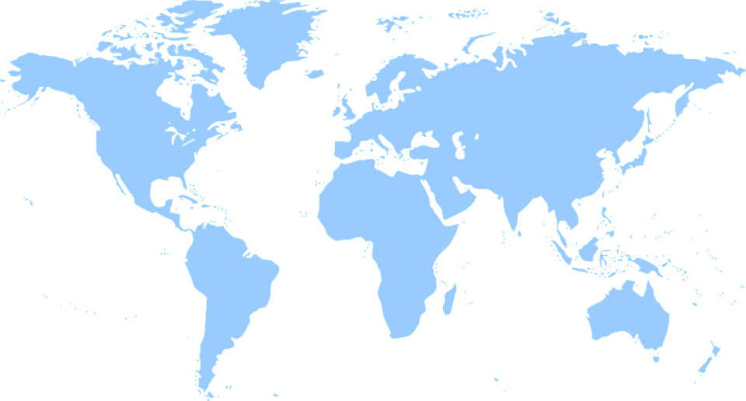
There are 5 Main Ocean Gyres:
North
Atlantic
North
Pacific
South
Pacific
South
Atlantic
Indian
Map adapted from: Wikimedia Commons
(https://en.wikipedia.org/wiki/File:World_map_green.png)
Visualize Ocean Gyres OR Learn More About Ocean Gyre Pollution
Notes:
Talking points/script: This shows where the 5 major ocean gyres are. Your researchers will work in groups, with one group working on each gyre. The videos will support your explanation of gyres. The first is a visualization of gyres moving in the ocean (it’s quick, but very helpful). The second is a longer video from the 5 gyres institute that talks about the ocean gyres pollution. It’s a bit more general, and not specific to just gyres, but it can be good background if you have the time.
Visualize ocean gyres: https://www.youtube.com/watch?v=x0EqbdSMC8E
Learn more about ocean gyre pollution: https://www.youtube.com/watch?v=h6i16CrI8ss
Map adapted from: Wikimedia Commons, labeled for reuse: https://en.wikipedia.org/wiki/File:World_map_green.png

Slide 5
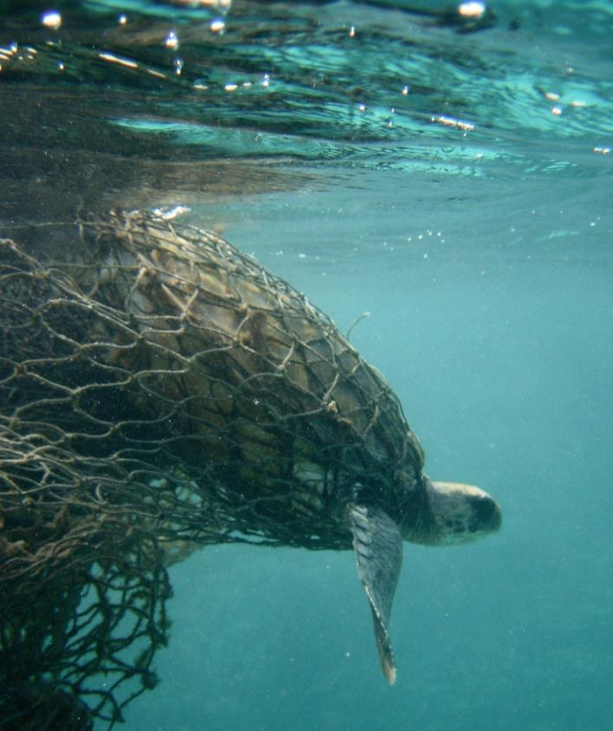
BACKGROUND INFORMATION
THE PROBLEM Researchers have found plastic pollution across the world’s oceans.
WHAT WE KNOW
1. Plastic accumulates in ocean gyres!
2. Marine debris can harm the ocean life!
Problems Caused by Marine Debris
Animal Entanglement
Animal Ingestion
Destroying Natural Habitat
Chemical Pollution
Watch this video to learn more.
Photo Credit: NOAA Photo Library
Notes:
Talking points/script: The sedond point is that plastic can harm ocean life. You can ask some students to brainstorm how wildlife might be harmed by marine debris, and then show the list here. Remind students that this is a small list, and there are many other ways that plastic can effect the oceans, and scientists are still finding and discovering some of these. The video explains some of the ways of harm, and explains the chemical pollution well.
Video: https://oceantoday.noaa.gov/trashtalk_impacts/ Talks about the problems plastic causes, including chemical issues.
***Image labeled for reuse by NOAA Photo Library (https://www.photolib.noaa.gov/) (https://www.google.com/url?sa=i&source=images&cd=&cad=rja&uact=8&ved=2ahUKEwiNose938XfAhUrUt8KHfCQCgUQjRx6BAgBEAU&url=https%3A%2F%2Fwww.photolib.noaa.gov%2Fhtmls%2Ffish1933.htm&psig=AOvVaw37N89jlg2LodBSk6TlwOW3&ust=1546197162360061)

Slide 6
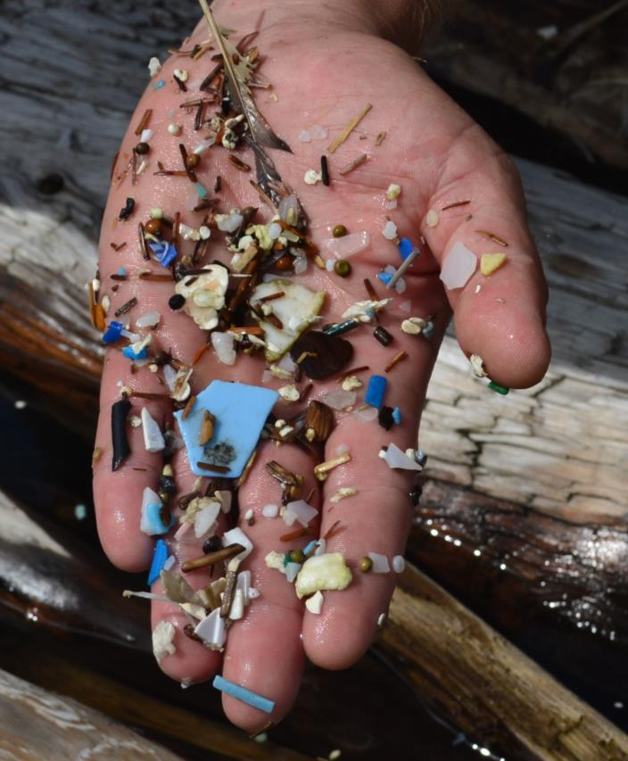
BACKGROUND INFORMATION
THE PROBLEM Researchers have found plastic pollution across the world’s oceans.
WHAT WE KNOW
1. Plastic accumulates in ocean gyres
2. Marine debris can harm the ocean life
3. A lot of ocean debris is microplastics
Microplastics are pieces of plastic that are smaller than 5 mm in diameter. They can be primary microplastics or secondary microplastics.
Primary microplastics are microplastics that have always been smaller than 5 mm (e.g. a bead). Secondary microplastics are microplastics that broke down from a large piece of plastic to become smaller than 5 mm.
Photo Credit: Meredith Evans Seeley
Notes:
Talking points/script: This adds that microplastics are a major point of pollution. Explain that microplastics are just pieces of plastic smaller than 5mm. Then explain primary v. secondary microplastics. There aren’t as many examples of primary microplastics (nurdle, plastic bead, microbead), but secondary microplastics can come from anything! A student may ask about how that works, since we always hear that it takes plastic hundreds of years to break down. But when the plastic is in the ocean, there are strong waves (and animals) that will break apart the plastic into smaller pieces. This doesn’t mean the plastic is degrading and going away, but it just means that the plastic is breaking into smaller pieces. Remind the students that this makes the plastic more difficult to study, and challenging to learn where the microplastic came from.
Later the students will count and sort microplastics, and identify where some of them came from. For example, some came from nylon fishing nets. Others are the polymer, like polystyrene or polypropylene, which make up many different consumer items. Scientists use a laser to determine this polymer type, and it helps them guess about what macroplastic lead to that microplastic.

Slide 7
BACKGROUND INFORMATION
THE PROBLEM Researchers have found plastic pollution across the world’s oceans.
WHAT WE KNOW
1. Plastic accumulates in ocean gyres
2. Marine debris can harm the ocean life
3. A lot of ocean debris is microplastics
WHAT WE NEED TO KNOW
How much plastic is in the ocean gyres?
What type of plastic is in the ocean gyres?
YOUR TASK
Work as a team of scientists to analyze debris from one ocean gyre.
Report the results and compare between gyres.
Notes:
Talking points/script: This is a summary slide of the ‘what we know’ and then introduces the questions and objective. Students will count and sort microplastics, and should be able to draw conclusions about the differences between the gyres.

Slide 8
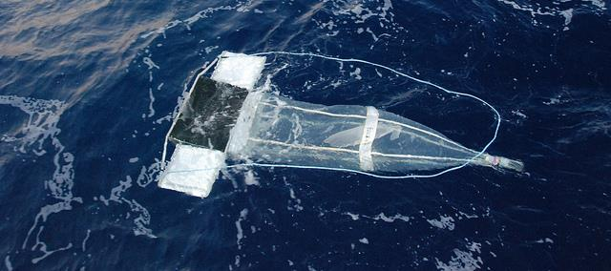
RESEARCH ASSIGNMENT
To collect debris from the oceans, researchers use a manta net.
This net is carefully dragged behind a research vessel, at a specific speed and over a specific distance. Then, the material the net caught is analyzed.
Photo Credit: NOAA Photo Library
Oceanographers have collected material from 5 manta net trawls (one from each of the main ocean gyres) for you to analyze!
Notes:
Talking points/script: This shows how microplastics are collected in the ocean. This is the same technique that scientists use to collect plankton samples, but because there’s so much plastic in the gyres, we use it to collect microplastics too! By knowing the size of the net opening, the speed and the distance, we can calculate how much water was ‘filtered’ by the net. When they start the project, the idea is that they’re sorting through one net that went across the middle of their gyre.
***Image labeled for reuse by NOAA Photo Library (https://www.photolib.noaa.gov/) (https://www.flickr.com/photos/51647007@N08/9787582414/)

Slide 9
RESEARCH ASSIGNMENT
DIRECTIONS:
Divide into 5 groups and get one trawl net per group
Open your trawl net and sort the microplastics by color/type
Identify each type of debris using the Plastic ID table
Count each type of plastic
Record your counts in the Plastic ID table
Graph the results of the plastic type and the quantity of each on the graph
Photo Credit: NOAA Photo Library
Notes:
Talking points/script: Leave this up to help you with instructions, but these are more clearly detailed on their worksheet and are not necessary for you to cover.
***Image labeled for reuse by NOAA Photo Library (https://www.photolib.noaa.gov/) (https://www.flickr.com/photos/51647007@N08/9787582414/)

Slide 10
RESEARCH ASSIGNMENT
WHAT DID YOU OBSERVE?
How do the 5 gyres differ?
What types of plastic are most common?
Present your results to the class, and answer questions 1 & 2 on your worksheet.
Photo Credit: NOAA Photo Library
Notes:
Talking points/script: This is here to help you prompt them to answer their worksheet questions. They should share results and discuss the questions amongst their group members before writing down answers.
***Image labeled for reuse by NOAA Photo Library (https://www.photolib.noaa.gov/) (https://www.flickr.com/photos/51647007@N08/9787582414/)

Slide 11
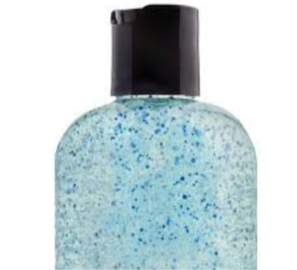
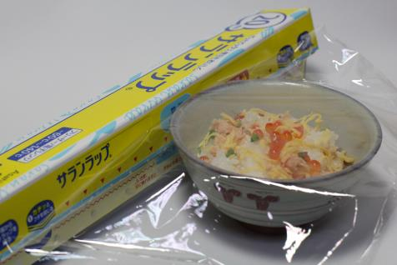
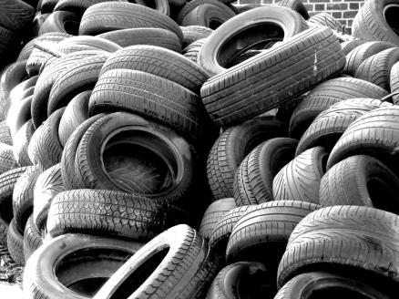
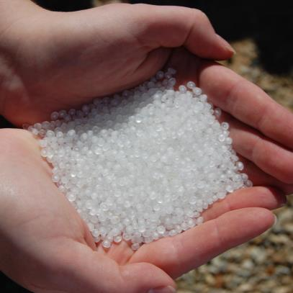
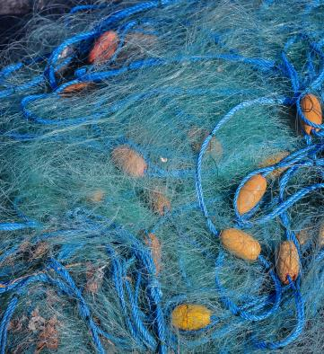
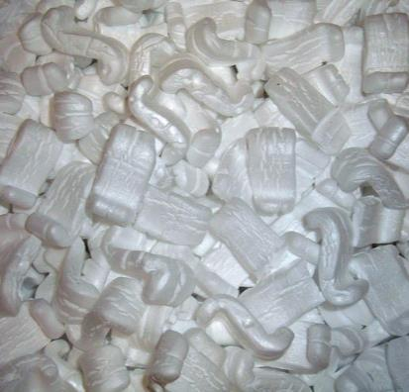
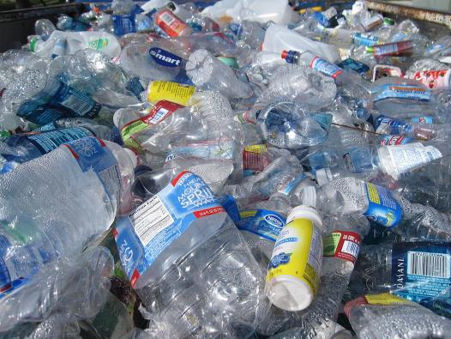
What makes the microplastics?
Use the examples below to help you answer question number 3 on your worksheet
PRIMARY MICROPLASTICS
SECONDARY MICROPLASTICS
MICROBEAD
PLASTIC FILM
RUBBER
Photo Credit: Wikimedia Commons (https://tr.m.wiki
pedia.org/wiki/Dosya:Saran_Wrap_02.JPG)
Photo Credit: Wikimedia Commons (https://www.flickr.com
/photos/71776010@N04/648402375)
Photo Credit: Minnesota Pollution Control Agency
Plastic beads in face washes, toothpaste, etc.
Plastic wrap, zip locks & food packaging
Tires, shoes, gloves.
NURDLES
NYLON THREAD
POLYSTYRENE
POLYPROPYLENE
Photo Credit: Wikimedia Commons (https://commons.wiki
media.org/wiki/File:Nurdles_01_gentlemanrook.jpg)
Photo Credit: Wikimedia Commons (https://com
mons.wikimedia.org/wiki/File:1-DSC_0001_(18).jpg)
Photo Credit: Wikimedia Commons (https://commons.wiki
media.org/wiki/File:Styrofoam_peanuts.JPG)
Photo Credit: Wikimedia Commons (https://commons.wikimedia.org/wiki/
File:Recyclables.JPG)
Plastic beads made by plastic manufacturers
Foam food containers, cups and packaging
A LOT of stuff! Plastic bottles, food wrappers, phone cases...
Fishing Nets & Clothes
Notes:
Talking points/script: This slide is to help them with question 3. Here, they can see examples of what types of materials lead to their microplastics. There are two primary microplastics, and five secondary microplastics. Review that definition with them. After this, you will point out to them that some of these plastics are “single-use”, or intended to be thrown away after one or a few uses. This includes plastic film, polystyrene, polyethylene and microbeads, which is discussed in greater detail on the next slide.
Microbeads: Free for non-commercial reuse from Minnesota pollution control agency (https://www.flickr.com/photos/mpcaphotos/22304478353)
Nurdles: available for reuse via wikicommons (https://commons.wikimedia.org/wiki/File:Nurdles_01_gentlemanrook.jpg)
Plastic Film: Wikicommons (https://tr.m.wikipedia.org/wiki/Dosya:Saran_Wrap_02.JPG)
Rubber: Labeled for re-use (https://www.flickr.com/photos/71776010@N04/648402375)
Nylon: Wikimedia Commons (https://commons.wikimedia.org/wiki/File:1-DSC_0001_(18).jpg)
Polystyrene: Wikimedia commons (https://commons.wikimedia.org/wiki/File:Styrofoam_peanuts.JPG)
Polypropylene: Wikimedia Commons (https://commons.wikimedia.org/wiki/File:Recyclables.JPG)

Slide 12
THINK ABOUT THE PROBLEM...
Did you notice that most of your debris came from SINGLE-USE PLASTICS!?
Single-use plastics are plastics that are only used one time, and then thrown away. Some examples include:
Straws
Food containers
To-go cups
What other examples can you think of?
How can you help the issue of plastic pollution by monitoring your use of single-use plastic?
Photo Credit: NOAA Photo Library
Notes:
Talking points/script: If you have not already covered single-use plastics, define them here (or review if you’ve already talked to them). If you’re going to do the challenge activity, or assign it as homework, it should be introduced here. Remind them that just because they don’t litter their plastic doesn’t mean that it won’t end up as litter, if the trash is blown away, goes down a sewer line, etc.

Slide 13
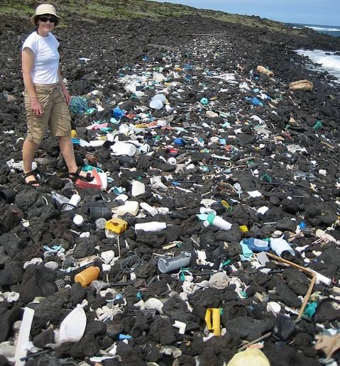
CAREERS STUDYING
MARINE POLLUTION
You could study marine debris as your job!
To do this, you could become:
Marine biologist, studying the effects on marine animals
Oceanographer, traveling on boats to track marine debris
A chemist, learning how chemicals from marine debris affect the environment
A educator, teaching people about the marine debris problem and what they could do to help
The path to one of these careers includes working hard in school, and going to college & graduate school after college. But, these careers are fun, and good for the planet!
Photo Credit: NOAA Photo Library
Photo Credit: NOAA Photo Library
Notes:
Talking points/script: This slide will help students see that there are a lot of jobs that study marine pollution. These can be traditional scientist roles (including biologists, physicists, chemists) but also educators, like you, who teach about marine debris!
***Image labeled for reuse by NOAA Photo Library (https://www.photolib.noaa.gov/) (https://www.flickr.com/photos/51647007@N08/5277298403/)

