Slide 1
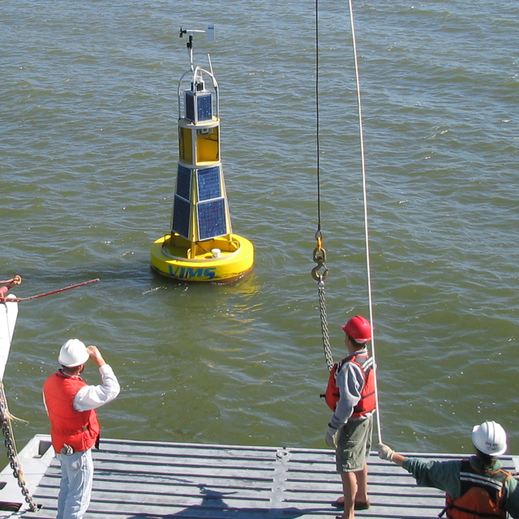

Virginia Institute of Marine Science
Three-part mission
  Research
  Education
  Advisory Service
Science for the Bay—
Impact for the World
  Fisheries
  Aquaculture
  Ecosystem Restoration
  Water Quality
  Shoreline Studies
Notes:
Brand Drivers
To ensure that messages created by VIMS support the Brand Positioning Statement, three brand drivers have been identified that should serve as the recurring themes in Institutional communications.
Marine Science
The Virginia Institute of Marine Science (VIMS) is a world-class center of coastal and estuarine research and expertise that is on the cutting edge of scientific discovery.
Our research identifies the challenges facing marine ecosystems, suggests effective responses to these challenges, and monitors the status of natural and restored ecosystems .
Impact
From the foods we eat to the watersheds we enjoy, research conducted by VIMS directly benefits the quality of life in the Commonwealth and the world.
VIMS research and expertise helps shape environmental and economic policy decisions at all levels of government.
VIMS research has direct application for marine-related businesses, environmental organizations, and the recreational fishing community.
Education
The School of Marine Science at VIMS, part of The College of William and Mary, prepares graduate students for leadership roles in marine science.
VIMS alumni are internationally recognized leaders in science and policy development, holding senior positions in government, business, and academia.
VIMS delivers educational programs for teachers, schoolchildren, local and state resource managers, and the general public through on-site programs and partnerships with schools.

Slide 2
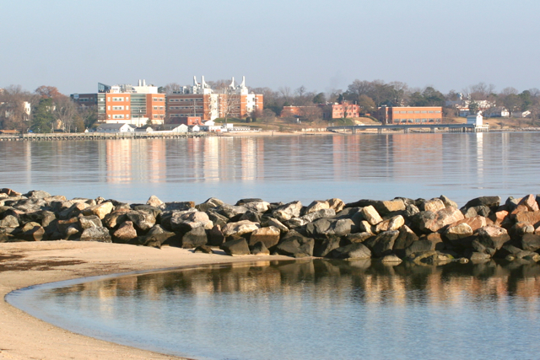
Virginia Institute of Marine Science
Three-Part Mission
  Research
  Education
  Advisory Service
Inform Management
  Fisheries
  Aquaculture
  Water Quality
  Shoreline Studies
  Ecosystem Restoration
Notes:
Brand Drivers
To ensure that messages created by VIMS support the Brand Positioning Statement, three brand drivers have been identified that should serve as the recurring themes in Institutional communications.
Marine Science
The Virginia Institute of Marine Science (VIMS) is a world-class center of coastal and estuarine research and expertise that is on the cutting edge of scientific discovery.
Our research identifies the challenges facing marine ecosystems, suggests effective responses to these challenges, and monitors the status of natural and restored ecosystems .
Impact
From the foods we eat to the watersheds we enjoy, research conducted by VIMS directly benefits the quality of life in the Commonwealth and the world.
VIMS research and expertise helps shape environmental and economic policy decisions at all levels of government.
VIMS research has direct application for marine-related businesses, environmental organizations, and the recreational fishing community.
Education
The School of Marine Science at VIMS, part of The College of William and Mary, prepares graduate students for leadership roles in marine science.
VIMS alumni are internationally recognized leaders in science and policy development, holding senior positions in government, business, and academia.
VIMS delivers educational programs for teachers, schoolchildren, local and state resource managers, and the general public through on-site programs and partnerships with schools.

Slide 3
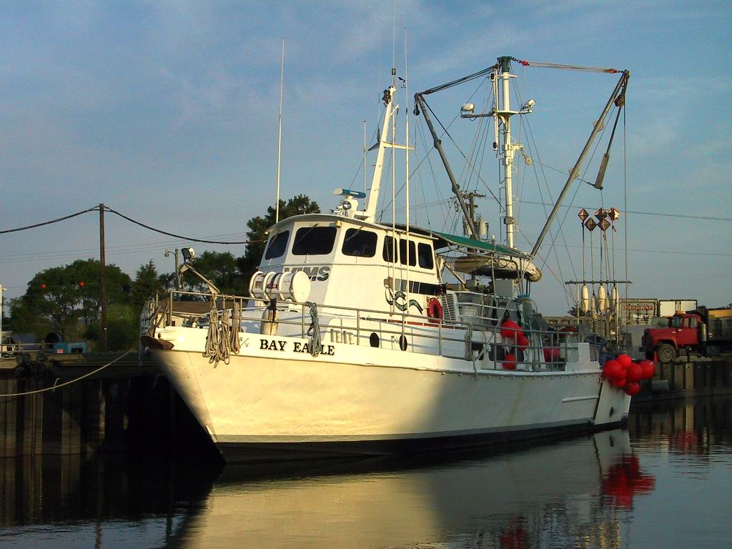
Virginia Institute of Marine Science
Three-part mission
  Research
  Education
  Advisory Service
Sound science for
Chesapeake Bay
  Fisheries
  Aquaculture
  Water Quality
  Shoreline Studies
  Ecosystem Restoration
Notes:
Brand Drivers
To ensure that messages created by VIMS support the Brand Positioning Statement, three brand drivers have been identified that should serve as the recurring themes in Institutional communications.
Marine Science
The Virginia Institute of Marine Science (VIMS) is a world-class center of coastal and estuarine research and expertise that is on the cutting edge of scientific discovery.
Our research identifies the challenges facing marine ecosystems, suggests effective responses to these challenges, and monitors the status of natural and restored ecosystems .
Impact
From the foods we eat to the watersheds we enjoy, research conducted by VIMS directly benefits the quality of life in the Commonwealth and the world.
VIMS research and expertise helps shape environmental and economic policy decisions at all levels of government.
VIMS research has direct application for marine-related businesses, environmental organizations, and the recreational fishing community.
Education
The School of Marine Science at VIMS, part of The College of William and Mary, prepares graduate students for leadership roles in marine science.
VIMS alumni are internationally recognized leaders in science and policy development, holding senior positions in government, business, and academia.
VIMS delivers educational programs for teachers, schoolchildren, local and state resource managers, and the general public through on-site programs and partnerships with schools.

Slide 4
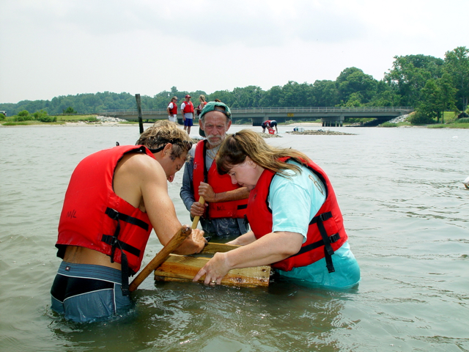
Virginia Institute of Marine Science
Three-part mission
  Research
  Education
  Advisory Service
Sound science for
Chesapeake Bay
  Fisheries
  Aquaculture
  Water Quality
  Shoreline Studies
  Ecosystem Restoration
Notes:
Brand Drivers
To ensure that messages created by VIMS support the Brand Positioning Statement, three brand drivers have been identified that should serve as the recurring themes in Institutional communications.
Marine Science
The Virginia Institute of Marine Science (VIMS) is a world-class center of coastal and estuarine research and expertise that is on the cutting edge of scientific discovery.
Our research identifies the challenges facing marine ecosystems, suggests effective responses to these challenges, and monitors the status of natural and restored ecosystems .
Impact
From the foods we eat to the watersheds we enjoy, research conducted by VIMS directly benefits the quality of life in the Commonwealth and the world.
VIMS research and expertise helps shape environmental and economic policy decisions at all levels of government.
VIMS research has direct application for marine-related businesses, environmental organizations, and the recreational fishing community.
Education
The School of Marine Science at VIMS, part of The College of William and Mary, prepares graduate students for leadership roles in marine science.
VIMS alumni are internationally recognized leaders in science and policy development, holding senior positions in government, business, and academia.
VIMS delivers educational programs for teachers, schoolchildren, local and state resource managers, and the general public through on-site programs and partnerships with schools.

Slide 5
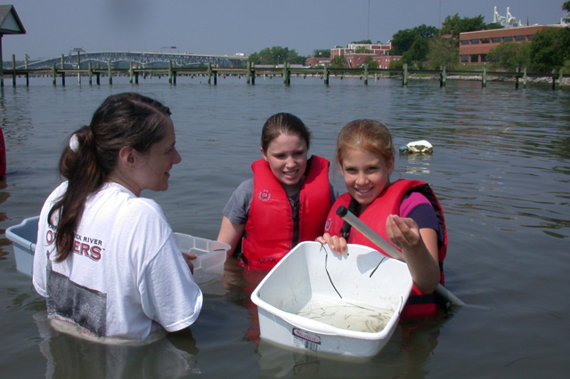
Virginia Institute of Marine Science
Three-part mission
  Research
  Education
  Advisory Service
Sound science for
Chesapeake Bay
  Fisheries
  Aquaculture
  Water Quality
  Shoreline Studies
  Ecosystem Restoration
Notes:
Brand Drivers
To ensure that messages created by VIMS support the Brand Positioning Statement, three brand drivers have been identified that should serve as the recurring themes in Institutional communications.
Marine Science
The Virginia Institute of Marine Science (VIMS) is a world-class center of coastal and estuarine research and expertise that is on the cutting edge of scientific discovery.
Our research identifies the challenges facing marine ecosystems, suggests effective responses to these challenges, and monitors the status of natural and restored ecosystems .
Impact
From the foods we eat to the watersheds we enjoy, research conducted by VIMS directly benefits the quality of life in the Commonwealth and the world.
VIMS research and expertise helps shape environmental and economic policy decisions at all levels of government.
VIMS research has direct application for marine-related businesses, environmental organizations, and the recreational fishing community.
Education
The School of Marine Science at VIMS, part of The College of William and Mary, prepares graduate students for leadership roles in marine science.
VIMS alumni are internationally recognized leaders in science and policy development, holding senior positions in government, business, and academia.
VIMS delivers educational programs for teachers, schoolchildren, local and state resource managers, and the general public through on-site programs and partnerships with schools.

Slide 6
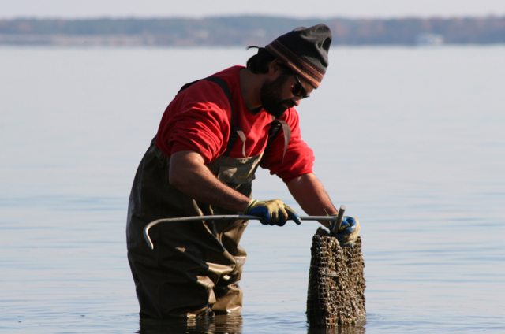
Virginia Institute of Marine Science
Three-part mission
  Research
  Education
  Advisory Service
Science for the Bay—
Impact for the World
  Fisheries
  Aquaculture
  Ecosystem Restoration
  Water Quality
  Shoreline Studies
Notes:
Brand Drivers
To ensure that messages created by VIMS support the Brand Positioning Statement, three brand drivers have been identified that should serve as the recurring themes in Institutional communications.
Marine Science
The Virginia Institute of Marine Science (VIMS) is a world-class center of coastal and estuarine research and expertise that is on the cutting edge of scientific discovery.
Our research identifies the challenges facing marine ecosystems, suggests effective responses to these challenges, and monitors the status of natural and restored ecosystems .
Impact
From the foods we eat to the watersheds we enjoy, research conducted by VIMS directly benefits the quality of life in the Commonwealth and the world.
VIMS research and expertise helps shape environmental and economic policy decisions at all levels of government.
VIMS research has direct application for marine-related businesses, environmental organizations, and the recreational fishing community.
Education
The School of Marine Science at VIMS, part of The College of William and Mary, prepares graduate students for leadership roles in marine science.
VIMS alumni are internationally recognized leaders in science and policy development, holding senior positions in government, business, and academia.
VIMS delivers educational programs for teachers, schoolchildren, local and state resource managers, and the general public through on-site programs and partnerships with schools.

Slide 7
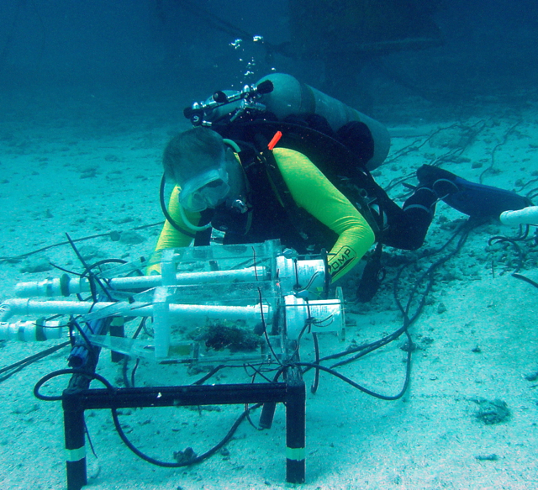
Virginia Institute of Marine Science
Three-part mission
  Research
  Education
  Advisory Service
Science for the Bay—
Impact for the World
  Fisheries
  Aquaculture
  Ecosystem Restoration
  Water Quality
  Shoreline Studies
Notes:
Brand Drivers
To ensure that messages created by VIMS support the Brand Positioning Statement, three brand drivers have been identified that should serve as the recurring themes in Institutional communications.
Marine Science
The Virginia Institute of Marine Science (VIMS) is a world-class center of coastal and estuarine research and expertise that is on the cutting edge of scientific discovery.
Our research identifies the challenges facing marine ecosystems, suggests effective responses to these challenges, and monitors the status of natural and restored ecosystems .
Impact
From the foods we eat to the watersheds we enjoy, research conducted by VIMS directly benefits the quality of life in the Commonwealth and the world.
VIMS research and expertise helps shape environmental and economic policy decisions at all levels of government.
VIMS research has direct application for marine-related businesses, environmental organizations, and the recreational fishing community.
Education
The School of Marine Science at VIMS, part of The College of William and Mary, prepares graduate students for leadership roles in marine science.
VIMS alumni are internationally recognized leaders in science and policy development, holding senior positions in government, business, and academia.
VIMS delivers educational programs for teachers, schoolchildren, local and state resource managers, and the general public through on-site programs and partnerships with schools.

Slide 8
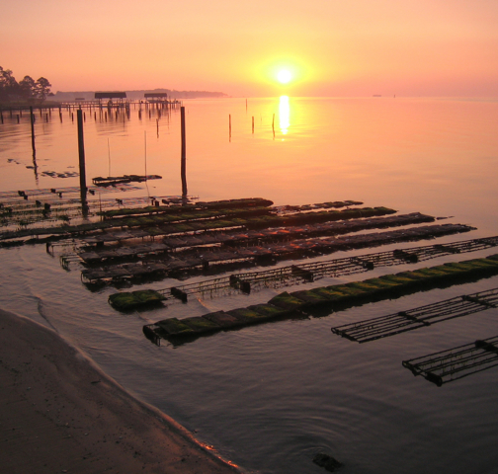
Virginia Institute of Marine Science
Three-part mission
  Research
  Education
  Advisory Service
Science for the Bay—
Impact for the World
  Fisheries
  Aquaculture
  Ecosystem Restoration
  Water Quality
  Shoreline Studies
Notes:
Brand Drivers
To ensure that messages created by VIMS support the Brand Positioning Statement, three brand drivers have been identified that should serve as the recurring themes in Institutional communications.
Marine Science
The Virginia Institute of Marine Science (VIMS) is a world-class center of coastal and estuarine research and expertise that is on the cutting edge of scientific discovery.
Our research identifies the challenges facing marine ecosystems, suggests effective responses to these challenges, and monitors the status of natural and restored ecosystems .
Impact
From the foods we eat to the watersheds we enjoy, research conducted by VIMS directly benefits the quality of life in the Commonwealth and the world.
VIMS research and expertise helps shape environmental and economic policy decisions at all levels of government.
VIMS research has direct application for marine-related businesses, environmental organizations, and the recreational fishing community.
Education
The School of Marine Science at VIMS, part of The College of William and Mary, prepares graduate students for leadership roles in marine science.
VIMS alumni are internationally recognized leaders in science and policy development, holding senior positions in government, business, and academia.
VIMS delivers educational programs for teachers, schoolchildren, local and state resource managers, and the general public through on-site programs and partnerships with schools.

Slide 9
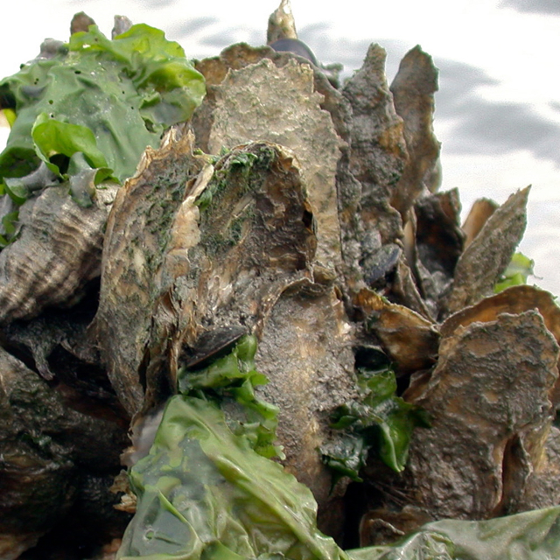
Virginia Institute of Marine Science
Three-part mission
  Research
  Education
  Advisory Service
Science for the Bay—
Impact for the World
  Fisheries
  Aquaculture
  Ecosystem Restoration
  Water Quality
  Shoreline Studies
Notes:
Brand Drivers
To ensure that messages created by VIMS support the Brand Positioning Statement, three brand drivers have been identified that should serve as the recurring themes in Institutional communications.
Marine Science
The Virginia Institute of Marine Science (VIMS) is a world-class center of coastal and estuarine research and expertise that is on the cutting edge of scientific discovery.
Our research identifies the challenges facing marine ecosystems, suggests effective responses to these challenges, and monitors the status of natural and restored ecosystems .
Impact
From the foods we eat to the watersheds we enjoy, research conducted by VIMS directly benefits the quality of life in the Commonwealth and the world.
VIMS research and expertise helps shape environmental and economic policy decisions at all levels of government.
VIMS research has direct application for marine-related businesses, environmental organizations, and the recreational fishing community.
Education
The School of Marine Science at VIMS, part of The College of William and Mary, prepares graduate students for leadership roles in marine science.
VIMS alumni are internationally recognized leaders in science and policy development, holding senior positions in government, business, and academia.
VIMS delivers educational programs for teachers, schoolchildren, local and state resource managers, and the general public through on-site programs and partnerships with schools.

Slide 10
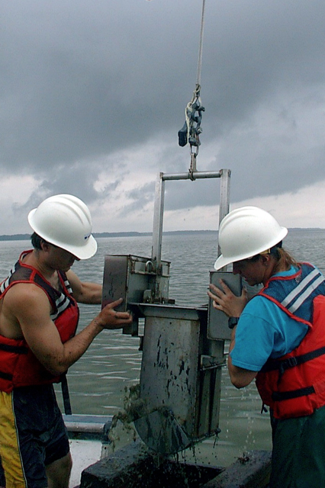
Virginia Institute of Marine Science
Three-part mission
  Research
  Education
  Advisory Service
Science for the Bay—
Impact for the World
  Fisheries
  Aquaculture
  Ecosystem Restoration
  Water Quality
  Shoreline Studies
Notes:
Brand Drivers
To ensure that messages created by VIMS support the Brand Positioning Statement, three brand drivers have been identified that should serve as the recurring themes in Institutional communications.
Marine Science
The Virginia Institute of Marine Science (VIMS) is a world-class center of coastal and estuarine research and expertise that is on the cutting edge of scientific discovery.
Our research identifies the challenges facing marine ecosystems, suggests effective responses to these challenges, and monitors the status of natural and restored ecosystems .
Impact
From the foods we eat to the watersheds we enjoy, research conducted by VIMS directly benefits the quality of life in the Commonwealth and the world.
VIMS research and expertise helps shape environmental and economic policy decisions at all levels of government.
VIMS research has direct application for marine-related businesses, environmental organizations, and the recreational fishing community.
Education
The School of Marine Science at VIMS, part of The College of William and Mary, prepares graduate students for leadership roles in marine science.
VIMS alumni are internationally recognized leaders in science and policy development, holding senior positions in government, business, and academia.
VIMS delivers educational programs for teachers, schoolchildren, local and state resource managers, and the general public through on-site programs and partnerships with schools.

Slide 11
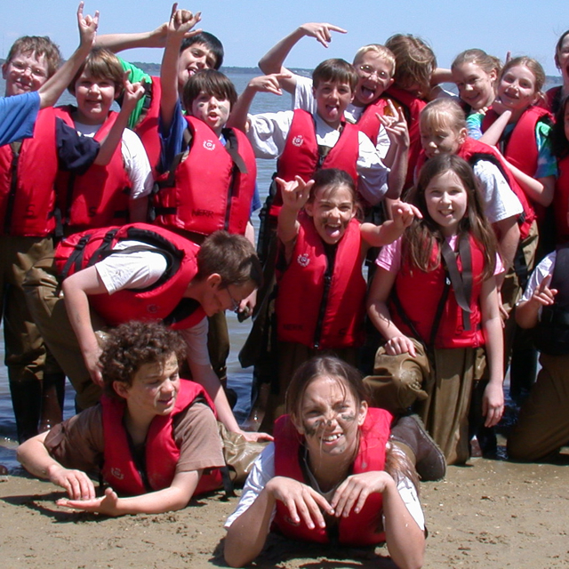
Virginia Institute of Marine Science
Three-part mission
  Research
  Education
  Advisory Service
Science for the Bay—
Impact for the World
  Fisheries
  Aquaculture
  Ecosystem Restoration
  Water Quality
  Shoreline Studies
Notes:
Brand Drivers
To ensure that messages created by VIMS support the Brand Positioning Statement, three brand drivers have been identified that should serve as the recurring themes in Institutional communications.
Marine Science
The Virginia Institute of Marine Science (VIMS) is a world-class center of coastal and estuarine research and expertise that is on the cutting edge of scientific discovery.
Our research identifies the challenges facing marine ecosystems, suggests effective responses to these challenges, and monitors the status of natural and restored ecosystems .
Impact
From the foods we eat to the watersheds we enjoy, research conducted by VIMS directly benefits the quality of life in the Commonwealth and the world.
VIMS research and expertise helps shape environmental and economic policy decisions at all levels of government.
VIMS research has direct application for marine-related businesses, environmental organizations, and the recreational fishing community.
Education
The School of Marine Science at VIMS, part of The College of William and Mary, prepares graduate students for leadership roles in marine science.
VIMS alumni are internationally recognized leaders in science and policy development, holding senior positions in government, business, and academia.
VIMS delivers educational programs for teachers, schoolchildren, local and state resource managers, and the general public through on-site programs and partnerships with schools.

Slide 12
Title of Presentation

