Slide 1
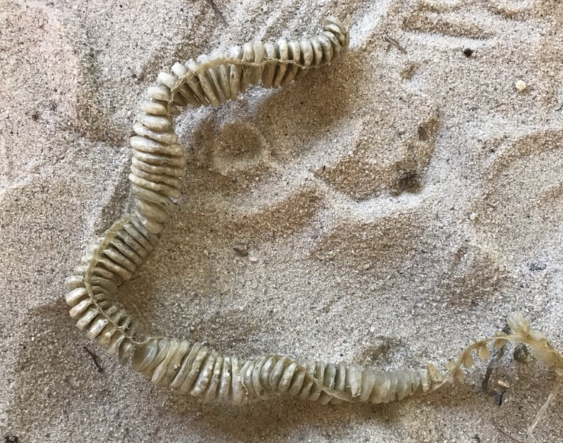
INVERTEBRATE OR NOT??

Slide 2
WHELK EGG CASES
YES! I belong to an invertebrate!
Whelks lay eggs like chickens

Slide 3
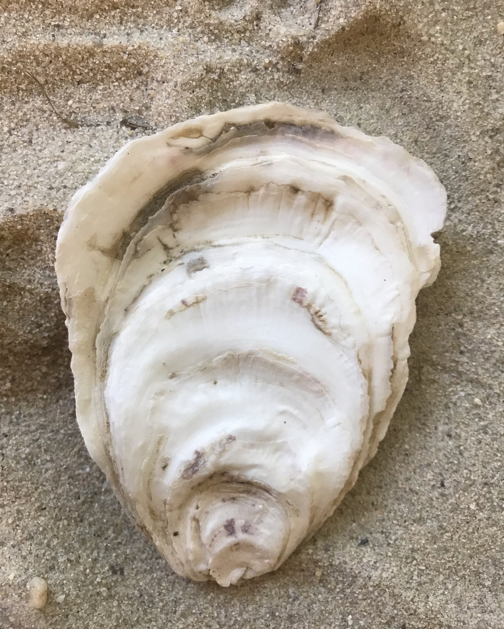
INVERTEBRATE OR NOT??

Slide 4
OYSTER SHELL
YES! I belong to an invertebrate!
This is only a half of an oyster. Oysters are bivalves and have two shells!

Slide 5
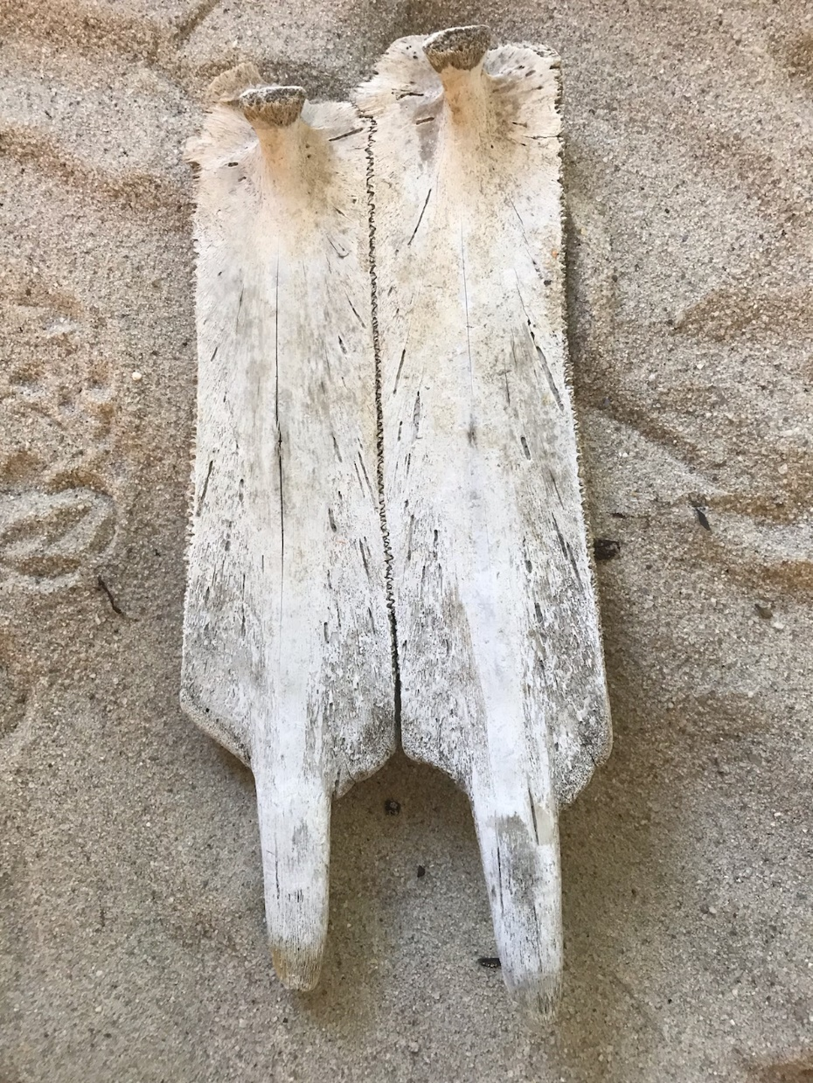
INVERTEBRATE OR NOT??

Slide 6
SEA TURTLE CARAPACE
NO! I belong to a vertebrate!
This is part of the turtle’s top shell and backbone. There are about 50 bones that make up the carapace.

Slide 7
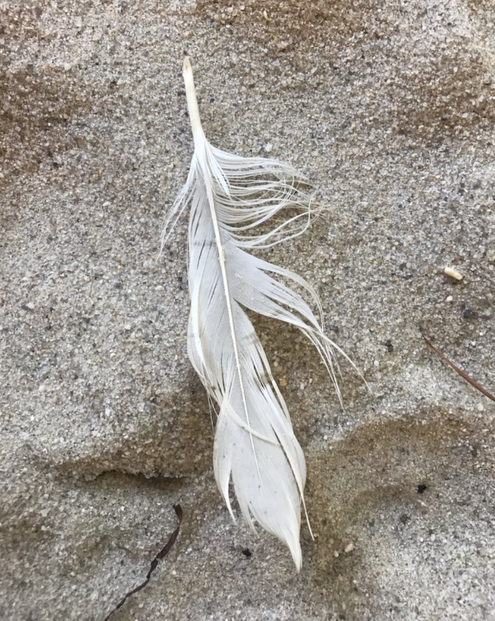
INVERTEBRATE OR NOT??

Slide 8
WHITE EGRET FEATHER
NO! I belong to a vertebrate!
There are two types of egrets in the Chesapeake Bay:
the great egret has black feet is larger than the snowy egret which has orange feet.

Slide 9
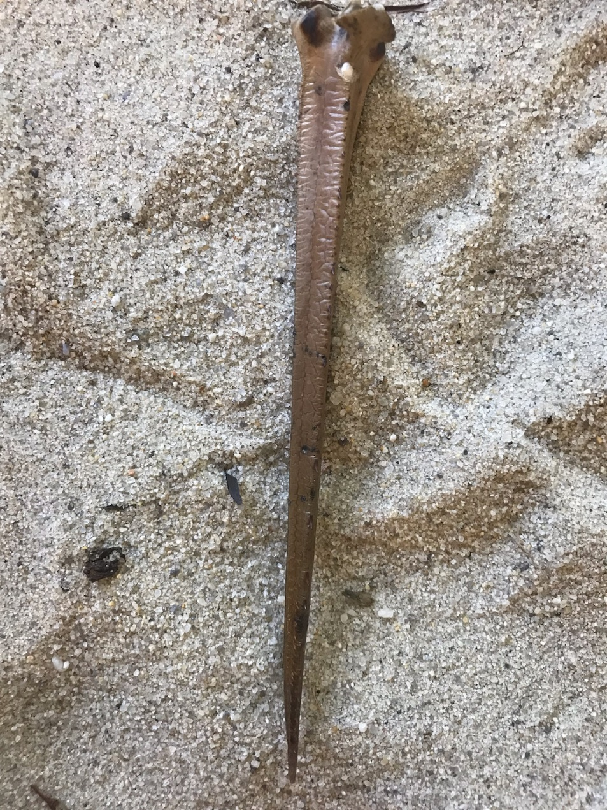
INVERTEBRATE OR NOT??

Slide 10
HORSESHOE CRAB TAIL
YES! I belong to an invertebrate!
Horseshoe crabs come to shore in the spring and summer to lay their eggs.

Slide 11
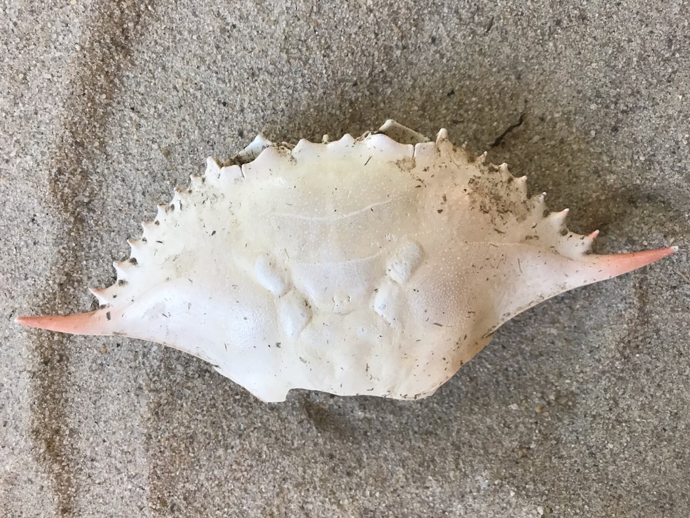
INVERTEBRATE OR NOT??

Slide 12
BLUE CRAB CARAPACE
YES! I belong to an invertebrate!
Blue crabs are a type of swimming crab.

Slide 13
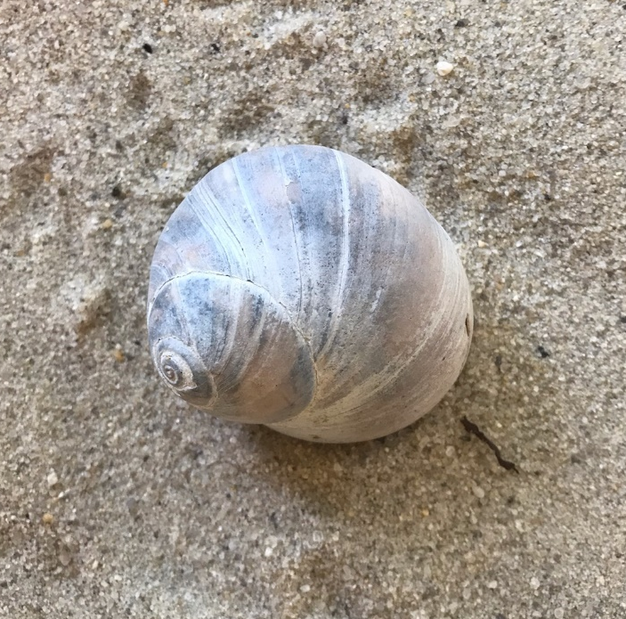
INVERTEBRATE OR NOT??

Slide 14
MOON SNAIL SHELL
YES! I belong to an invertebrate!
The animal that lives inside of the shell has a light purple color.

Slide 15
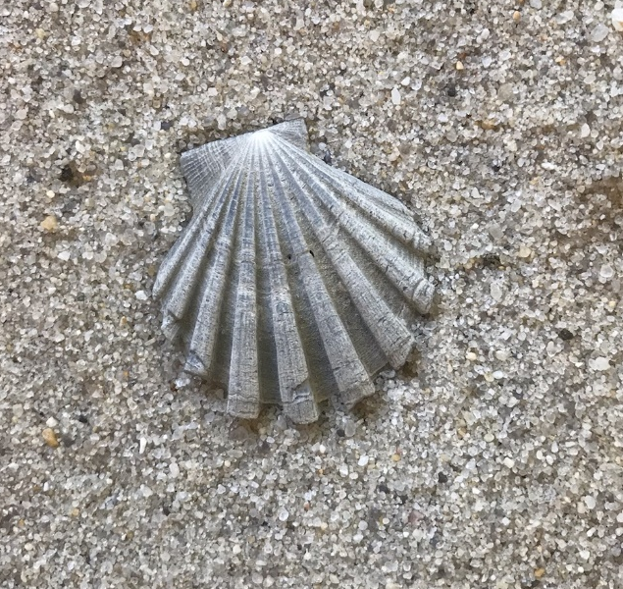
INVERTEBRATE OR NOT??

Slide 16
BAY SCALLOP
YES! I belong to an invertebrate!
Bay scallops can actually swim away from predators!

Slide 17
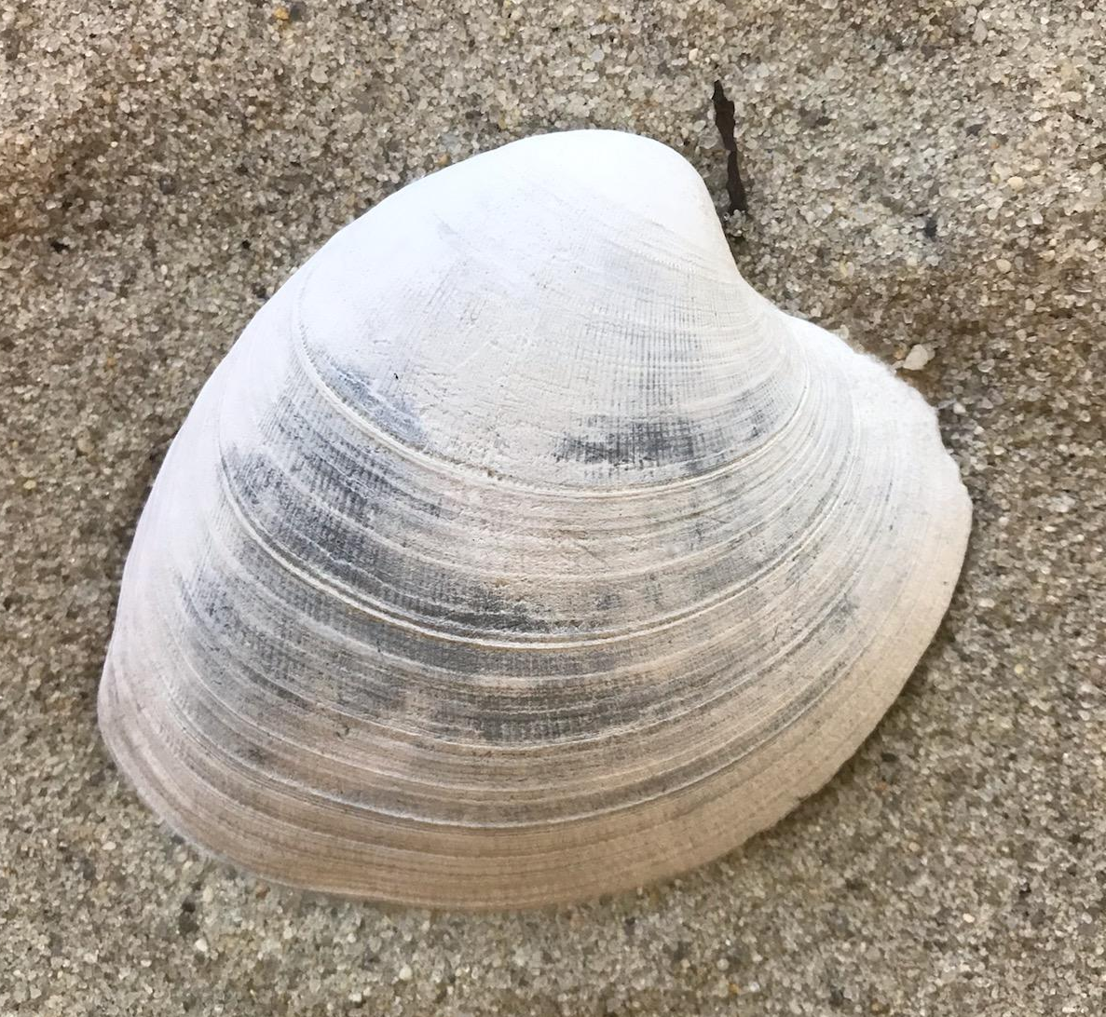
INVERTEBRATE OR NOT??

Slide 18
HARD CLAM
YES! I belong to an invertebrate!
Hard clams have different names dependent on their size cherries, casinos, chowders, and many more.

Slide 19
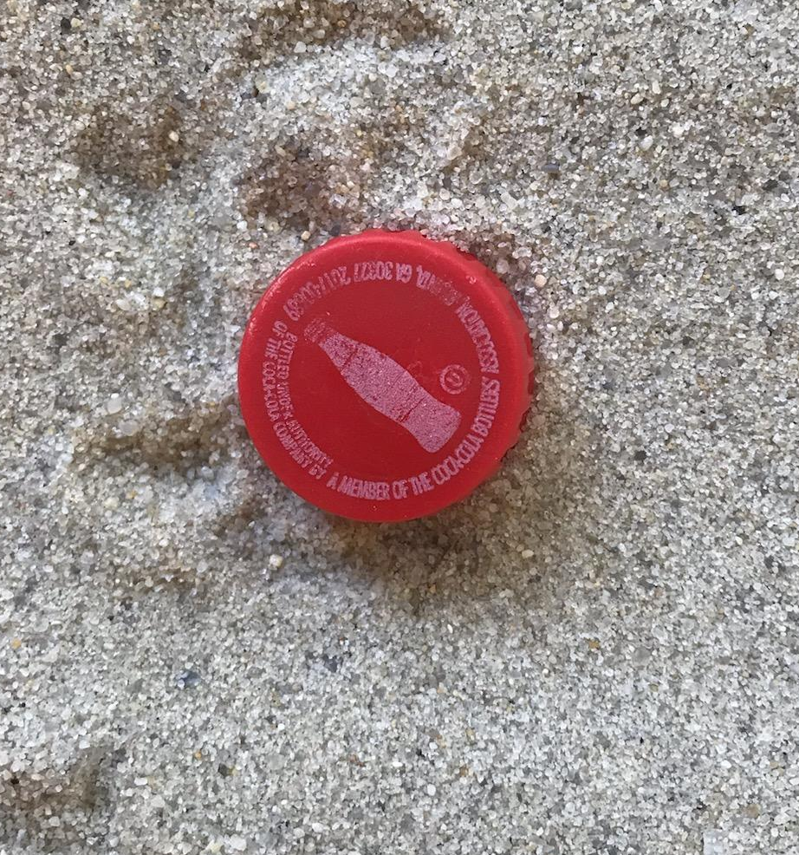
INVERTEBRATE OR NOT??

Slide 20
BOTTLE CAP
NO! I belong to a bottle!
Animals often mistake bottle caps for food.
PLEASE pick up any trash you find when you go to the beach!

Slide 21
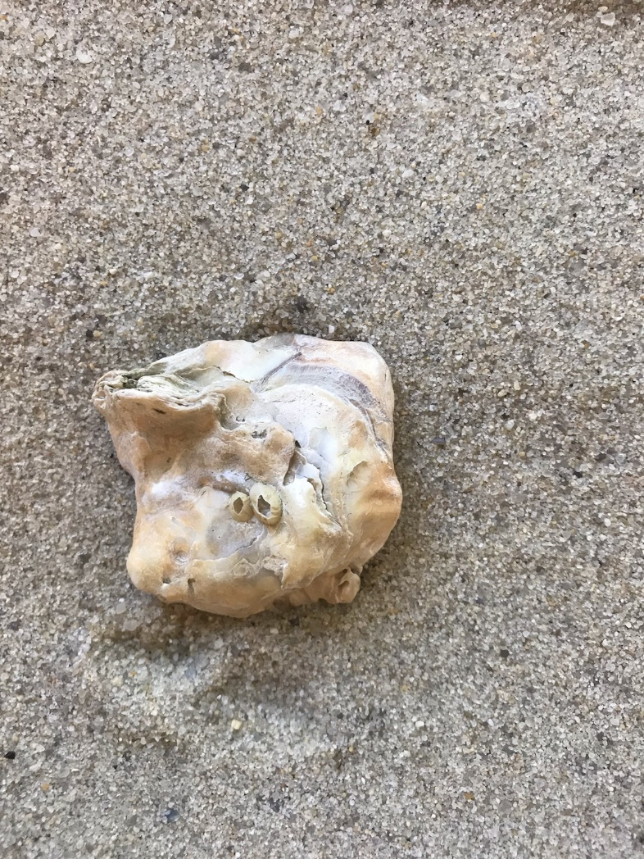
INVERTEBRATE OR NOT??

Slide 22
OYSTER SHELL PIECE
YES! I belong to an invertebrate!
Oyster shells break all the time from predators like cow nose stingrays and people!

Slide 23
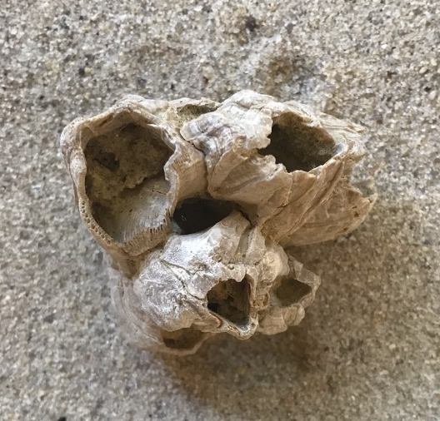
INVERTEBRATE OR NOT??

Slide 24
BARNACLE SHELL
YES! I belong to an invertebrate!
Even though barnacles have an outer shell they are classified as arthropods.

Slide 25
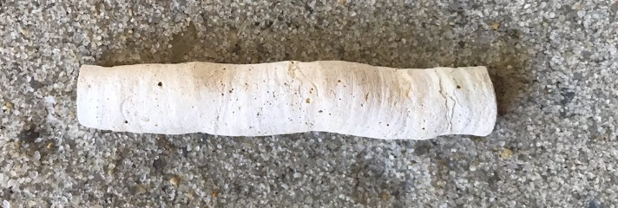
INVERTEBRATE OR NOT??

Slide 26
WORM TUBE
YES! I belong to an invertebrate!
Some worms create tubes to protect themselves.

Slide 27
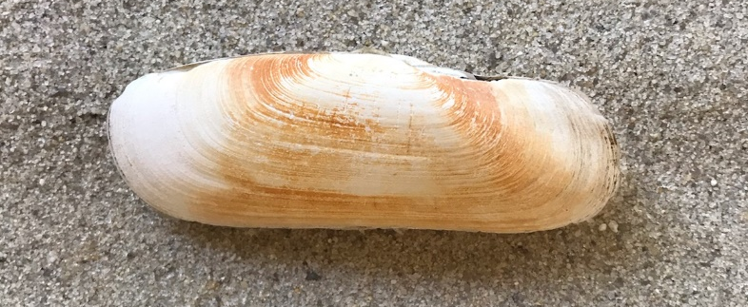
INVERTEBRATE OR NOT??

Slide 28
RAZOR CLAM
YES! I belong to an invertebrate!
Razor clams live in mud or sand.

Slide 29
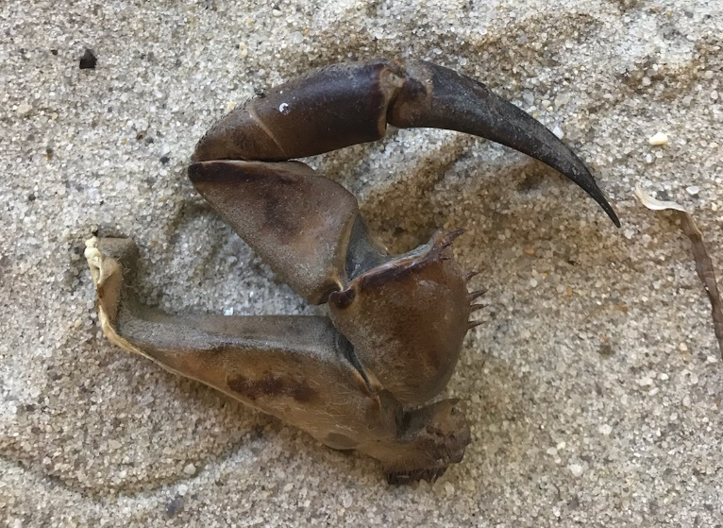
INVERTEBRATE OR NOT??

Slide 30
HORSESHOE CRAB CLAW
YES! I belong to an invertebrate!
Horseshoe crabs have their claws under their body.

Slide 31
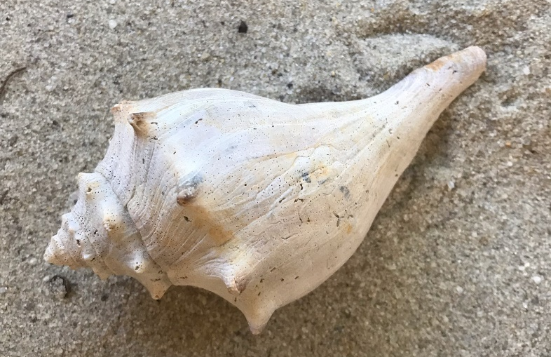
INVERTEBRATE OR NOT??

Slide 32
KNOBBED WHELK
YES! I belong to an invertebrate!
There are two types of whelks in the Chesapeake bay the knobbed whelk which has knobs along its shell and the channel whelk has a spiral shell.

Slide 33
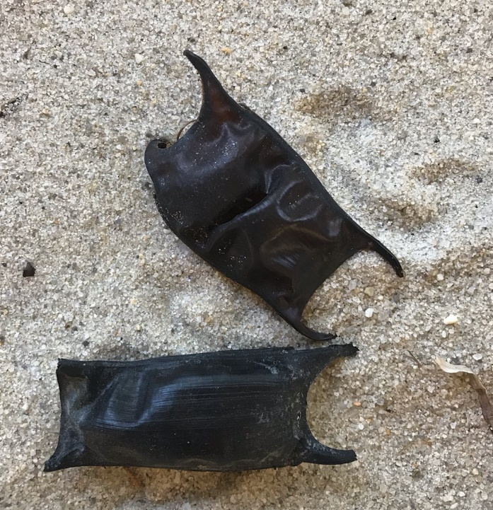
INVERTEBRATE OR NOT??

Slide 34
SKATE EGG CASINGS
NO! I belong to a vertebrate!
Skates lay their eggs and they wash up on the beach
after they hatch.

