Slide 1
Plastics
“Like diamonds, plastics are forever.”

Slide 2
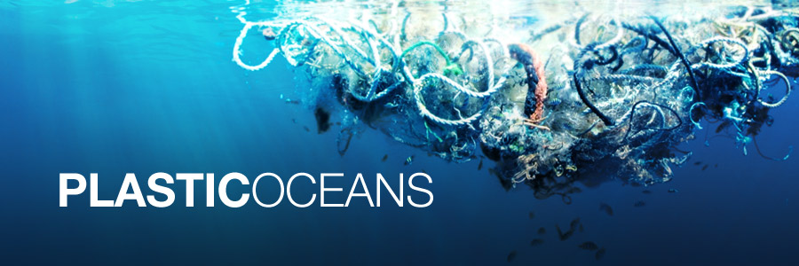
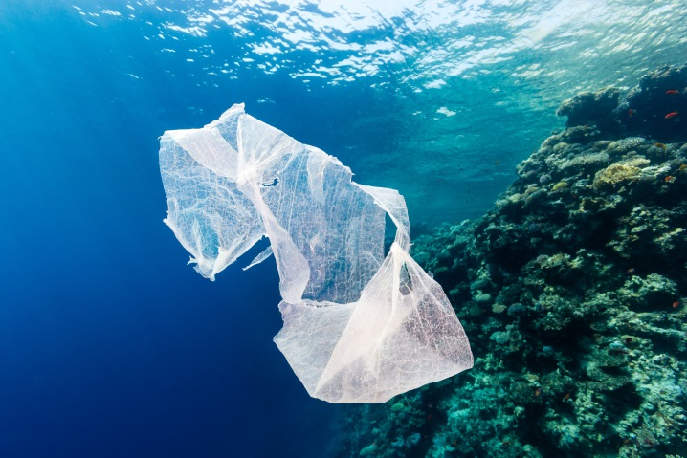
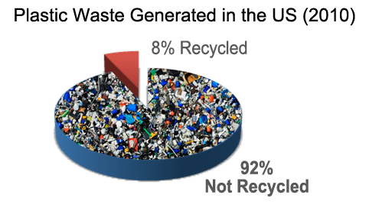
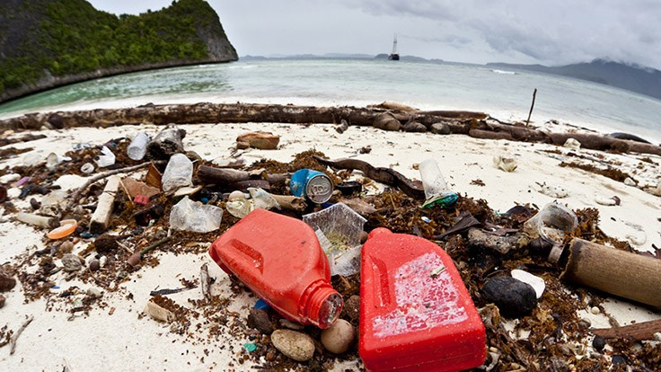
Notes:
Plastic Waste Problem
Photo sources:
http://www.plastic2oil.com/site/problem
http://blog.geogarage.com/2015/10/we-can-solve-ocean-plastic-problem.html
http://www.factorydirectpromos.com/blog/how-much-plastic-is-really-in-our-oceans
http://www.2luxury2.com/the-curse-of-the-plastic-plastic-lost-at-sea-is-an-environmental-and-potential-human-health-hazard/
http://www.seaturtlecamp.com/one-plastic-buffet-please/

Slide 3
Notes:
Note the plastic bottles since they will do an activity with these at the end.
Large plastics and other marine debris.
Picture source:
http://gradygreentips.blogspot.com/2014/12/putting-our-waste-into-perspective.html

Slide 4
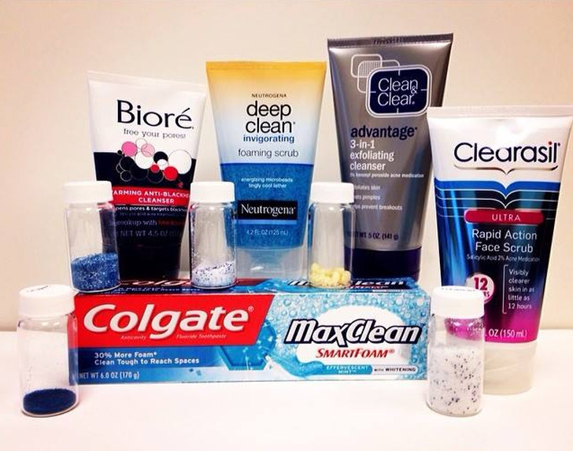
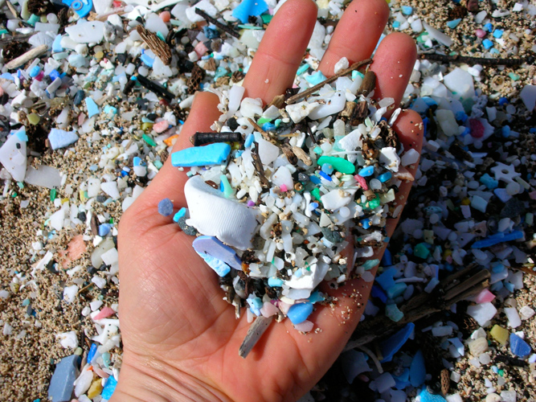
Microplastics
Very small plastic fragments (< 5mm)
Manufactured products (Primary) used in:
Facial cleansers and cosmetics – Microbeads
Banned in United States by 2018!
Pieces of plastic that have broken off larger plastic objects (Secondary)
*Primary
Notes:
What about microplastics??
Explain that much of the plastic in the ocean is small because it’s being broke down or starts out small.
Ask the students if they have seen these Primary products in their homes. Note the small jars filled with the beads.
Picture sources:
http://www.huffingtonpost.com/2011/10/26/plastic-ocean-pacific-conservation_n_1032897.html
http://theboatalley.com/instead-of-microbeads/

Slide 5
Notes:
Ask the students to tell what they know.

Slide 6
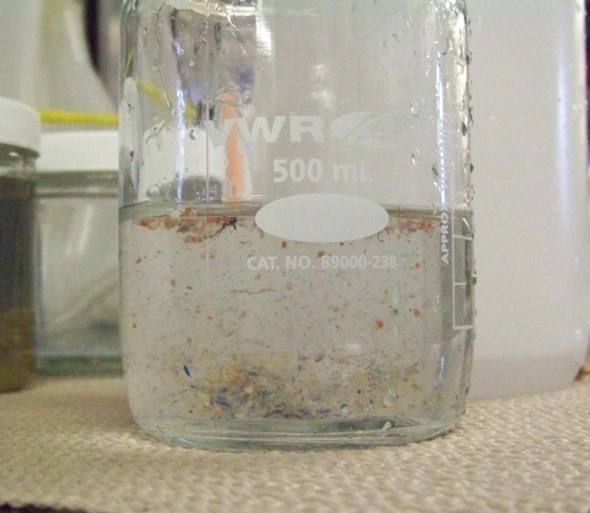
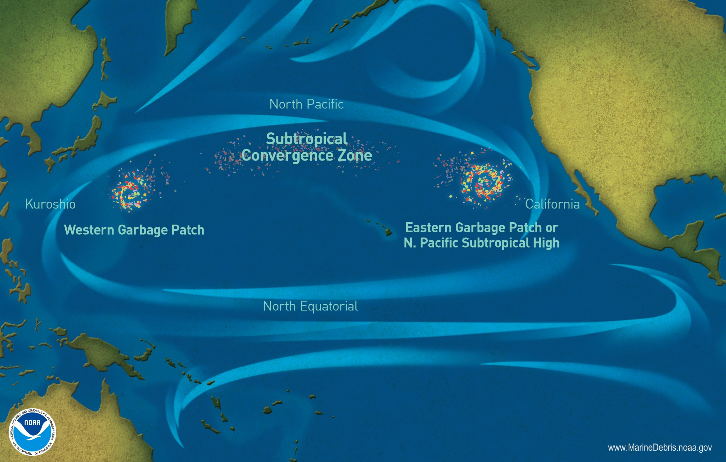
“Great Pacific Garbage Patch”
In the central North Pacific, plastic outweighs surface zooplankton 6 to 1!
Notes:
Explain gyres and how the movement of surface currents accumulates marine debris in the middle.
Point out colors in the jar – tiny plastic pieces! More abundant than tiny organisms!
Picture sources:
https://marinedebris.noaa.gov/movement/great-pacific-garbage-patch
http://discovermagazine.com/2008/jul/10-the-worlds-largest-dump

Slide 7
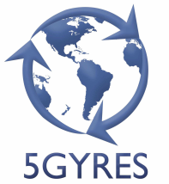
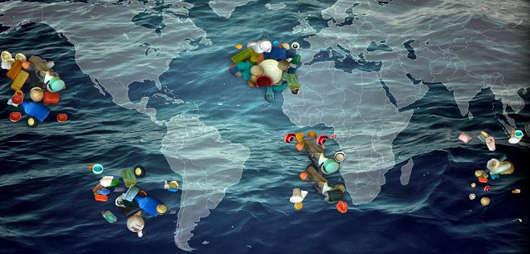
5 Gyres
http://worldminded.com/the-5-gyres-institute/
https://wastewatchers.wordpress.com/tag/5-gyres/
Plastic Pollution in the World's Oceans - 5 Gyres
Notes:
Plastic is not only in the Pacific – it’s in every ocean!
Can we watch the video to see how much plastic is in the oceans??? (link – only 3 min)
Picture Sources:
http://worldminded.com/the-5-gyres-institute/
https://wastewatchers.wordpress.com/tag/5-gyres/

Slide 8
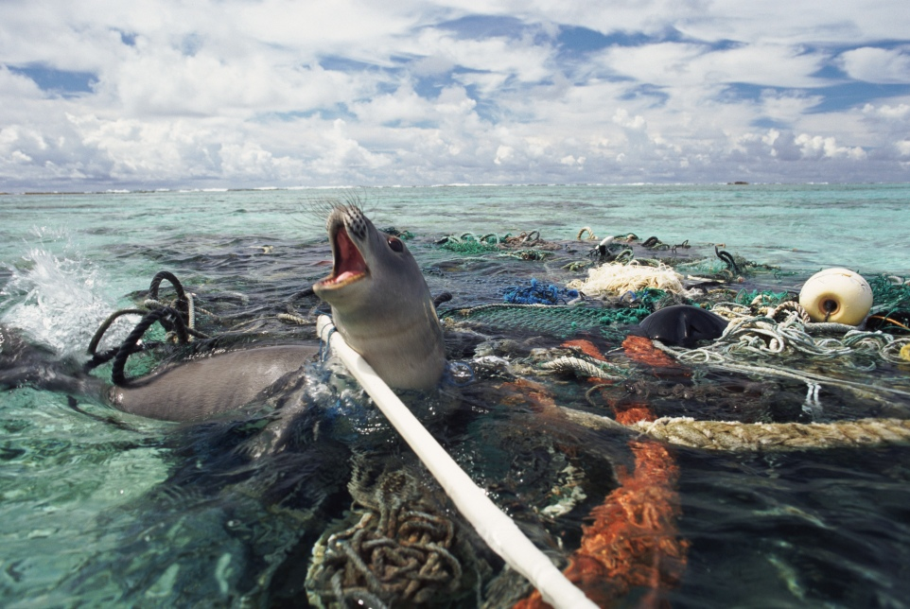
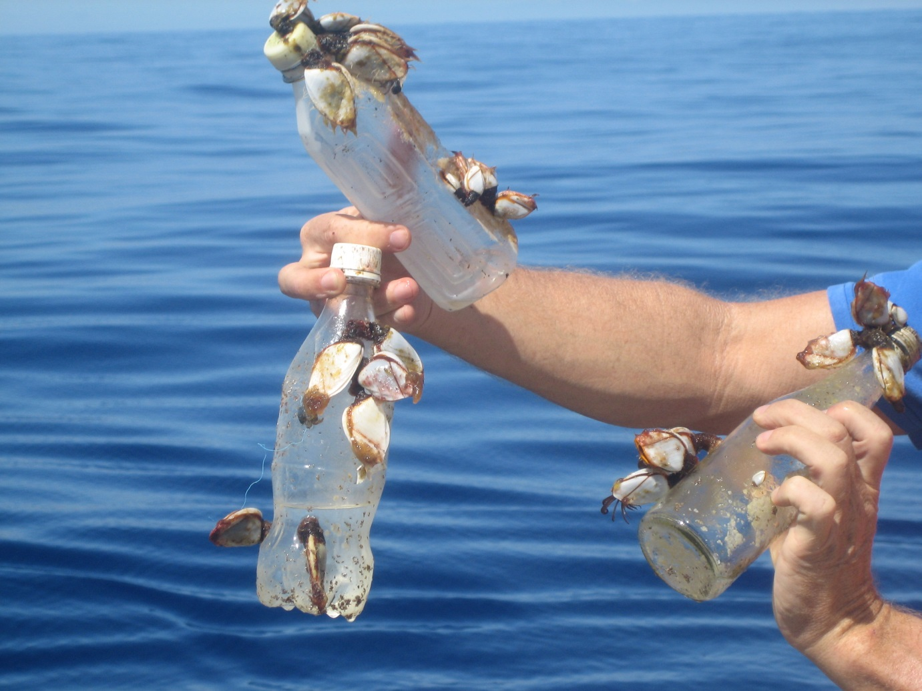
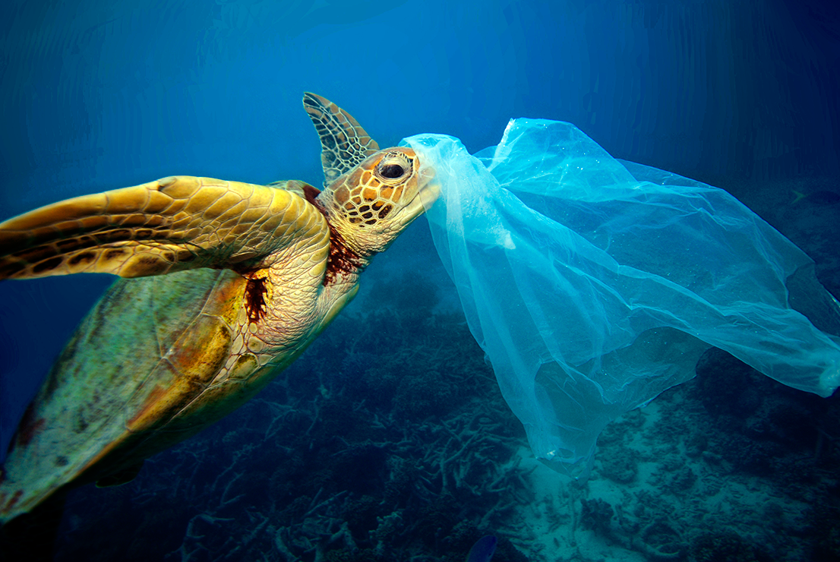
Why is plastic pollution a problem?
Aesthetic – Visual disturbances for people
Ingestion – marine animals mistake plastic for food
Entanglement – marine animals get tangled in debris
Transport – movement of non-native organisms
Notes:
Ask the students to brainstorm about why plastic is a problem.
Show them these reasons.
Picture Sources:
http://plasticos.se/skoldpaddor/
https://keinajooste.wordpress.com/2016/04/23/apocalypse-oblivion/
http://cce.lternet.edu/outreach/media-gallery/photos/72157637885940525

Slide 9
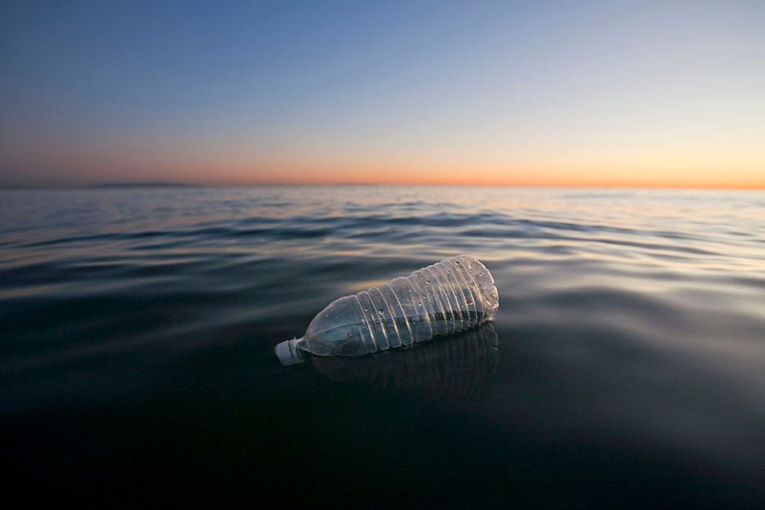
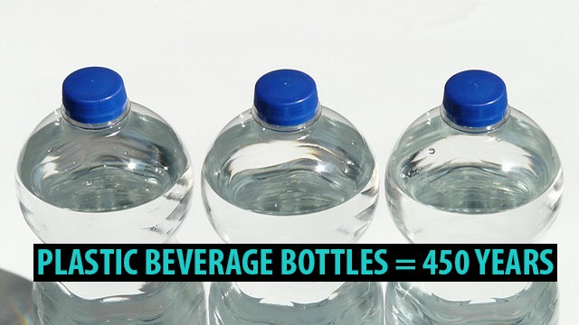
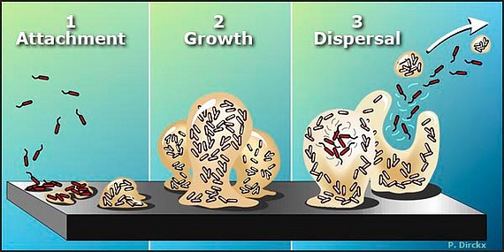
What about bacteria?
Bacteria live on many surfaces in biofilms
These biofilms create living conditions that protect bacteria from the environment
Bacteria are found living on plastic in the oceans – Plastic serves as a habitat!
Plastic is a long-lasting substrate that moves with ocean currents – Transport of bacteria!
Notes:
Explain biofilms and how they protect bacteria.
Relate bacteria and biofilms to plastics and transport.
Picture sources:
http://www.abc.net.au/news/2016-03-11/plastic-bottle-on-ocean/7237354
http://nexusacademicpublishers.com/table_contents_detail/2/393/html

Slide 10
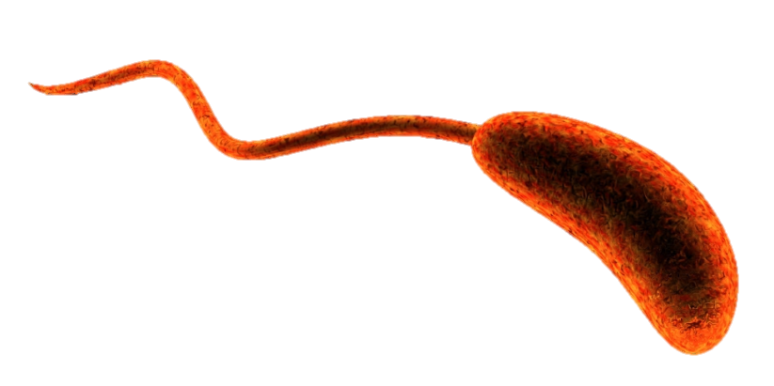
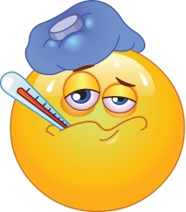
Vibrio
Kingdom: Bacteria
Rod shaped
Flagella
Motile
Can be pathogens, which can make you very sick!
They occur naturally in estuarine and marine waters worldwide
Temperature and salinity dependent
They love warm temperatures and high salinity!
Notes:
Explain that Vibrio are dangerous when pathogenic and how the transport or ingestion of these bacteria would be bad for humans and marine animals.
Explain what a pathogen is.
Picture Sources:
http://www.shutterstock.com/pic-49326607/stock-photo-d-rendered-vibrio-bacteria-on-black-background.html
http://2.bp.blogspot.com/-Z-QYD1N8Ewg/TyLTdAnXqvI/AAAAAAAAAZo/DkQjJ5H0XfU/s1600/Sick+pic.jpg

Slide 11
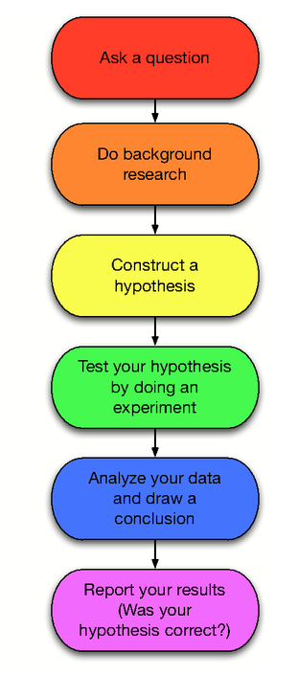
Scientific Method
We use the Scientific Method to investigate and acquire new knowledge!
Hypothesis – an idea or explanation that you test through study and experimentation

Slide 12
Our Hypothesis
If plastics remain in the marine environment for long periods of time, then plastics may be a vector for bacteria and human pathogens

Slide 13
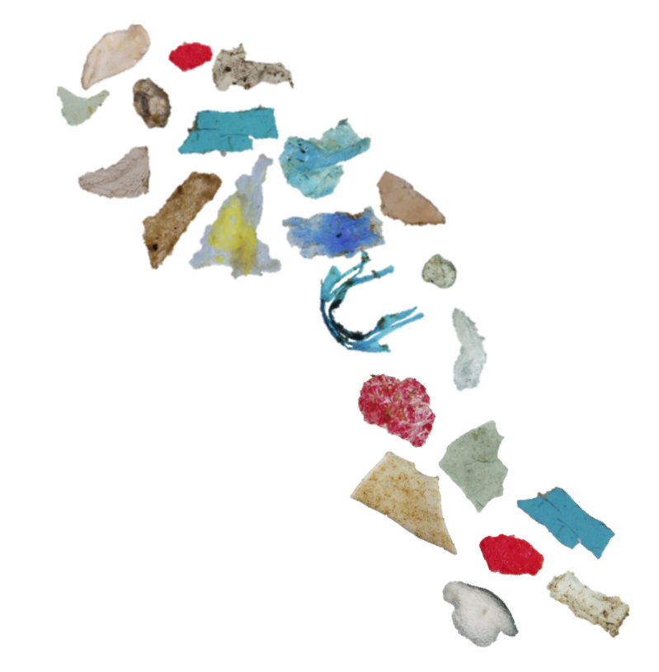
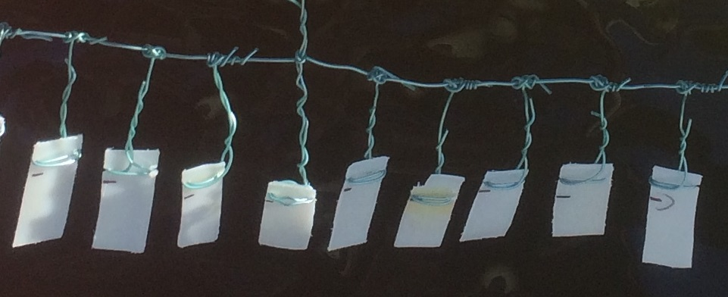
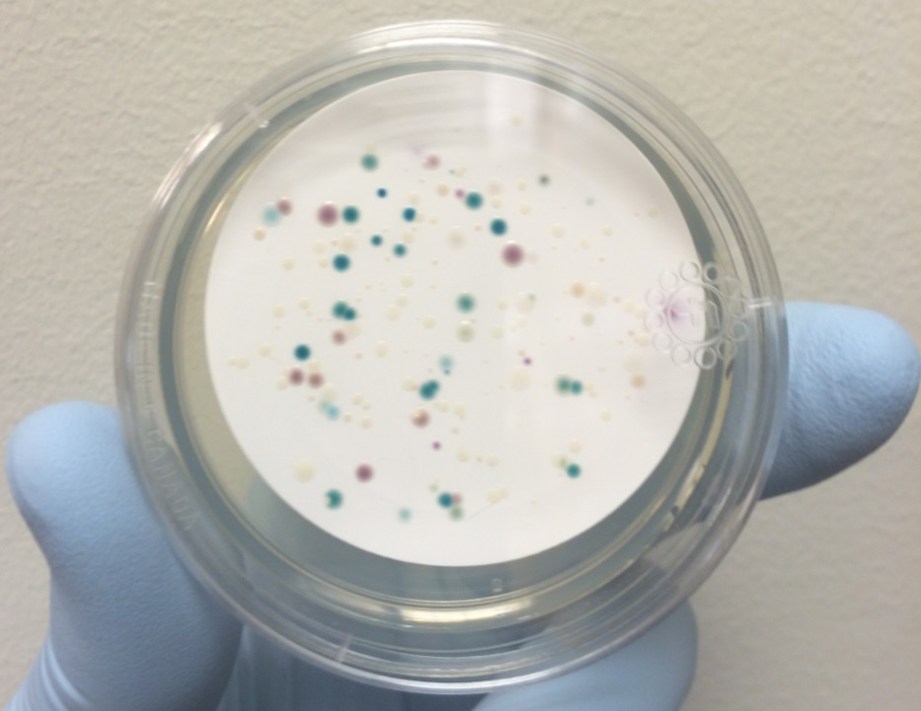
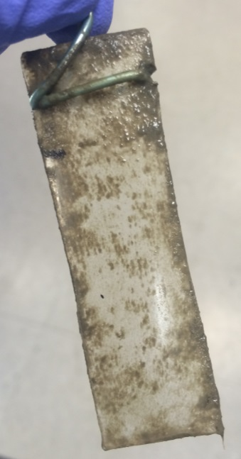
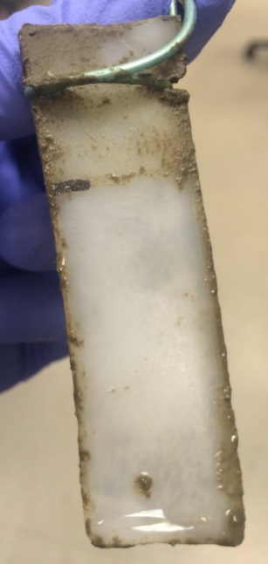
Plastics and microplastics as vectors for bacteria and human pathogens
Vibrio spp.
(Not to scale)
CHROMagar
Colony Forming Unit (CFU)
Biofilm removed
Biofilm
Notes:
Explain the experiment.
We set up two experiments on a local dock in the Lafayette River to examine Vibrio spp. colonization over time. We hung plastic types from a floating dock and sampled the biofilms on each over time for two separate experiments. The biofilms were suspended in medium and filtered onto CHROMagar, a selective growth medium for Vibrio bacteria.
Colonies grow different colors based on specific enzymes produced from different species of Vibrio bacteria.
Colonies can be counted after ~24 hours.
Define colony, colony forming units, chromagar.

Slide 14
Overview of work
Polypropylene, Low-density polyethylene, H2O
Three replicates for each substrate
Each group will count replicate plates and record CFUs (colony-forming units)
Why do we have replicates?
Having replication allows us to examine variability in the experiment and to ensure reproducibility
Notes:
Explain reproducibility and why it is important in science.

Slide 15
Overview of work
CFUs for plastics need to be corrected for the area that the biofilms were scraped from
2cm X 1cm = 2cm²
Units: CFUs/cm²
CFUs for water need to be corrected for volume of water filtered
2ml
Units: CFU/ml

Slide 16
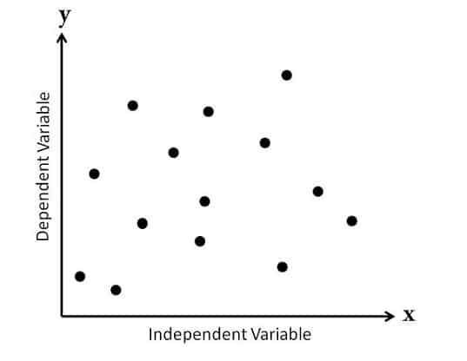
Graphing
Scatter Plot
Ability to show nonlinear relationships between variables
A variable is something that can change depending on conditions or information
Independent variable
Dependent variable
Notes:
I need to elaborate on this.

Slide 17
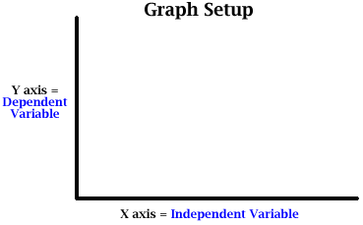
Graphing
Independent Variable – input or cause (time)
Dependent Variable – dependent on the independent variable (bacterial growth)

Slide 18
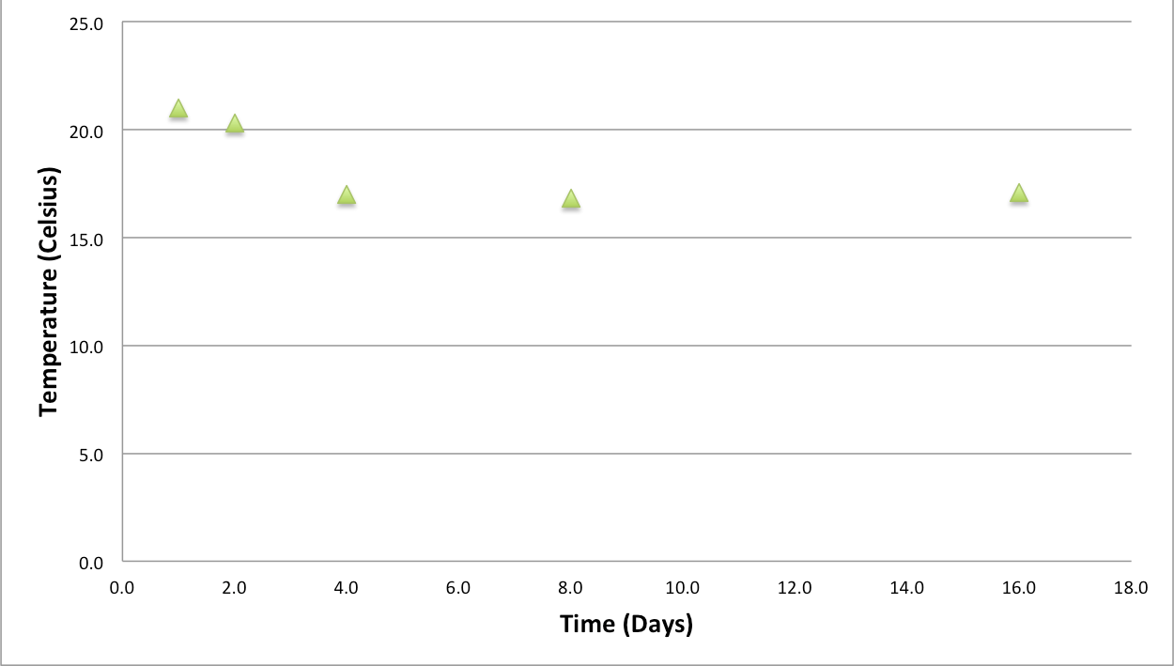
Example
Variables: Water Temperature and Time
Which is the independent variable?
Which is the dependent variable?

Slide 19
Questions?

Slide 20
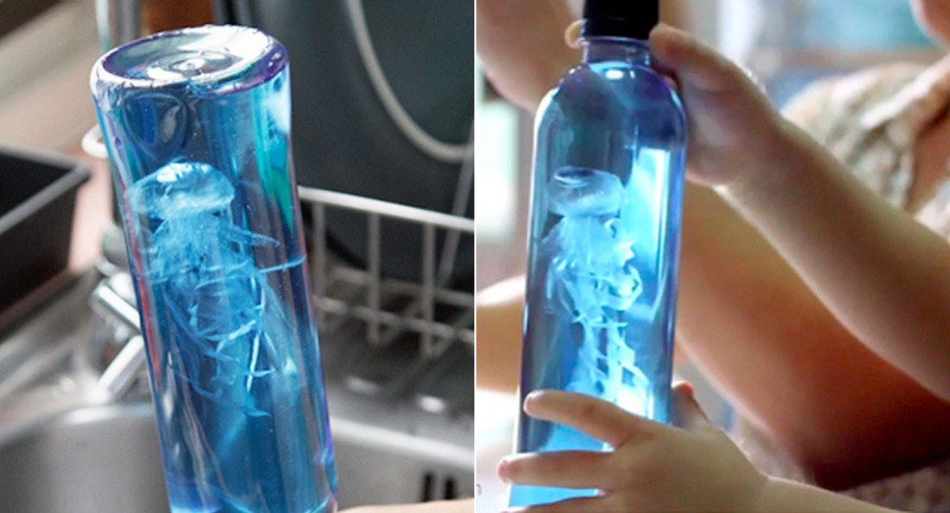
Take Home Craft
Jellyfish Bottles!
Ingredients:
Transparent plastic grocery bags
Clear plastic bottles
Thread
Food coloring
Scissors
Notes:
Activity website: https://bhoomplay.wordpress.com/2011/09/09/diy_jellyfish_eng/ (pictures for the activity) – NOT my design
This should only be done with recycled bottles and plastic bags!

Slide 21
Take Home Craft
Instructions:
Flatten the bag and cut off the handle and the bottom part
Cut to split into 2 plastic sheets (just use one)
From the center of the plastic sheet, fold it like a tiny balloon to make the head and tie it with thread – not too tight
Leave a small hole to pour some water in the head
Cut from the edge up to the head – make about 8-10 large tentacles
For each of them, cut again into 3-4 small strings – just cut off the remaining part.
Trim to make random long and short tentacles
Put some water into the head to make it sink - leave some air inside to make it float up
Fill up your water bottle
Put your jellyfish in the bottle with a few drops of blue food coloring
Screw on the cap and that’s it!

Slide 22
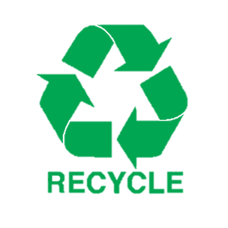
Notes:
Print out take home message related to the craft.

Slide 23
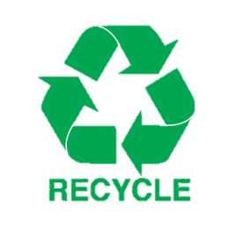
Notes:
Print out take home message.

